Slide 1
Introduction to the focus of the session: Digitalisation for AFNs
Transnational Innovation Hub 2nd Event Online | 19 January 2026
Name Riccardo Maratini - Open ENLoCC (PP9)

Slide 2
AGENDA
Overview and objective of the Food4CE Transnational Innovation Hub
TIH concept and stakeholders
Timeline and next steps of the TIH joint workshops with external associations and IHs
Focus of the session: Digitalisation for AFNs

Slide 3
STARTING POINT
Transnational Innovation Hub
Knowledge Transfer Platform
Matchmaking Platform
Food4CE main GOALS:
Strengthening Innovation Capacities Among Central European Alternative Food Networks (AFN)
TO BE ACHIEVED AT THE TRANSNATIONAL LEVEL
LEVERAGING ON KNOW-HOW AND TOOLS DEVELOPED IN FOOD4CE
Notes:
Alternative food networks (AFNs) are food distribution systems that are alternative to the traditional food chain. AFNs are often characterized by greater involvement of producers, consumers, and communities, which focus on healthy, sustainable, and local food through short food supply chain (SFSC)
While the importance of AFNs is more and more acknowlegded becoming increasingly popular. Nontheless, they face a number of challenges, which we aim to address thorugh the Food4CE project at the transnational level.
The Food4CE Matchmaking Platform is an innovative web-based tool designed to connect key players in the alternative food sector. The platform serves as a virtual hub that connects, supports, and empowers key players in the alternative food market.
The Food4CE Knowledge Transfer Platform (KTP) has been developed within the project, which supports Alternative Food Networks (AFNs) in Central Europe by providing logistics knowledge, best practices, and innovative solutions.

Slide 4
Transnational innovation hub
Transnational Innovation Hub supports transnational exchange of knowledge, transfer and/or uptake of new practices, technologies and solutions among Regional Innovation Hubs (in participating countries) and create a unique mutual support network for CE AFNs.
Transnational innovation hub
Slovenian Innovation Hub ORbITaLA
Austrian Future Food Connective Innovation Hub
Italian Innovation Hub Localog
Hungarian Innovation Hub Food4Health
Polish Innovation Hub
PULS

Slide 5
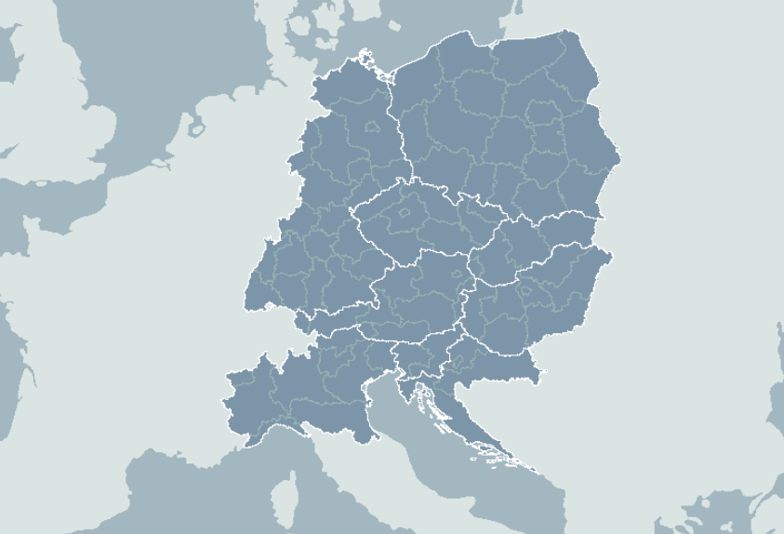
Transnational innovation hub

Slide 6
TRANSNATIONAL INNOVATION HUB
Main topics to be addressed
Sustainable and Cooperative Logistics: Pooling deliveries, optimizing routes, and using eco-friendly vehicles to cut costs and emissions. Sharing warehousing and improving last-mile delivery solutions for efficiency and sustainability.
Digitalization and Automation: Implementing digital platforms for contracting and invoicing, leveraging data-driven logistics. Using robotics for packaging and warehousing to boost productivity and reduce manual workload.
Knowledge and Policy Support: Gathering best practices and developing policy recommendations aligned with EU Green Deal goals. Supporting integration of long-distance distribution with local alternative food networks (AFNs).
Matchmaking and Networking: Connecting alternative food networks, SMEs, logistics providers, policymakers, and researchers across Central Europe to foster collaboration and innovation.
Capacity Building: Offering training programs, co-creation workshops, and living labs to test and implement new logistics and food system solutions.

Slide 7
TIH: THE ACTORS TO BE INVOLVED
Recalling that TIH supports transnational exchange of knowledge, transfer and/or uptake of new practices, technologies and solutions among Regional Innovation Hubs (in participating countries) and create a unique mutual support network for CE AFNs.
Stakeholders’ list
Alternative Food Networks
Producers & SMEs
Logistics service providers
Research & Academia
Policymakers & public authorities
Business support organizations & clusters

Slide 8
TIH Timeline
Kick-off meeting
To launch the Transnational Innovation Hub, a KoM has been held on 19th November 2025.
2nd TIH meeting
held on 19th January 2026 to exchange knowledge about the topic of Digitalization.
3rd TIH meeting
To be held in February 2026, to exchange knowledge about the topic of Last Mile Delivery.
Follow-up
Beyond Food4CE Project lifetime
TIH will be kept alive.

Slide 9
TRANSNATIONAL INNOVATION HUB
TODAY FOCUS: Digitalisation for AFNs
...
Digitalization and Automation: Implementing digital platforms for contracting and invoicing, leveraging data-driven logistics. Using robotics for packaging and warehousing to boost productivity and reduce manual workload.
…
-> In theory, high potentials and remarkable room for improvement
-> In practice, relevant difficulties in the adoption (further) implementation

Slide 10
Mapping the issue and filling in the Miro Board
Remarks for the interactive session

Slide 11
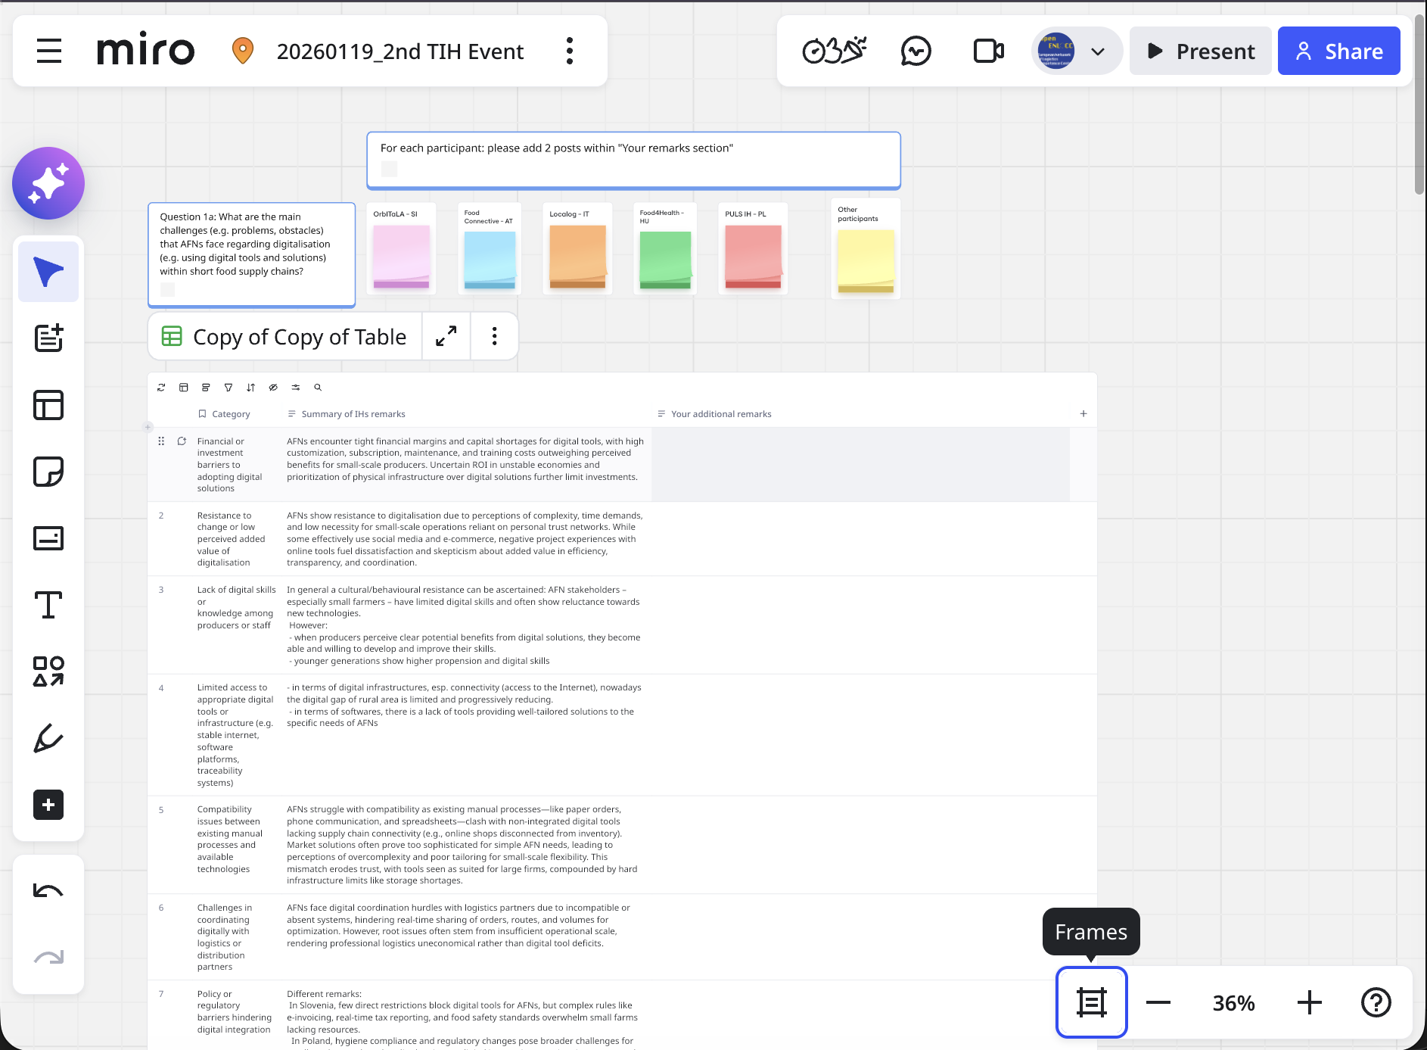
TRANSNATIONAL INNOVATION HUB
AFN-IH digitalization framework
Excel (to be) filled in by each IH
Miro board for the interactive session of today
Category | Relevance level (please rank from the most important (1) to the less important (8, or higher values in case you add "Other" categories)) | Your specific remarks | Relevance level (please rank from the most important (1) to the less important (8, or higher values in case you add "Other" categories)) | Your specific remarks | Relevance level (please rank from the most important (1) to the less important (8, or higher values in case you add "Other" categories)) | Your specific remarks | Relevance level (please rank from the most important (1) to the less important (8, or higher values in case you add "Other" categories)) | Your specific remarks | Relevance level (please rank from the most important (1) to the less important (8, or higher values in case you add "Other" categories)) | Your specific remarks | Relevance level (please rank from the most important (1) to the less important (8, or higher values in case you add "Other" categories)). AVERAGE VALUE from all IHs | Summary of IHs remarks | Your Additional remarks
Other |  |  | 0 | 0 | 0 | Important barriers to the digitalisation of operations are also posed by regulatory frameworks that limit cooperation and by the lack of shared spaces. Greater collaboration among small actors during transport and storage phases would, in fact, create stronger incentives for the adoption of digital solutions. | 0 | 0 | 0 | 0 | 0 | Important barriers to the digitalisation of operations are also posed by regulatory frameworks that limit cooperation and by the lack of shared spaces. Greater collaboration among small actors during transport and storage phases would, in fact, create stronger incentives for the adoption of digital solutions.
Financial or investment barriers to adopting digital solutions | 3 | AFNs typically operate with very limited financial margins and lack capital for investing in software, hardware, digital platforms, or professional IT support. The costs of customised digital tools, subscriptions, maintenance, and staff training are perceived as high relative to expected benefits, particularly for small volumes and seasonal production typical of Slovenian SFSCs. | 1 | Return on Investment; especially in economically unstable times; not efficient for small producers | 4 | 0 | 1 | 0 | 3 | Financial barriers are indeed a significant limitation to the adoption of digital solutions. There are numerous financial and investment needs, and in many cases, AFN representatives perceive hard infrastructure as more important than digital tools. As a result, digital solutions often have a lower priority when it comes to investment. We may conclude that financial limitations are closely connected to the lower prioritization of digital solutions. In other words, because digital solutions are often viewed as less critical investments, financial constraints further reinforce their lower place on the priority list. | 2,4 | AFNs encounter tight financial margins and capital shortages for digital tools, with high customization, subscription, maintenance, and training costs outweighing perceived benefits for small-scale producers. Uncertain ROI in unstable economies and prioritization of physical infrastructure over digital solutions further limit investments.
Resistance to change or low perceived added value of digitalisation | 2 | Even where basic digital tools are available, there is notable resistance to adoption. Digitalisation is often perceived as complex, time-consuming, or unnecessary for small-scale operations. Many AFNs rely on trust-based relationships and personal communication and therefore underestimate the added value of digital tools for efficiency, transparency, and coordination, especially in logistics and sales. | 7 | 0 | 2 | 0 | 2 | 0 | 1 | Besides the many examples of very efficient digital marketing campaigns run by AFN representatives - often using widely available tools like social media, trade, or e-commerce platforms - there is also some dissatisfaction visible among these representatives. For instance, some have had negative experiences with these online solutions created as an outcomes of the project. | 2,8 | AFNs show resistance to digitalisation due to perceptions of complexity, time demands, and low necessity for small-scale operations reliant on personal trust networks. While some effectively use social media and e-commerce, negative project experiences with online tools fuel dissatisfaction and skepticism about added value in efficiency, transparency, and coordination.
Lack of digital skills or knowledge among producers or staff | 1 | Many Slovenian AFN stakeholders – especially small farmers – have limited digital literacy and often show reluctance towards new technologies. This cultural resistance leads to a conservative approach to tech adoption (average IT usage among most AFNs is very low), which hinders their ability to scale operations efficiently. | 2 | 0 | 4 | 0 | 6 | 0 | 2 | Here, the situation is very different. First, digital skills are strongly related to the age of producers. While digital skills among the older generation are generally limited, the most important barrier appears to be reluctance toward digital solutions. The evidence shows that when producers perceive clear potential benefits from digital solutions, they are able and willing to develop and improve their skills. Second, there are numerous positive examples and good practices demonstrating that digital skills are already present and can be effectively applied in practice. These positive examples are mainly observed among the younger generation, which tends to be more open to adopting digital solutions and more confident in developing the necessary digital skills. | 3 | In general a cultural/behavioural resistance can be ascertained: AFN stakeholders – especially small farmers – have limited digital skills and often show reluctance towards new technologies. However: - when producers perceive clear potential benefits from digital solutions, they become able and willing to develop and improve their skills. - younger generations show higher propension and digital skills
Limited access to appropriate digital tools or infrastructure (e.g. stable internet, software platforms, traceability systems) | 7 | While basic internet access exists in most areas, some rural locations still face connectivity issues that limit reliable use of cloud-based tools. More importantly, there is a lack of affordable, user-friendly, and AFN-specific digital solutions (e.g. for traceability, stock management, or cold-chain monitoring), meaning that many digital needs remain unused despite infrastructure improvements.Most digital tools on the market are generic (e-commerce, ERP, logistics software) and not adapted to:mixed product baskets,seasonal variability,short supply chains,combined B2C and B2B sale.AFNs struggle to find tools that match their real operational needs.Customisation is expensive and technically demanding. | 3 | 0 | 2 | 0 | 3 | 0 | 5 | Digital infrastructure does not appear to be a significant constraint in this context. According to the Central Statistical Office, 96% of households in Poland had access to the internet in 2025. These values are very similar in large cities and rural areas. Although there are still isolated locations where wireless internet access is unavailable, such areas are rapidly disappearing. Overall, this indicates that internet availability is not a major structural barrier to the adoption of digital solutions in Poland. | 4 | - in terms of digital infrastructures, esp. connectivity (access to the Internet), nowadays the digital gap of rural area is limited and progressively reducing. - in terms of softwares, there is a lack of tools providing well-tailored solutions to the specific needs of AFNs
Compatibility issues between existing manual processes and available technologies | 4 | Existing digital tools are often isolated and not integrated across the supply chain, leading to inefficient, ad-hoc workflows. For example, there is online shop which is not digitally conected to invenotry database...Each AFN tends to operate its own stand-alone system for production, sales, logistics, etc., with little integration with other process. Many AFNs rely on manual, fragmented workflows (paper-based orders, phone communication, spreadsheets). Available digital tools are often not adapted to these practices or to the small scale and flexibility required in AFNs. This creates difficulties in integrating digital solutions into daily routines across production planning, warehousing, transport scheduling, and sales, leading to partial or abandoned implementation. | 4 | 0 | 4 | 0 | 5 | 0 | 4 | In some cases, digital solutions offered by the market or by professional companies appear to be too sophisticated in relation to the actual needs of AFN representatives. In many instances, AFN logistics processes are relatively simple and do not require highly advanced digital systems. As a result, such solutions are often perceived as overly complex and not tailored to their specific requirements of AFN's. This mismatch may lead to limited trust in digital tools, which are sometimes seen as solutions designed primarily for large organizations rather than smaller AFN structures. At the same time, AFNs frequently face constraints related to hard infrastructure, such as insufficient storage capacity, limited processing facilities, or a lack of appropriate trading spaces. | 4,2 | AFNs struggle with compatibility as existing manual processes—like paper orders, phone communication, and spreadsheets—clash with non-integrated digital tools lacking supply chain connectivity (e.g., online shops disconnected from inventory). Market solutions often prove too sophisticated for simple AFN needs, leading to perceptions of overcomplexity and poor tailoring for small-scale flexibility. This mismatch erodes trust, with tools seen as suited for large firms, compounded by hard infrastructure limits like storage shortages.
Challenges in coordinating digitally with logistics or distribution partners | 5 | Digital coordination between AFNs and logistics providers (e.g. parcel services, shared transport, cooperatives) is limited. Different actors use incompatible systems or none at all, making it difficult to share real-time information on orders, delivery routes, volumes, and timing. This weak digital coordination reduces opportunities for route optimisation, load consolidation, and shared logistics solutions. | 0 | 0 | 6 | 0 | 7 | 0 | 7 | There are certain limitations in the coordination of logistics and distribution partners among AFN representatives. However, in our view, the root cause of these limitations is not the lack of digital solutions, but rather the insufficient scale of activity. In many cases, AFNs are unable to reach the critical mass required for logistics operations, which makes cooperation with professional logistics providers economically unjustified. As a result, coordination challenges stem primarily from scale constraints rather than from shortcomings in digital tools. | 5 | AFNs face digital coordination hurdles with logistics partners due to incompatible or absent systems, hindering real-time sharing of orders, routes, and volumes for optimization. However, root issues often stem from insufficient operational scale, rendering professional logistics uneconomical rather than digital tool deficits.
Policy or regulatory barriers hindering digital integration | 8 | In Slovenia, there are few direct legal restrictions that prevent AFNs from using digital tools. However, small farms often face difficulties because they must comply with many different rules at the same time. New requirements such as mandatory electronic invoicing, real-time tax reporting, and various food safety and reporting standards make the regulatory environment complex. Many small farms do not yet have the knowledge, time, or resources needed to manage these digital obligations effectively. | 5 | 0 | 7 | 0 | 4 | 0 | 6 | Regulatory and policy barriers are mainly observed in other areas of activity of alternative food networks. For example, many food producers - particularly smaller ones - face challenges related to compliance with hygiene and food safety standards. They often struggle to keep up with regulatory changes and may fear inspections and potential fines. In contrast, regulatory frameworks do not appear to constitute a major barrier to digital integration. From the perspective of adopting digital tools and solutions, policy and regulatory issues play a relatively minor role compared to other constraints. | 6 | Different remarks: In Slovenia, few direct restrictions block digital tools for AFNs, but complex rules like e-invoicing, real-time tax reporting, and food safety standards overwhelm small farms lacking resources. In Poland, hygiene compliance and regulatory changes pose broader challenges for small producers, though policy barriers to digital integration remain minor compared to other issues. Overall, regulations demand digital compliance without adequate support, amplifying resource strains.
Customer or consumer-related digital gaps, such as limited digital literacy or trust in online platforms | 6 | Certain customer groups—particularly older consumers—still prefer face-to-face purchasing and cash payments, showing limited trust in online ordering, digital payments, or platform-based sales. This constrains AFNs’ willingness to fully digitalise sales channels and limits the scalability of e-commerce, even where producers are technically capable of using such tools. | 8 | depending on the targeted customers | 7 | 0 | 8 | 0 | 8 | We would argue that the situation is rather the opposite. From the consumer side, there is strong and growing interest in the offer of alternative food producers and, more broadly, Alternative Food Markets (AFMs). One of the main channels of communication between consumers and AFMs is social media, often complemented by more professional digital solutions, such as digital marketplaces or online shops. Importantly, in Poland, we observe a dynamic increase in overall e-commerce turnover. Although the share of e-commerce in the food sector remains relatively limited, it is characterized by one of the highest growth dynamics, indicating substantial future potential for digital sales channels in this segment. | 7,4 | AFNs face consumer gaps where older groups prefer face-to-face buys and cash, lacking trust in online platforms and digital payments, thus curbing e-commerce adoption. Conversely, growing consumer interest drives use of social media and digital marketplaces, bolstered by rising e-commerce in food sectors like Poland's, signaling potential despite varying customer profiles.

Slide 12
TRANSNATIONAL INNOVATION HUB / Miro boarD
Question 1a: What are the main challenges?
Key takeaways from the feedback received so far
In general, a limited usage of IT tools due to different factors
Financial or investment barriers
Resistance to change or low perceived added value of digitalisation
...
A certain degree of heterogeneity, due to specific conditions (including the age)

Slide 13
TRANSNATIONAL INNOVATION HUB / Miro boarD
Question 1b: Remarks on experiences related to the use or lack of specific digital tools
Key takeaways from the feedback received so far
Advanced digital tools usage is limited by (perceived)
Complexity
Costs
Lack of adequate tailoring to the real needs of AFN
...
Partial exceptions: Some differences between the different typologies of tools

Slide 14
TRANSNATIONAL INNOVATION HUB / Miro boarD
Question 2: Aspects that need the most improvement and ways to approach it
Key takeaways from the feedback received so far

Slide 15
PP9 – Open ENLoCC
Riccardo Maratini
https://www.openenlocc.net/
riccardo.maratini@openenlocc.net

