Slide 1

Training 6. Good practices in accessible tourism
Online training
Zoom | 7 May 2024
An-Sofie Leenknecht
European Disability Forum
Notes:
Good practices in accessible tourism
Online training
Zoom 7 May 2024
An-Sofie Leenknecht
European Disability Forum

Slide 2


Agenda
Welcoming and introduction
Christian Takow, Autism Europe
Timo Kallioaho, European Network of (Ex-)Users and Survivors of Psychiatry
Lucia Kleekamm, Mental Health Crowd (Germany)
Q&A and Discussions with everyone
Closing remarks
Notes:
Agenda
Welcoming and introduction
Christian Takow, Autism Europe
Timo Kallioaho, European Network of (Ex-)Users and Survivors of Psychiatry
Lucia Kleekamm, Mental Health Crowd (Germany)
Q&A and Discussions with everyone
Closing remarks

Slide 3


Christian Takow, Advocacy Officer
Autism Europe
Notes:
Christian Takow, Advocacy Officer
Autism Europe

Slide 4
What is autism?
Autism is a complex lifelong developmental disability experienced differently by each individual. An estimated seven million people in Europe are considered autistic given that prevalence rates estimate one in 100 people are on the autism spectrum
Notes:
What is autism?
Autism is a complex lifelong developmental disability experienced differently by each individual. An estimated seven million people in Europe are considered autistic given that prevalence rates estimate one in 100 people are on the autism spectrum

Slide 5
Accessible tourism for autistic people
Accessible tourism for autistic people should be:
Coming with preparations (plans, schedules, itinerary)
Sensory sensitive (no loud noises, availability of quiet rooms)
Predictable (availability of pre-visits, no delays)
Flexible (allowing for detours if needed or not if not needed)
Smooth and enjoyable (no triggers for stress and anxiety)
Having clear guidance (instructions written and directly spoken to)
Notes:
Accessible tourism for autistic people
Accessible tourism for autistic people should be:
Coming with preparations (plans, schedules, itinerary)
Sensory sensitive (no loud noises, availability of quiet rooms)
Predictable (availability of pre-visits, no delays)
Flexible (allowing for detours if needed or not if not needed)
Smooth and enjoyable (no triggers for stress and anxiety)
Having clear guidance (instructions written and directly spoken to)

Slide 6
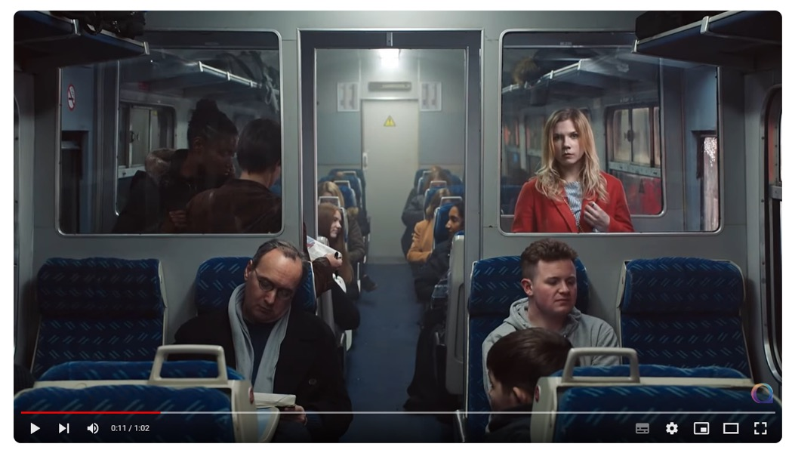
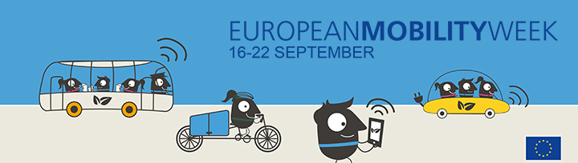
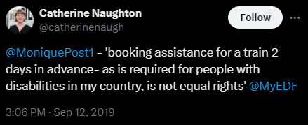
Raising awareness for accessible tourism for autistic people
National Autistic Society (UK): Too Much information campaign
Autism-Europe (2019): Autistic people request accessible train and air travel during EU Mobility Week
Notes:
Raising awareness for accessible tourism for autistic people
National Autistic Society (UK): Too Much information campaign
Autism-Europe (2019): Autistic people request accessible train and air travel during EU Mobility Week

Slide 7
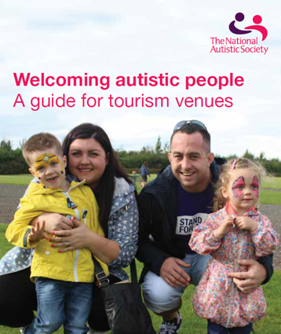
Examples of good practices
From United Kingdom:
Welcoming autistic people guide (2018)
Autistic people and their families can face barriers that others don’t when visiting tourism venues. That’s why the National Autistic Society and VisitEngland, along with England’s Inclusive Tourism Action Group have created this guide, to help tourism businesses overcome common barriers and welcome autistic people. Accessible here
Notes:
Examples of good practices
From United Kingdom:
Welcoming autistic people guide (2018)
Autistic people and their families can face barriers that others don’t when visiting tourism venues. That’s why the National Autistic Society and VisitEngland, along with England’s Inclusive Tourism Action Group have created this guide, to help tourism businesses overcome common barriers and welcome autistic people. Accessible here

Slide 8

Examples of good practices
Accessible Museums
National Autistic Society (2016) Making museums autism friendly
Early Openings
Multi-sensory activity backpack
Notes:
Examples of good practices
Accessible Museums
National Autistic Society (2016) Making museums autism friendly
Early Openings
Multi-sensory activity backpack

Slide 9

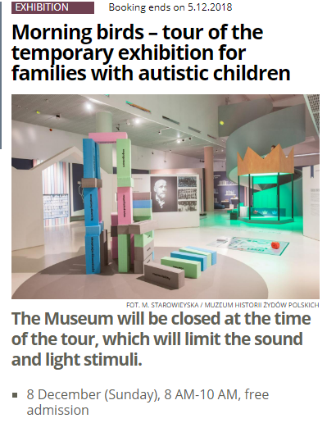

Examples of good practices
From Poland:
POLIN Museum in Warsaw – Visit the Museum with a child with autism
Foreguide
Virtual Tour of Core Exhibition
In the past: Morning birds
Notes:
Examples of good practices
From Poland:
POLIN Museum in Warsaw – Visit the Museum with a child with autism
Foreguide
Virtual Tour of Core Exhibition
In the past: Morning birds

Slide 10
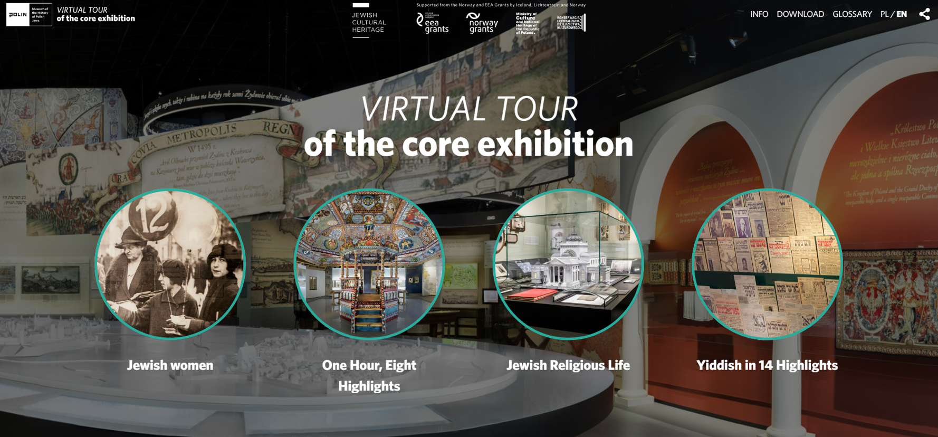
Examples of good practices
Notes:
Examples of good practices
website of the Polin museum where it says 'virtual tour of the core exhibition'

Slide 11
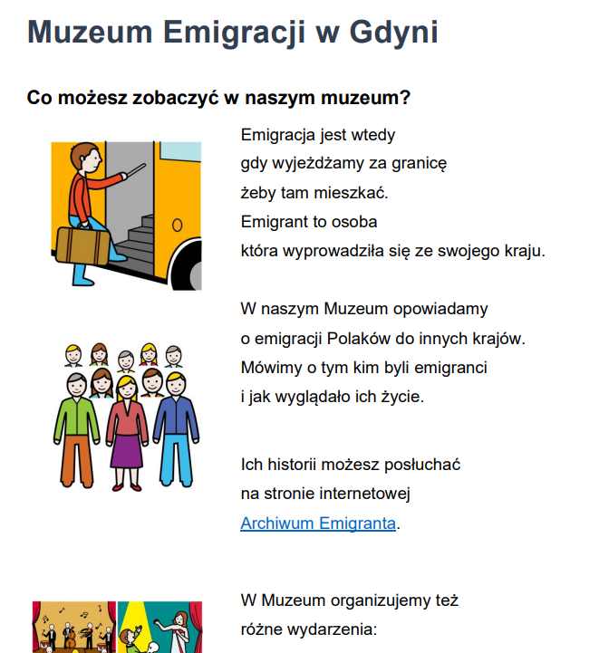
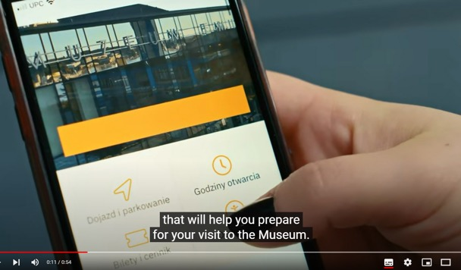

Examples of good practices
From Poland:
Emigration Museum Gdynia
Explanation video
Notes:
Examples of good practices
From Poland:
Emigration Museum Gdynia
Explanation video

Slide 12
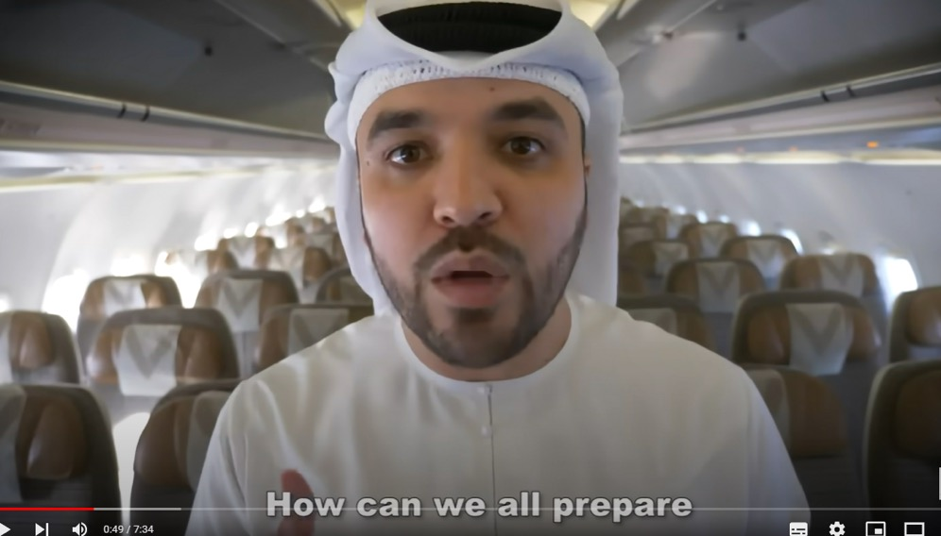
Air travel for autistic people and their families
Issues:
Khalid Al Ameri (2019) AIRPLANES & AUTISM
travels with his autistic son
uses DPNA code
raises awareness
lists good practice examples
Notes:
Air travel for autistic people and their families
Issues:
Khalid Al Ameri (2019) AIRPLANES & AUTISM
travels with his autistic son uses DPNA code raises awareness and lists good practice examples

Slide 13
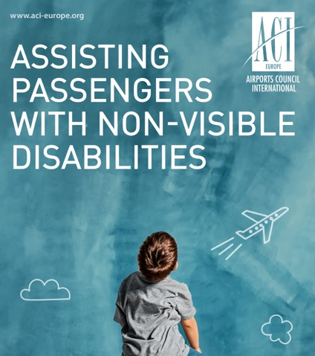
Air travel for autistic people and their families
Issues:
Airport Council International Europe –ACI-Europe (2024) Europe’s airports put the needs of passengers with non-visible disabilities centre stage with inaugural guidance
Olivier Jankovec, ACI EUROPE Director General said: “Travel is a fundamental right for all, and it is our collective responsibility to ensure that airports across Europe remain accessible to everyone. This document serves as a guiding light for airport managing bodies and their stakeholders, offering practical guidance on how to assist passengers with non-visible disabilities in an empathetic and respectful manner. Together, we can make air travel more inclusive, ensuring that every passenger's journey is marked by dignity, respect, and equal access to the wonders of our world.”
Notes:
Air travel for autistic people and their families
Issues:
Airport Council International Europe –ACI-Europe (2024) Europe’s airports put the needs of passengers with non-visible disabilities centre stage with inaugural guidance
Olivier Jankovec, ACI EUROPE Director General said: “Travel is a fundamental right for all, and it is our collective responsibility to ensure that airports across Europe remain accessible to everyone. This document serves as a guiding light for airport managing bodies and their stakeholders, offering practical guidance on how to assist passengers with non-visible disabilities in an empathetic and respectful manner. Together, we can make air travel more inclusive, ensuring that every passenger's journey is marked by dignity, respect, and equal access to the wonders of our world.”

Slide 14

Examples of good practices
Hidden Disabilities Scheme:
Sunflower Lanyard
Recognised in:
London Gatwick: Special Assistance: Hidden disabilities
Krakow Airport: Hidden Disabilities
Flughafen Berlin Brandenburg: BER wird Sunflower-Airport
Vienna Airport: Barrierefrei reisen: Das Unsichtbare sichtbar machen
Osijek Airport became part of Hidden Disabilities Sunflower program
Notes:
Examples of good practices
Hidden Disabilities Scheme:
Sunflower Lanyard
Recognised in:
London Gatwick: Special Assistance: Hidden disabilities
Krakow Airport: Hidden Disabilities
Flughafen Berlin Brandenburg: BER wird Sunflower-Airport
Vienna Airport: Barrierefrei reisen: Das Unsichtbare sichtbar machen
Osijek Airport became part of Hidden Disabilities Sunflower program

Slide 15
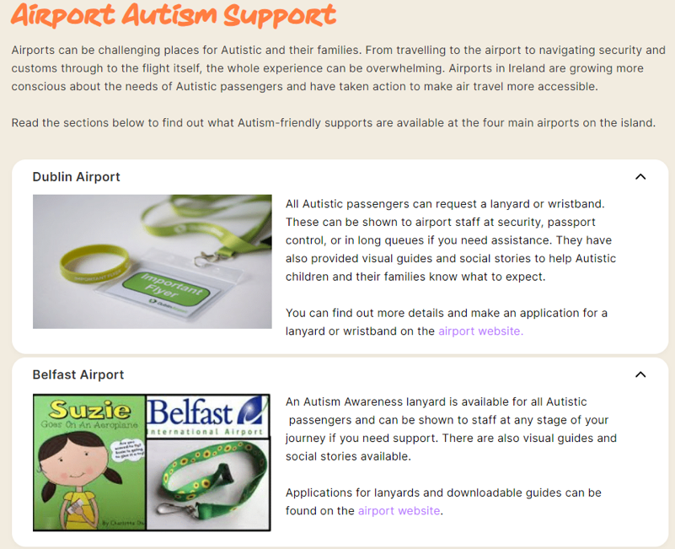
Examples of good practices
Other hidden disabilities schemes:
From Ireland:
AsIam: Accessing Support: Airport Autism Support
Dublin Airport: Travelling with Autism
Autism Awareness at Belfast International Airport
Notes:
Examples of good practices
Other hidden disabilities schemes:
From Ireland:
AsIam: Accessing Support: Airport Autism Support
Dublin Airport: Travelling with Autism
Autism Awareness at Belfast International Airport

Slide 16
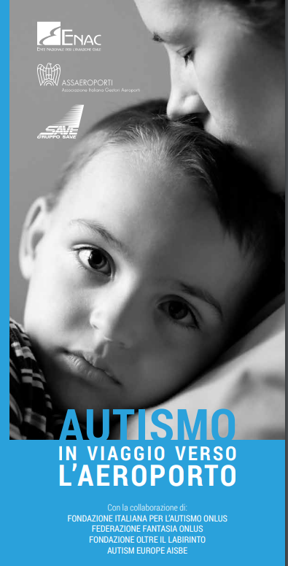
Examples of good practices
Other hidden disabilities schemes:
From Italy:
Venezia Airport – Autismo - Informazioni generali, raccomandazioni e consigli di viaggio per gli accompagnatori di bambini e adulti con autismo
Notes:
Examples of good practices
Other hidden disabilities schemes:
From Italy:
Venezia Airport – Autismo - Informazioni generali, raccomandazioni e consigli di viaggio per gli accompagnatori di bambini e adulti con autismo

Slide 17
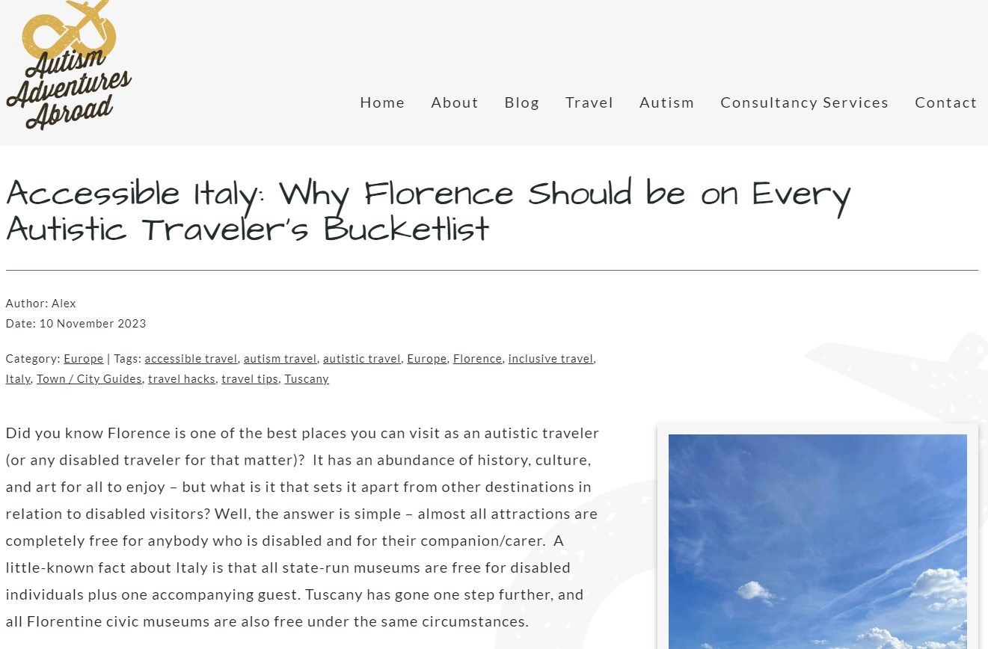
Examples of good practices
Autistic travellers’ experience in Italy:
Autism Adventures Abroad: Accessible Italy: Why Florence Should be on Every Autistic Traveler’s Bucketlist
Notes:
Examples of good practices
Autistic travellers’ experience in Italy:
Autism Adventures Abroad: Accessible Italy: Why Florence Should be on Every Autistic Traveler’s Bucketlist

Slide 18
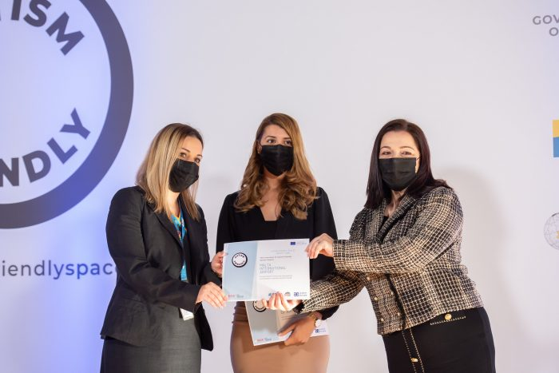
Examples of good practices
From Malta:
Malta International Airport Awarded the ‘Autism Friendly Spaces’ Quality Label
Notes:
Examples of good practices
From Malta:
Malta International Airport Awarded the ‘Autism Friendly Spaces’ Quality Label

Slide 19
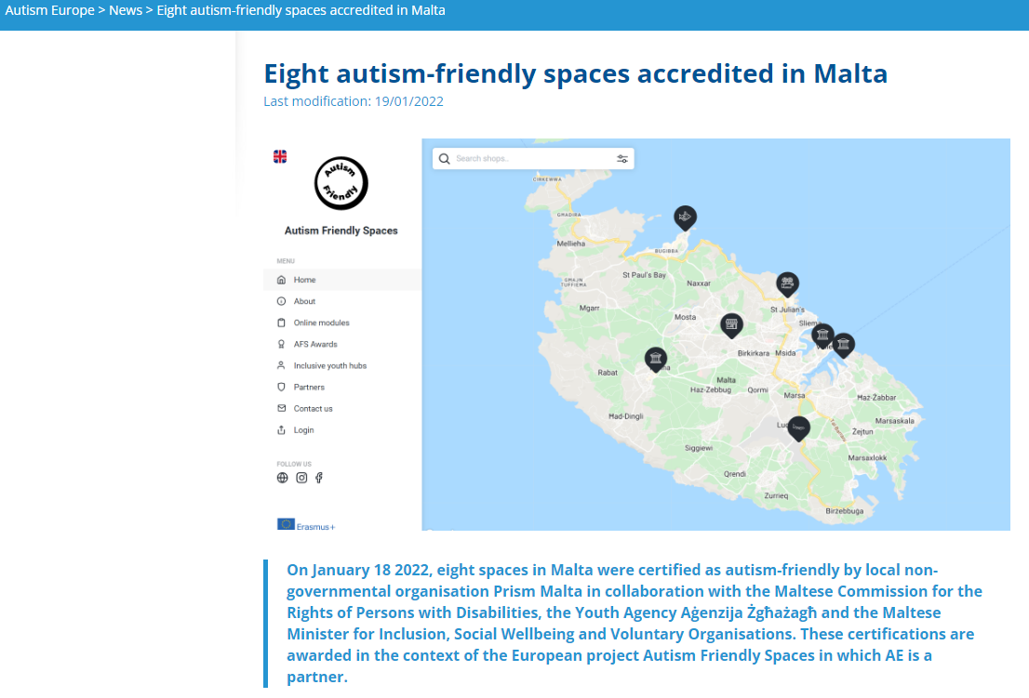
Examples of good practices
Autism-Europe (2022) Eight autism-friendly spaces accredited in Malta
On January 18 2022, eight spaces in Malta were certified as autism-friendly by local non-governmental organisation Prism Malta in collaboration with the Maltese Commission for the Rights of Persons with Disabilities, the Youth Agency Aġenzija Żgħażagħ and the Maltese Minister for Inclusion, Social Wellbeing and Voluntary Organisations. These certifications are awarded in the context of the European project Autism Friendly Spaces in which AE is a partner.
Notes:
Examples of good practices
Autism-Europe (2022) Eight autism-friendly spaces accredited in Malta
On January 18 2022, eight spaces in Malta were certified as autism-friendly by local non-governmental organisation Prism Malta in collaboration with the Maltese Commission for the Rights of Persons with Disabilities, the Youth Agency Aġenzija Żgħażagħ and the Maltese Minister for Inclusion, Social Wellbeing and Voluntary Organisations. These certifications are awarded in the context of the European project Autism Friendly Spaces in which AE is a partner.

Slide 20

Examples of good practices
Autism Friendly Spaces project
Autism Friendly Spaces is a concept created to address the needs of persons on the autism spectrum. It offers an educational aspect through online modules, criteria and guidelines for shops and services to apply for an AFS award and how to create an inclusive youth centre.
The project is managed by Prisms Malta, together with Autism Europe, Agenzija Zghazagh, Commission of the Rights of Persons with Disability Malta, Macedonian Scientific Society for Autism, Learning Designers and Autisme Catalunya. It is funded by Erasmus+ funds through the European Union.
Developed Quality Label
Notes:
Examples of good practices
Autism Friendly Spaces project
Autism Friendly Spaces is a concept created to address the needs of persons on the autism spectrum. It offers an educational aspect through online modules, criteria and guidelines for shops and services to apply for an AFS award and how to create an inclusive youth centre.
The project is managed by Prisms Malta, together with Autism Europe, Agenzija Zghazagh, Commission of the Rights of Persons with Disability Malta, Macedonian Scientific Society for Autism, Learning Designers and Autisme Catalunya. It is funded by Erasmus+ funds through the European Union.
Developed Quality Label

Slide 21
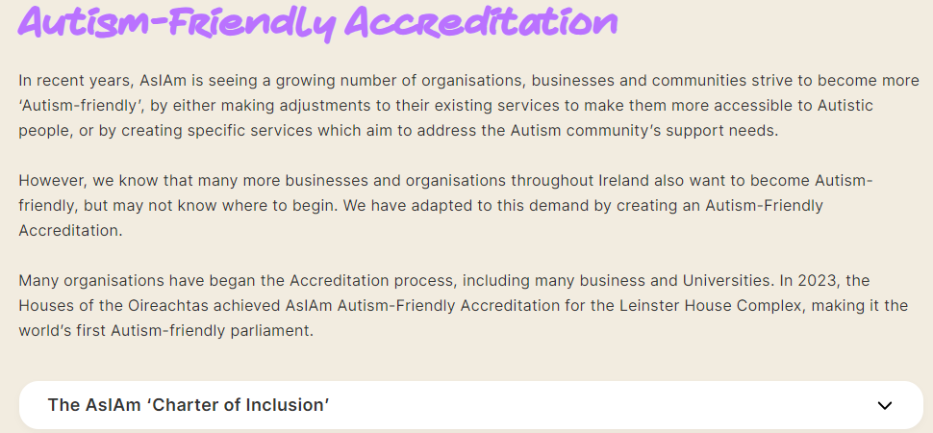
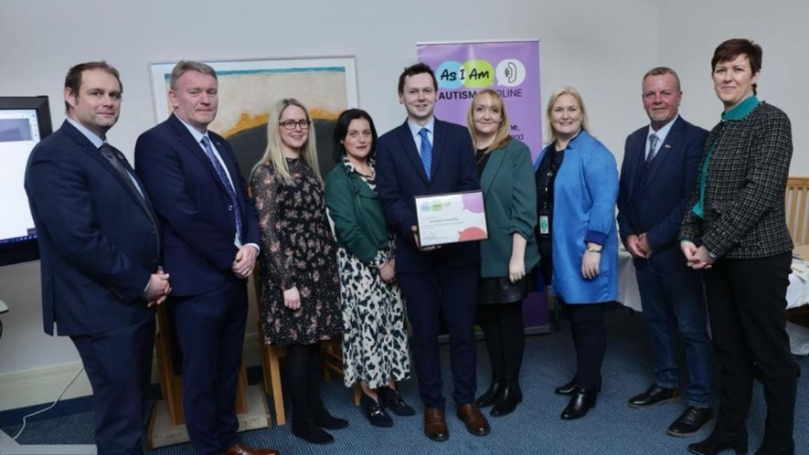
Examples of good practices
Other autism friendly spaces quality label:
AsIam’s Autism friendly accreditation
Notes:
Examples of good practices
Other autism friendly spaces quality label:
AsIam’s Autism friendly accreditation

