Slide 1

Training 6. Good practices in accessible tourism- part 2
Online training
Zoom | 7 May 2024
An-Sofie Leenknecht
European Disability Forum
Notes:
Good practices in accessible tourism
Online training
Zoom 7 May 2024
An-Sofie Leenknecht
European Disability Forum

Slide 2
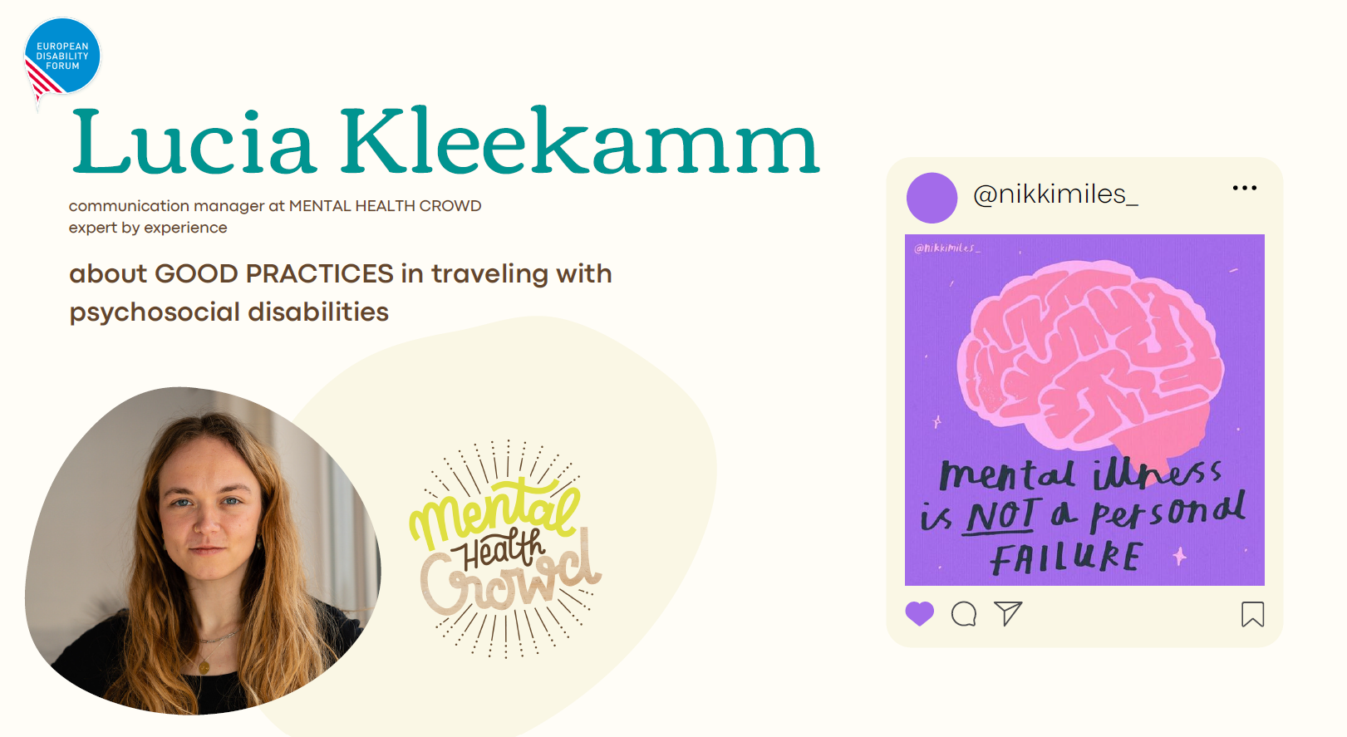

Lucia Kleekamm
Mental Health Crowd, Germany
Notes:
Lucia Kleekamm
Mental Health Crowd, Germany
Communication manager at Mental Health Crowd
Expert by experience
Mental Health Crowd
@nikkimiles_
"Mental Health is not a personal failure"

Slide 3
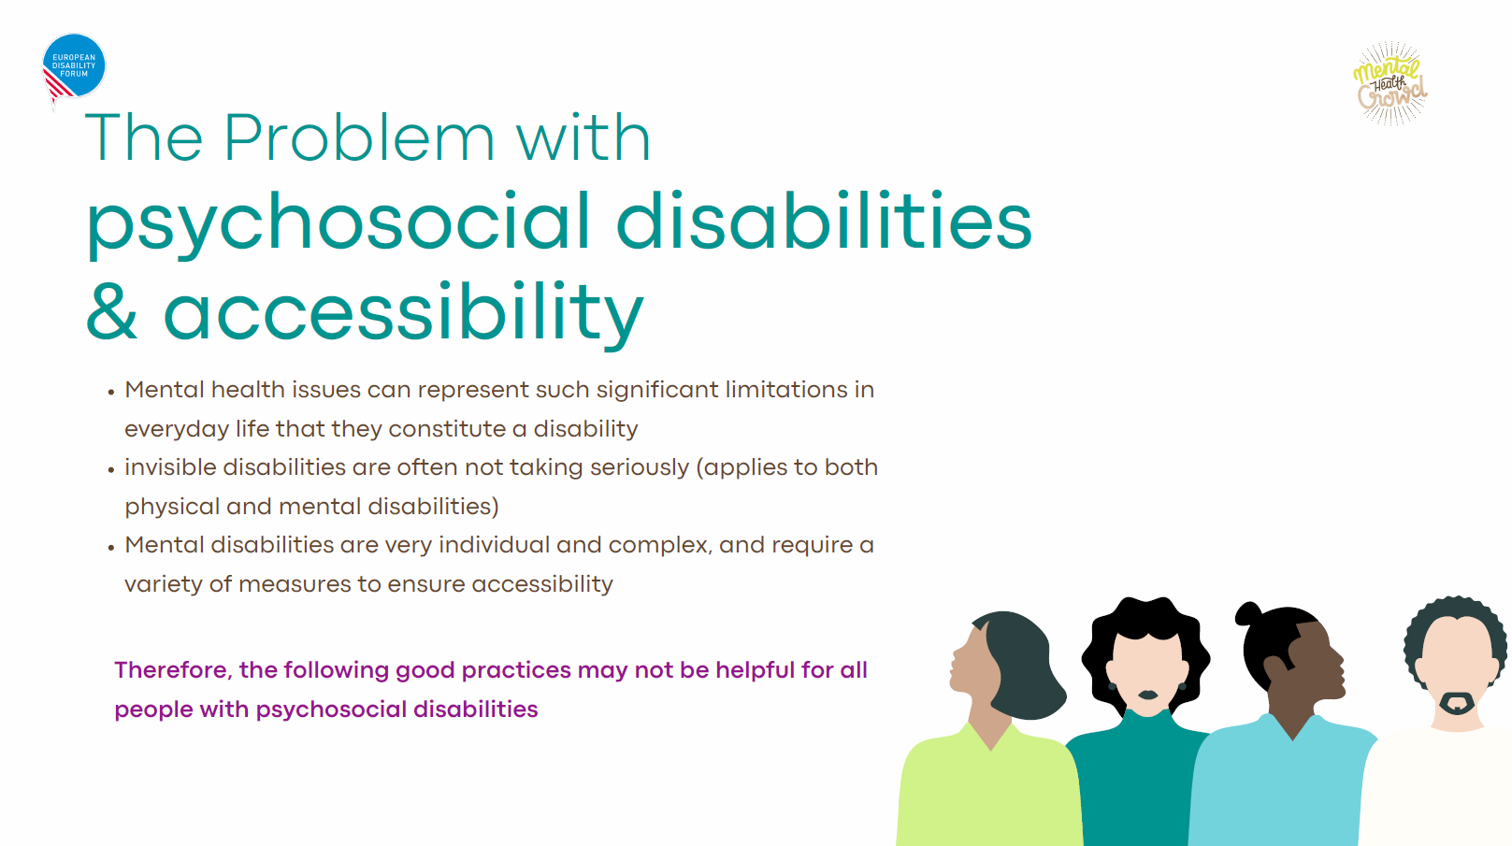
Lucia Kleekamm
Mental Health Crowd, Germany
Notes:
The problem with psychosocial disabilities
Mental health issues can represent significant limitations in everyday life that they constitute a disability
Invisible disabilities are often not taken seriously (applies to both physical and mental disabilities)
Mental disabilities are very individual and complex, and require a variety of measures to ensure accessibility.
Therefore, the following good practices may not be helpful for all people with psychosocial disabilities.

Slide 4
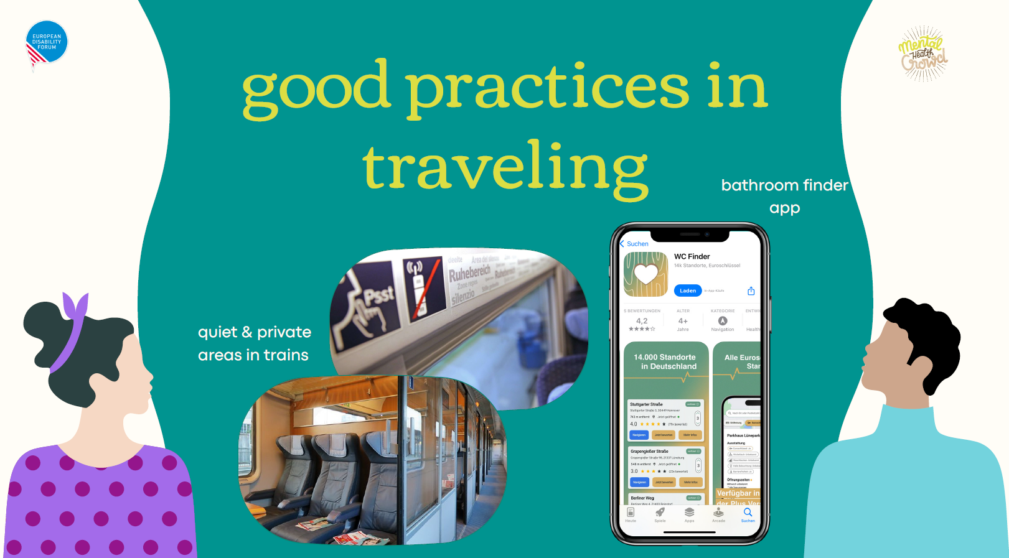
Lucia Kleekamm
Mental Health Crowd, Germany
Notes:
Good practices in traveling
Quiet and private areas in trains
Bathroom finder app

Slide 5
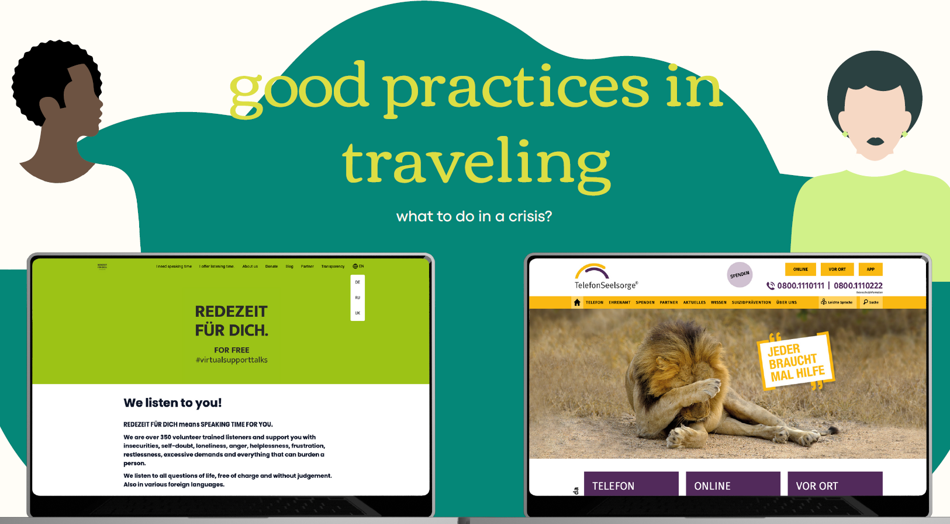
Lucia Kleekamm
Mental Health Crowd, Germany
Notes:
Good practices in traveling
What to do in a crisis?

Slide 6
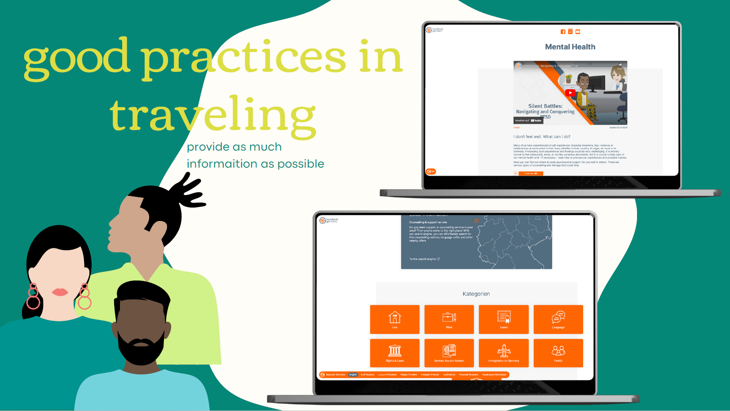
Lucia Kleekamm
Mental Health Crowd, Germany
Notes:
Good practices in travelling
Provide as much information as possible

Slide 7
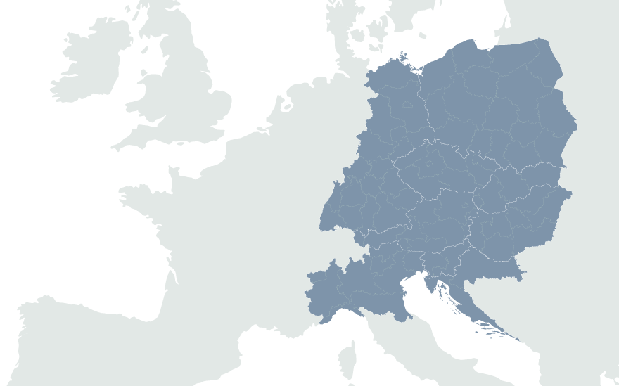
European Disability Forum
7-9 Avenu des Arts
1210 Brussels, Belgium
www.edf-feph.org
Ansofie.Leenknecht@edf-feph.org
Facebook.com/CESpaces4All
Linkedin.com/company/ce-spaces4all/
Youtube.com/@CE-Spaces4All
Instagram.com/ce_spaces4all/
Notes:
European Disability Forum
7-9 Avenu des Arts
1210 Brussels, Belgium
www.edf-feph.org
Ansofie.Leenknecht@edf-feph.org
Facebook.com/CESpaces4All
Linkedin.com/company/ce-spaces4all/
Youtube.com/@CE-Spaces4All
Instagram.com/ce_spaces4all

