Slide 1

Accessible tourism – the EU perspective
Project meeting “CE Accessible Spaces for All”
Vienna/online | 13 June 2023
Marie Denninghaus, Senior Policy Coordinator
European Disability Forum

Slide 2

Different disability and access needs in the context of tourism

Slide 3
Recap: What is disability?
There is no single agreed upon definition of disability. EDF uses the UN Convention of on the Rights of Persons with Disabilities (UN CRPD), ratified by the EU and all Member States, entails a shift away from charity/medical perspectives towards a human rights perspective. The definition of disability is therefore:
“Persons with disabilities include those who have long-term physical, mental, intellectual or sensory impairments which in interaction with various barriers may hinder their full and effective participation in society on an equal basis with others.“
→ Disability is a flexible concept, there are no “categories”!
Notes:
The language we use reflects on our thoughts and the way we see other people. When speaking about persons with disabilities, it is important to keep in mind they are persons with a family, a job, hobbies, talents and dreams and they are not defined by their impairments.
Therefore, focus on the individual and not on their particular limitation also in your use of language. Do not say “the disabled”, “the blind”, “the wheelchair”, etc., but refer to “the person with disability”, “the person who is blind”, “the person using a wheelchair” and so on.

Slide 4
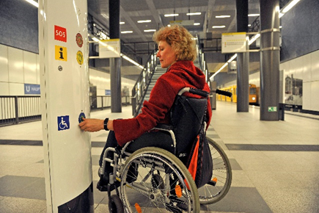
Some examples of disabilities
Persons with mobility impairments
Persons using wheelchairs or other kinds of mobility equipment like crutches, canes, walking frames, etc.
Persons with artificial or missing limbs.
Person of short/tall stature.
Many mobility impairments are not visible (e.g. heart disorders, diabetes), but still make it difficult for persons to move around
Copyright: Joite |Berliner Verkehrsbetriebe (BVG)

Slide 5
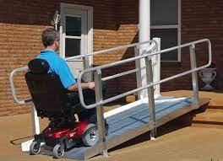
Possible accessibility needs
Step-free access
Handrails
Lower counters/tables
Smooth surfaces but not slippery
Websites and mobile applications accessible with limited dexterity/movement
Assistance service e.g. to carry luggage
Amenities for Assistance Dogs

Slide 6
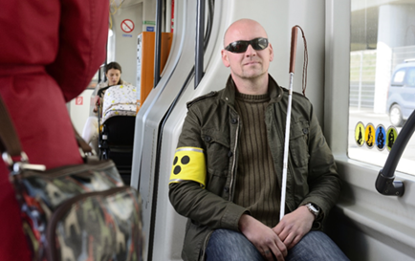
Some examples of disabilities
Persons who are blind or partially sighted
Some persons who are blind or partially sighted use white canes.
A red and white cane often indicates that the person is deaf-blind.
Some people might wear dark glasses.
Others might be accompanied by a personal assistant or a guide dog with a distinctive harness.
But not all blind or partially sighted persons have any of these characteristics!
Copyright: Wiener Linien
Notes:
How does the person perceive his/her surroundings?
Visual disabilities vary widely. One person may have a total loss of vision, while another may have difficulty seeing only under certain conditions or have a limited field of vision.
Perception depends on both the individual’s eyesight and the conditions in the surrounding environment, for example the amount of light or level of contrast.
Persons who are blind or partially sighted and using a cane may need their arms to balance.

Slide 7
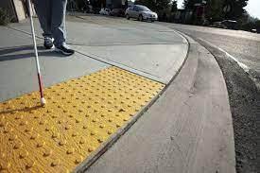
Possible accessibility needs
Tactile walking surface indicators
Tactile and/or audio information
No overhead obstacles
Labelling in Braille
Audio signal for location
Accessible websites and mobile applications to be compatible with screen readers
Amenities for Assistance Dogs
Notes:
Picture credit: Safety Step Canada

Slide 8
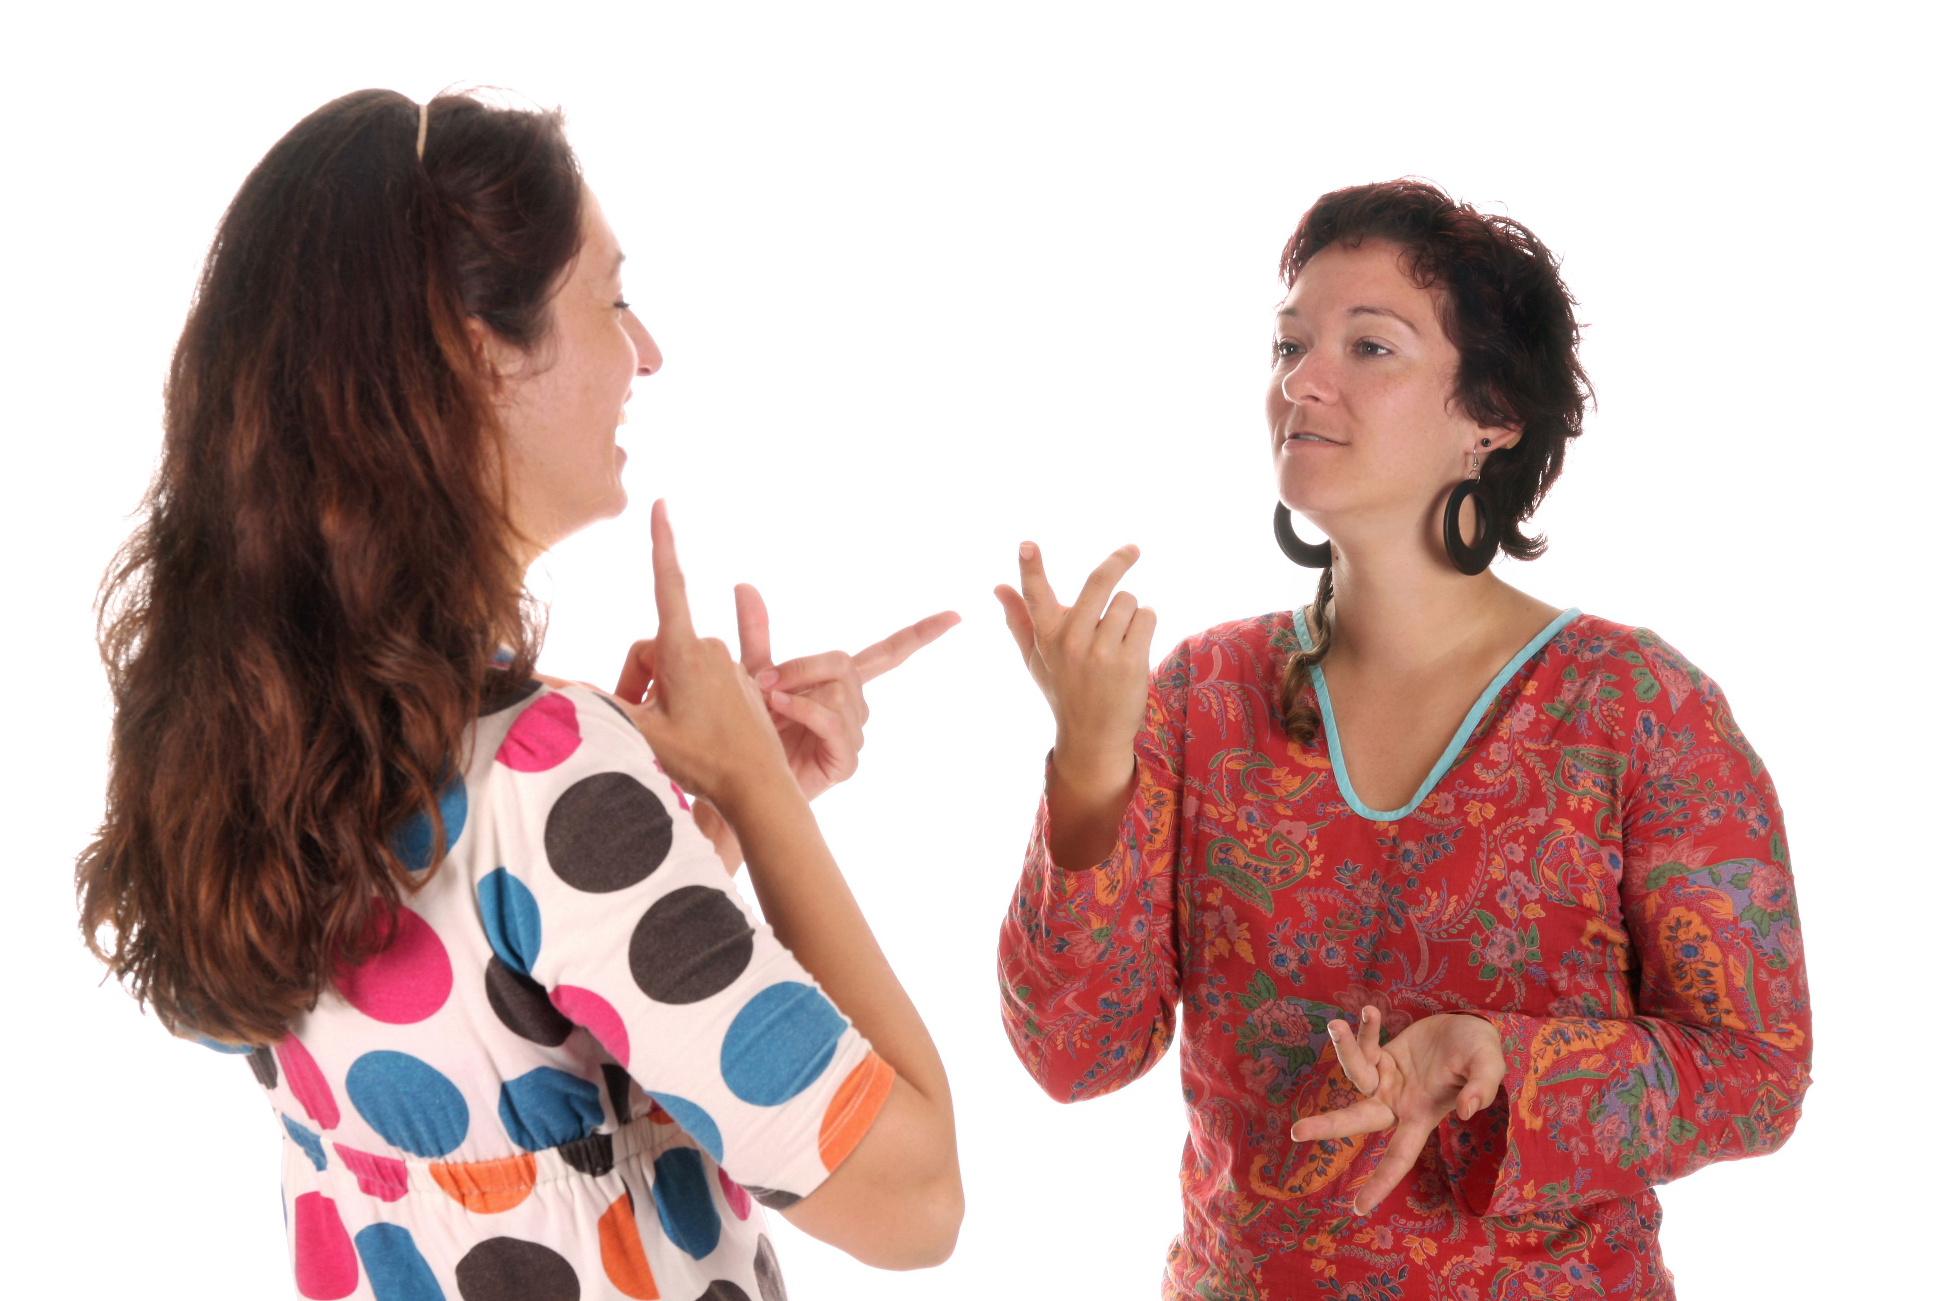
Some examples of disabilities
Persons who are deaf or hard of hearing
Various hearing impairments – deaf is not the same as hard of hearing!
Chances are you won’t notice a person who is deaf or hearing impaired unless you see the person using sign language or wearing a hearing aid.
Sign Language is the first language for many deaf persons
There are (almost) as many sign languages as spoken languages!
Copyright: Shutterstock / Vladimir Mucibabic
Notes:
There are various types of hearing impairments ranging from slight hearing impairments that can be corrected by hearing aids to complete deafness. There are also persons who are deaf-blind, i.e. they have both a hearing impairment and a visual impairment (but do not necessarily have to be completely deaf and blind). Some people use implants that allow them to hear well. For some people, also those with hearing aids, loud environmental sounds may be amplified.
Many persons who are born deaf rely primarily on sign language for communication; it’s their mother tongue. There is not one single sign language that all deaf people use – there are different national sign languages, just like French, German, English, etc.
Lip-reading can help persons that are deaf or hard of hearing but not all persons use this technique.
Some persons who are deaf or hearing impaired speak clearly while others’ speech might sound different.

Slide 9

Possible accessibility needs
Written/visual information
Sign Language interpretation
Hearing Loops
Good lighting and acoustics indoors
Limiting background noise
Direct contact face-to-face
In (online) meetings or events: speech-to-text interpretation (live captioning)
Notes:
Picture credit: Safety signs

Slide 10
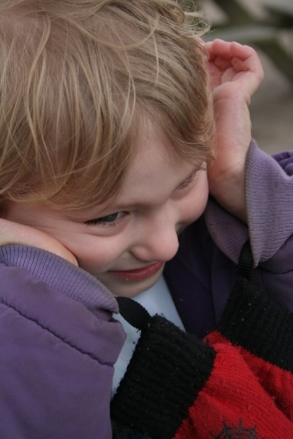
Some examples of disabilities
Persons with cognitive disabilities (e.g. intellectual disabilities, traumatic brain injury, or autism)
Sometimes also called „hidden disabilities“ – you will probably not recognize it at first sight
The person may have a hard time processing information or expressing themselves, difficulties orienting themselves, or understanding and following instructions
The person may get stressed in a seemingly “normal” situation, so their behaviour might seem erratic and strange.
Notes:
Even though some disabilities such as Down's Syndrome are well-known, you will probably not recognise persons with intellectual disabilities in most cases. Intellectual disabilities come in many different forms so do not draw any conclusions from the way somebody looks.
Persons with a brain injury may have loss of muscle control or poor impulse control, but this is not necessarily visible. They may also have poor directional orientation and use an assistance dog although seemingly not mobility impaired.
It may not be obvious if a person is on the autism spectrum. Autism affects how a person communicates with, and relates to, other people. It also affects how they make sense of the world around them. The main symptoms of autism are deficits in social communication and social interaction as well as restricted, repetitive patterns of behaviour, interests or activities.
Persons with dyslexia can have problems reading written information.
Persons with an auditory processing disorder may not be able to process verbal information.
Persons with autism often experience sensory difficulties, such as increased or reduced sensitivity to light, sound, colour, smell, taste or touch.
Persons with autism may have difficulty understanding figurative language and idioms.
What problem may the person encounter? What may they worry about? What can go wrong?
The person may find it difficult to ask for information or help, or he/she might be confused by the information and multiple stimuli in a given situation.
The person may have difficulties reading The person may find it difficult to count the correct amount of money for the fare and/or the change. The person may get stressed in a seemingly “normal” situation, so their behaviour might seem erratic and strange.
The person might be confused when addressed and he/she may have problems communicating.
Persons with autism may be uncomfortable with eye contact and direct communication. They may avoid your gaze while listening to you.
They may also be uncomfortable in crowded places and in situations that are unfamiliar
Their tone of voice, body language and facial expressions may not match the content of their communication.
Some persons with autism are unaware of dangers, such as approaching vehicles.
In situations of extreme distress, they may shut down and stop responding to outside stimuli.
In case of an epileptic seizure, the person may be in danger of getting hurt by falling or choking when unconscious.
How to assist?
Be patient and give the person your full attention, but never assume that he/she is “stupid” and does not understand you.
If the person seems to have difficulties understanding information or instructions, repeat clearly and slowly what you said, using simple language if necessary.
If the person asks for it, do not hesitate to write simple instructions down for them. He/she may also ask you for information that is clearly written somewhere.
Use simple words or use gestures to underline what you are saying, e.g. by pointing at objects to clarify.
If the person asks for it, indicate clearly the stop where he/she plans to get off. Sometimes they carry a self-made map or other information with them that points out their destination.
Bear in mind that you cannot expect persons with autism to pick up on non-verbal communication, so be direct if necessary. Also be concrete and specific, e.g. do not use figurative language.
In case of conflicts between a person with a cognitive disability and other passengers, try to de-escalate the situation and intervene calmly.
Be patient and give the person space to calm down.
Should a conflict escalate, give priority to the person with the disability. Should it nevertheless be necessary to ask a person with a cognitive disability to leave the bus, try to ensure that the person is safe and knows how to orient him/herself or is accompanied.
In case of a seizure, follow your company instructions and inform emergency services. In the meantime, depending on your situation, you can provide first aid or ask others to do so and make sure the person is safe.

Slide 11

Possible accessibility needs
Information in easy-to-read format
Individual/personalized support
Repetition
Clear signage and instructions
Quiet space
Flexibility to adapt the surrounding (e.g. Lower volume of music, provide separate table, etc.)
Notes:
Picture credits: Inclusion Europe

Slide 12
Examples of areas that should be accessible in tourism
Tourist information offices | Hotel establishments | Restaurants and cafés
entrances space to move around customer service desk waiting area access | car parks doors stairs lifts corridors ramps surfaces reception desk rooms bathrooms access | car parks doors stairs lifts corridors ramps surfaces furniture distribution tables and chairs buffet bar bar/café counter
Notes:
Source: Website of the European Commission https://single-market-economy.ec.europa.eu/sectors/tourism/eu-funding-and-businesses/business-portal/accessibility_en

Slide 13
But: Persons with disabilities are diverse!
The previously mentioned disabilities are only examples
People can have variations of those, and also combinations of different disabilities
Do NOT jump to conclusions – always ask!
Both on individual level but also for organisations – it is always better to ask representative organisations for input
No „one size fits all“ solution, we need to design and think flexibily
Not only the accessibility of the venue/location/event/activity is important, but also the information about it!

Slide 14
Short introduction to EU Tourism policy

Slide 15
EU tourism policy - introduction
„Soft“ policy – no hard legislation exists directly on (accessible)tourism
But the EU acts indirectly:
The EU coordinates, resesarches, and highlights good practice examples
Funding of projects such as ours!
Awards, studies, recommendations, pledges, mutual recognition, voluntary collaboration, standards....
Also, parts of the tourism sector are covered by legislation on transport, package travels, consumer rights, web accessibility, etc.

Slide 16
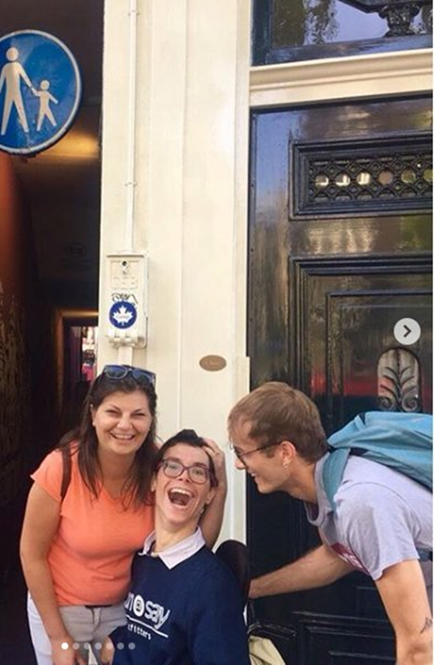
Accessible tourism – the benefits
In 2012:
783 million trips within the EU
Direct gross value added € 150 billion;
Multiplier effect € 356 billion.
Accessible tourism is not only a right, it is also big business!
With an ageing population, accessible tourism is predicted to become even more necessary in the coming years
The idea is not to have segregated, accessible destinations but make ALL destinations more accessible
→ Improving accessibility does not only benefit tourists, it is also improving for locals!
Notes:
The Photo is of Javier, who travelled in the Netherlands through the discover EU programme.
The European Commission has published a set of studies on accessible tourism in the EU which will contain more detailed statistics about the economic impact of accessible tourism.
http://ec.europa.eu/DocsRoom/documents/5566/attachments/1/translations
In the study mentioned above, it is estimated that as of 2011, there were 138.6 million people with access needs in the EU and that in 2012, people with access needs in the EU took approximately 783 million trips within the EU and that. Furthermore, the study mentions that the direct gross value added of EU’s Accessible Tourism in 2012 was about € 150 billion; after taking the multiplier effect into account, the total gross value added contribution amounted to about € 356 billion. You can find a summary of the findings in the study in this presentation:

Slide 17
But this is too expensive!
It costs less thank you think. A 2004 study of the Technical University of Zürich showed that the cost of making a new building accessible from its outset only costs on average 1.8 % of the entire construction cost; and it’s even lower (0.5 %) for big projects. This was also confirmed in a 2017 study of the German Council of Cities and Municipalities.
The loss of potential customers also has to be taken into account - 71% of disabled customers with access needs will click away from a website that they find difficult to use. Those customers who click away have an estimated spending power of £11.75 billion in the UK alone (source: “Click away Pound” survey 2016)

Slide 18
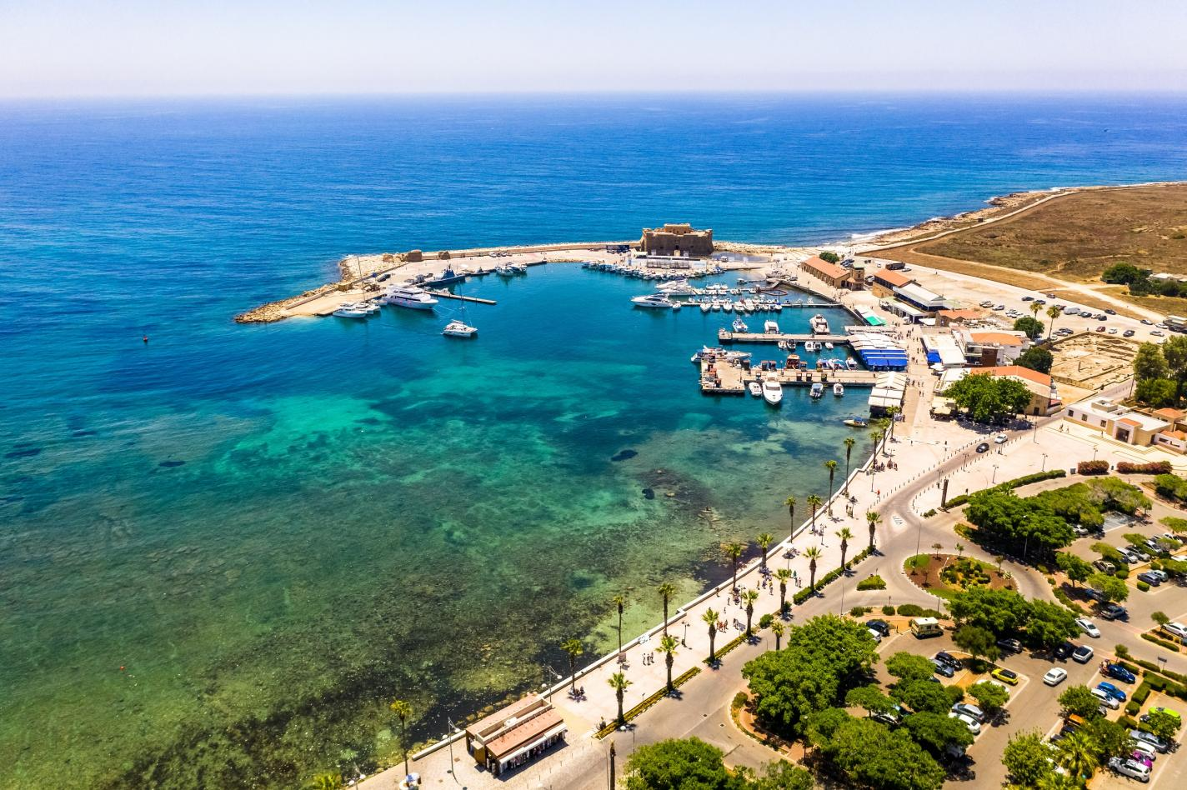
Examples of EU actions on accessible tourism
2022 industrial strategy „ Transition Pathway for Tourism” include references to accessibility
Access City Awards
European Capital and Green Pioneer of Smart Tourism – accessibility as 1 out of 4 categories
Skills for the EU tourism work force
Notes:
Picture credit: European Commission
Pafos (Cyprus), 2023 Capital of Smart Tourism

Slide 19
EU and international standards
ISO 21902:2021 – “Tourism and related services — Accessible tourism for all — Requirements and recommendations”
EN 17210:2021 – “Accessibility and usability of the built environment - Functional requirements”
BUT: Standards are voluntary and driven by industry so they are not a guarantee for accessibility
Notes:
https://www.iso.org/standard/72126.html

Slide 20
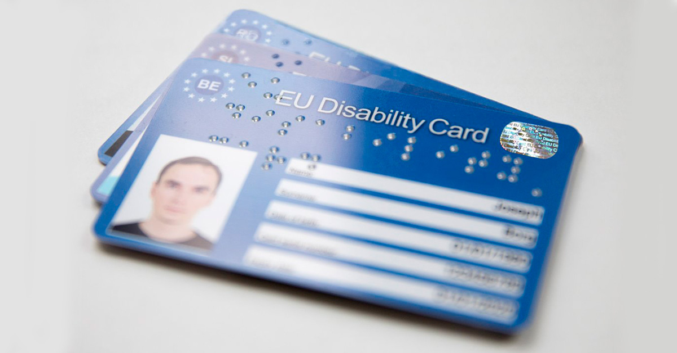
Last but not least: the Disability Card
Successful pilot project; flagship initiative under the 2021 European Strategy on the Rights of Persons with Disabilities
Legislative proposal (binding legislation) expected for 2nd semester of 2023
Should cover at the minimum culture, leisure, sport, and transport but basically all services that nationals with disabilities have access to (exception: social security)
Mutual recogntion of disability – if you travel to another Member State temporarily (for example as a tourist)
Aim: Facilitate freedom of movement for persons with disabilities
Notes:
https://ec.europa.eu/social/main.jsp?catId=1139

Slide 21
Conclusion
There are some initiatives on EU level but the EU could do more
Accessible tourism is at the crossroads of several policies so it has to be adressed in a multi-disciplinary way
There is still a lack of harmonisation – what does „accessible“ mean in the tourism industry? Consumer would like a wider offer, better information, and clear standards.
More binding rules would be preferable to drive the issue forward

Slide 22
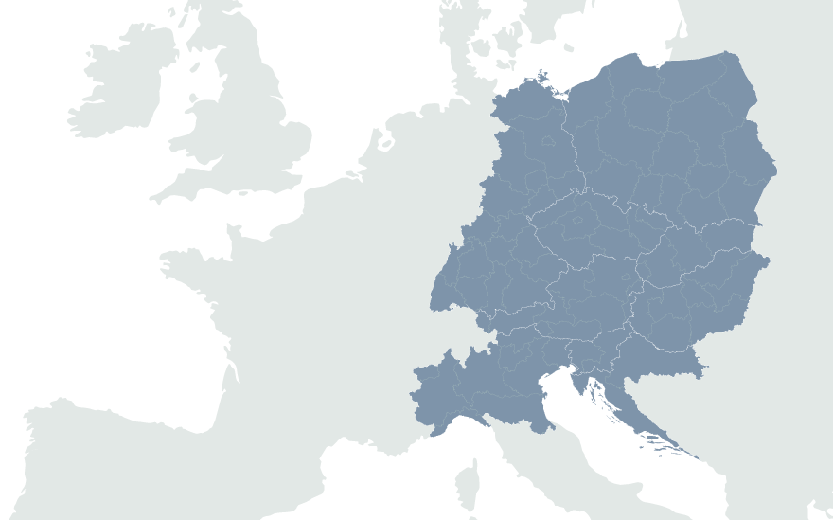
Marie Denninghaus
European Disability Forum
www.edf-feph.org
Marie.denninghaus@edf-feph.org

