Slide 1


Training on accessible events and communication
Roberta Lulli, Digital Accessibility Trainer
An-Sofie Leenknecht, Human Rights Coordinator
5th June 2023
Notes:
Accessible Spaces for All
Training on accessible events and communication
Roberta Lulli, Digital Accessibility Trainer
An-Sofie Leenknecht, Human Rights Coordinator
5th June 2023

Slide 2



Agenda
Online meetings/events
Face to Face meetings/events
Questions & Answers
Break
Notes:
Agenda
Online meetings/events
Face to Face meetings/events
Questions & Answers

Slide 3


Accessibility
Accessibility is all about making something easily available for as many people as possible.
It benefits everyone.
It's about ability, not disability.
Notes:
Accessibility
Accessibility is all about making something easily available for as many people as possible.
It benefits everyone.
It's about ability, not disability.

Slide 4




Accessible communication
It about more than just sharing content
We need to make sure we:
Inform Connect Engage
Audience
Notes:
Accessible Communication
It about more than just sharing content.
We need to make sure we:
Inform – Connect – Engage with your Audience

Slide 5
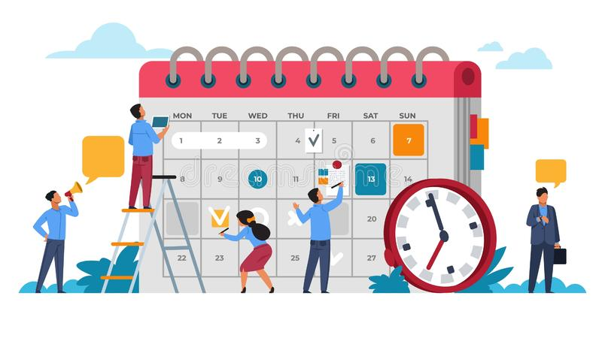
Accessible events and meetings
When meetings and events are held remotely or in presence, accessibility is important to ensure that all attendees, including persons with disabilities, are able to participate and engage with the content and audience.
Be accessible from the beginning!
Planning is the key
With a little pre-planning, event hosts can structure an inclusive and functional environment for all participants.
Notes:
Accessible events and meetings
When meetings and events are held remotely or in presence, accessibility is important to ensure that all attendees, including persons with disabilities, are able to participate and engage with the content and audience.
Be accessible from the beginning!
Planning is the key
With a little pre-planning, event hosts can structure an inclusive and functional environment for all participants.

Slide 6
Persons with disabilities
Persons with disabilities include persons who are blind, Deafblind, Deaf, who have physical, intellectual or psychosocial disabilities.
Examples of support needs include:
  Accessible rooms
  Sign language interpretation and captioning
  Easy to read information and explanation about the meeting beforehand
Notes:
Introduction
Persons with disabilities include persons who are blind, Deafblind, Deaf, who have physical, intellectual or psychosocial disabilities.
Example of support needs include accessible rooms, sign language interpretation and captioning, easy to read information and explanation about the meeting beforehand

Slide 7

Online meetings/events
Make your checklist!
Choose a platforms that support accessibility
Create and send accessible invitations
Add accessibility requirements section
Share information in advance
Provide Real-time captioning, International Sign interpretation
Follow up after the meeting/event
Notes:
Online meetings/events
Make your check list!
Choose a platforms that support accessibility
Create and send accessible invitations
Add accessibility requirements section
Share information in advance
Provide Real-time captioning, International Sign interpretation
Follow up after the meeting/event

Slide 8

Digital Meeting Platforms
Choose a platform that supports accessibility.
Zoom, Microsoft Teams, Google Meet, Skype, Webex…
Before choosing one, consider some elements/features:
Provide Real-time captions or otherwise support captions,
Can be navigated by a keyboard only
Support screen readers and interpreters
Notes:
Digital Meeting Platforms
Choose a platform that supports accessibility.
Zoom, Microsoft Teams, Google Meet, Skype, Webex…
Before choosing one, consider some elements/features:
Provide Real-time captions or otherwise support captions,
Can be navigated by a keyboard only
Support screen readers and interpreters

Slide 9
Accessibility Features on Zoom
Zoom is the most widely used platform for conferencing:
Real-time captioning integrated as subtitles and full transcript modes
Screen reader compatible
Meeting and Webinar formats
Language interpretation up to 9 different languages
Breakout rooms
Buttons large and with icons
Does not require download, launches on Browser
Requires a good internet connection and mobile version less accessible than desktop.
Notes:
Accessibility Features on Zoom
Zoom is the most widely used platform for conferencing
Real-time captioning integrated as subtitles and full transcript modes
Screen reader compatible
Meeting and Webinar formats
Language interpretation up to 9 different languages
Breakout rooms
Buttons large and with icons
Does not require download, launches on Browser
Requires a good internet connection and mobile version less accessible than desktop.

Slide 10
Meeting and event invitations
Send the link to register via email / post on social media
The invitation may have multiple graphical elements, ensure that images and logos have alt text and documents/programs are accessible
If you are including a submission form, ensure that the form and the platform is accessible, especially to users who might not be using a mouse, or use a screen reader.
Include a statement letting individuals know that they can request accessibility requirements.
Notes:
Meeting and event invitations
Send the link to register via email / post on social media
The invitation may have multiple graphical elements, ensure that images and logos have alt text and documents/programs are accessible
If you are including a submission form, ensure that the form and the platform is accessible, especially to users who might not be using a mouse, or use a screen reader.
Include a statement letting individuals know that they can request accessibility requirements.

Slide 11
Accessibility requirements
Ask accessibility requirements. Give options like:
  Real time captioning in English
  International Sign Interpretation
  Other
Gives a deadline for requests
Provides the name, email address, or phone number of the individual to contact.
Did you know… on zoom you can customise your questions.
Notes:
Accessibility requirements
Ask accessibility requirements. Give options like:
Real time captioning in English
International Sign Interpretation
Other
Gives a deadline for requests
Provides the name, email address, or phone number of the individual to contact.
Did you know… on zoom you can customise your questions.

Slide 12
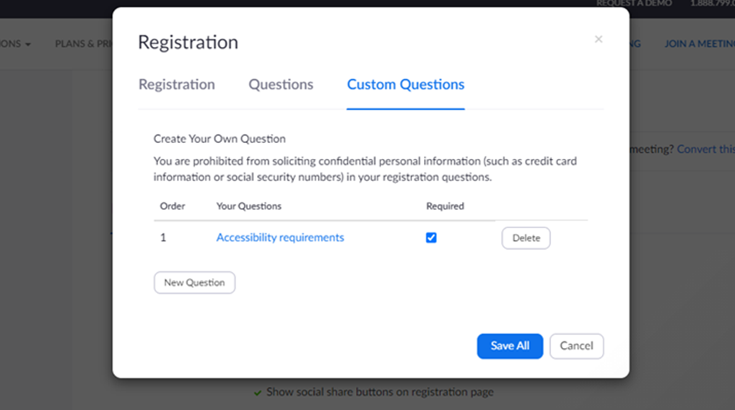
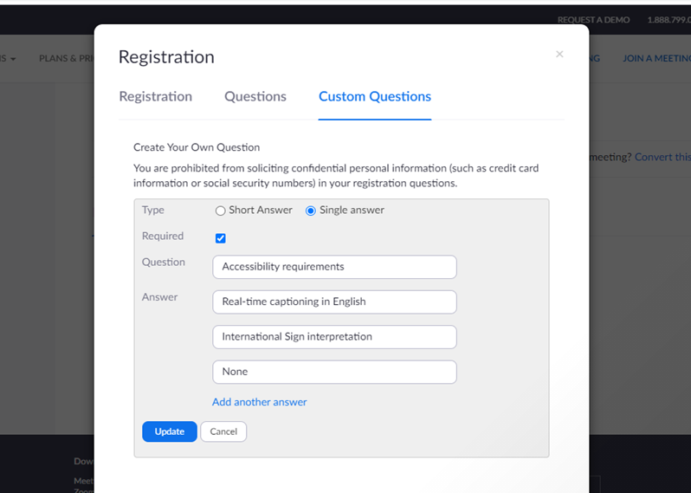
Zoom accessibility requirements
At the bottom of your event click on:
Registration > edit > Custom Questions
Notes:
Zoom accessibility requirements
At the bottom of your event click on:
Registration > edit > Custom Questions

Slide 13
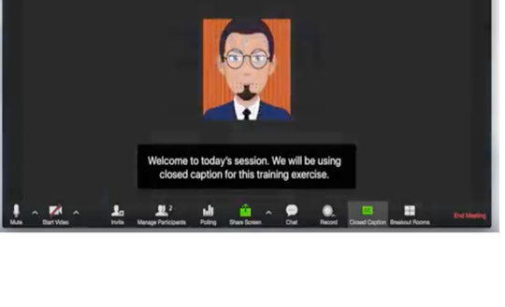
Real time captioning
Allows participants to follow the event simultaneously and in text
Useful for many participants (hard of hearing people)
Integrated in the platform (Zoom) or through an external link
Subtitles and/or full transcript
Different languages available but only one as subtitle and the rest in external links (Zoom)
One captioner per language
Notes:
Real time captioning
Allows participants to follow the event simultaneously and in text
Useful for many participants (hard of hearing people)
Integrated in the platform (Zoom) or through an external link
Subtitles and/or full transcript
Different languages available but only one as subtitle and the rest in external links (Zoom)
One captioner per language

Slide 14
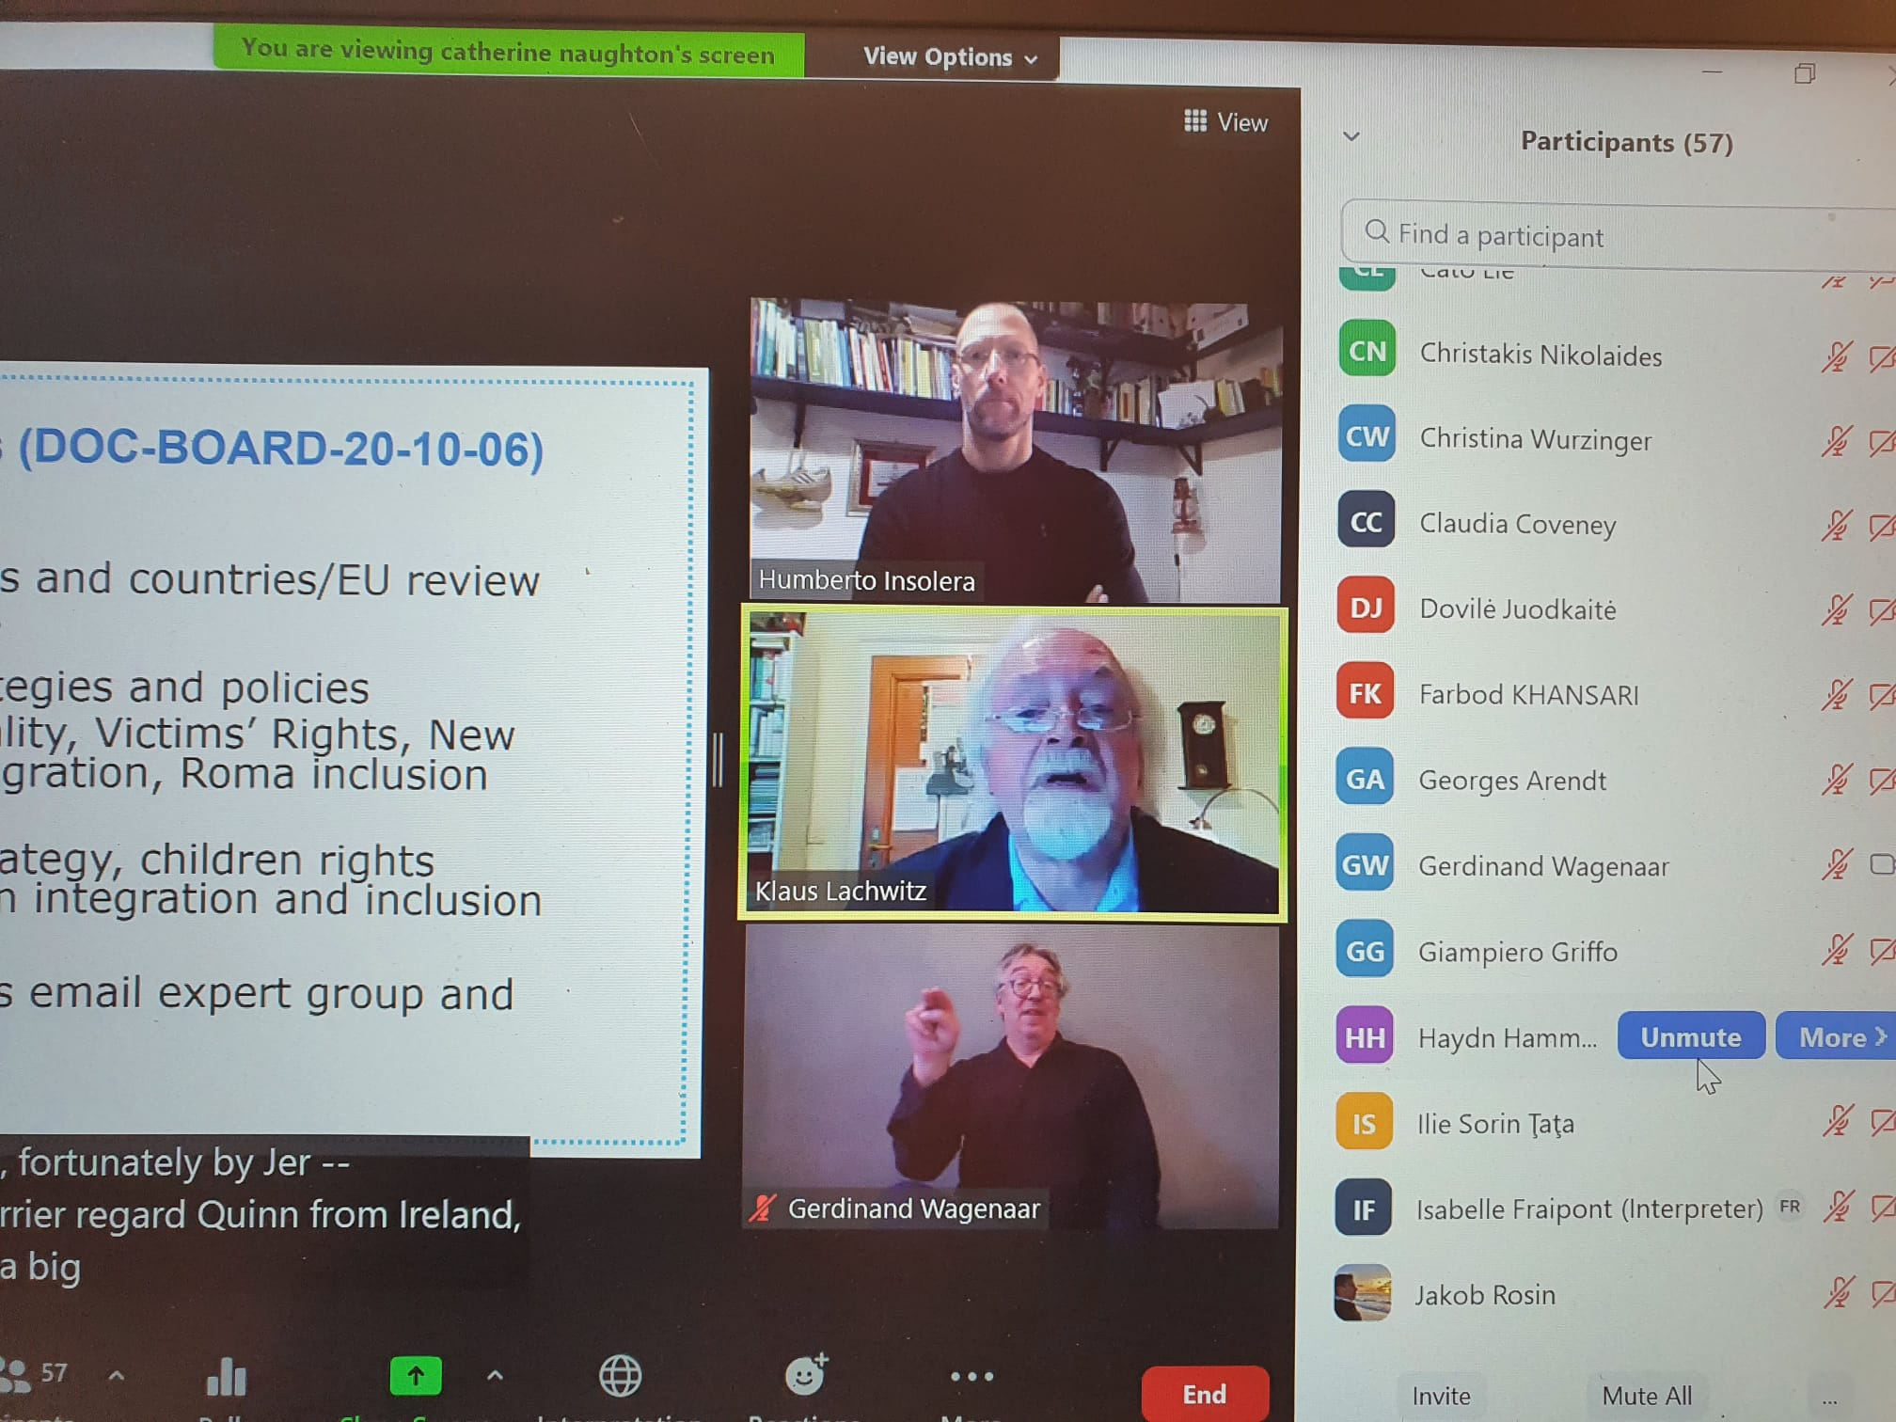
Sign interpretation
Hire a sign language interpreter through a service as early as possible.
Allows participants to follow the event with sign interpretation
Useful for deaf and hard of hearing
Usually, 2 interpreters switching every 10 minutes
Possibility to pin and resize the images (Zoom allows to multi-pin)
Notes:
Sign interpretation
Hire a sign language interpreter through a service as early as possible.
Allows participants to follow the event with sign interpretation
Useful for deaf and hard of hearing
Usually, 2 interpreters switching every 10 minutes
Possibility to pin and resize the images (Zoom allows to multi-pin)

Slide 15
Share the material in advance
Create in advance all documents in an accessible format.
(PowerPoint presentation, program of the day, reports, videos)
Send all the material to the interpreters and participants in advance
Ask the permission from speakers
Share names of speakers and any PowerPoints ahead of time so the interpreters and participants can become familiar with the materials.
Notes:
Share the material in advance
Create in advance all documents in an accessible format.
(PowerPoint presentation, program of the day, reports, videos)
Send all the material to the interpreters and participants in advance
Ask the permission from speakers
Share names of speakers and any PowerPoints ahead of time so the interpreters and participants can become familiar with the materials.

Slide 16
During the online event
Say your name every time you speak
Speak slowly and not too fast
For events where everyone is visible and able to speak, any individual not speaking should be on mute.
Consider having breaks to have time to process information.
It is recommended to have a 10-minute break every hour or so.
Have a staff person monitor the chat or Q&A function for accessibility issues
Notes:
During the online event
Say your name every time you speak
Speak slowly and not too fast
For events where everyone is visible and able to speak, any individual not speaking should be on mute.
Consider having breaks to have time to process information.
It is recommended to have a 10-minute break every hour or so.
Have a staff person monitor the chat or Q&A function for accessibility issues

Slide 17
Present in an Accessible Manner
Turn on your video and face the camera. Seeing the speaker helps participants maintain attention, and it can be helpful for anyone who is reading lips.
Encourage all attendees to identify themselves by name before speaking.
Keep in mind that expressions such as, “right here” or “here we see” or "in the upper-right" will not translate well to participants who cannot see the screen.
Notes:
Present in an Accessible Manner
Turn on your video and face the camera. Seeing the speaker helps participants maintain attention, and it can be helpful for anyone who is reading lips.
Encourage all attendees to identify themselves by name before speaking.
Be descriptive and describe visual content (including videos)
Keep in mind that expressions such as, “right here” or “here we see” or "in the upper-right" will not translate well to participants who cannot see the screen.

Slide 18
PowerPoint presentations
Remove acronyms from any document, including agenda, working documents, presentations and briefings.
Ask presentations from speakers in advance.
The organizer of the event is responsible to send some suggested links or useful readings to participants in advance
Be descriptive and describe visual content (including videos)
Notes:
PowerPoint presentations
• Remove acronyms from any document, including agenda, working documents, presentations and briefings.
• Ask presentations from speakers in advance.
• The organizer of the event is responsible to send some suggested links or useful readings to participants in advance
Be descriptive and describe visual content (including videos)

Slide 19
How you take questions
Participants have a few options for asking questions in a web conferencing
Raise their virtual hands and unmute themselves
They can post questions directly in the chat window, to be answered whenever possible.
Always repeat any questions posed in the chat.
Repeating the questions helps anyone who can’t access the chat visually during the session, and it can even improve quality of captioning.
Notes:
How you take questions
Participants have a few options for asking questions in a web conferencing
Raise their virtual hands and unmute themselves
They can post questions directly in the chat window, to be answered whenever possible.
Always repeat any questions posed in the chat.
Repeating the questions helps anyone who can’t access the chat visually during the session, and it can even improve quality of captioning.

Slide 20
After the event
Follow up after the meeting sharing materials (notes, transcript, recording, links, resources) in an accessible format.
Post a Video Recording of the Meeting with accurate captions
Post-event Survey
Collect feedback from participants on the content and accessibility of your event.
Do not exceed 15 questions if possible
Notes:
After the event
Follow up after the meeting sharing materials (notes, transcript, recording, links, resources) in an accessible format.
Post a Video Recording of the Meeting with accurate captions
Post-event Survey
Collect feedback from participants on the content and accessibility of your event.
Do not exceed 15 questions if possible

Slide 21
Break
Notes:
Questions

Slide 22

Face to face meeting
Plan the logistics of the meeting
Before
During
After
If this is your first time planning an accessible event, then ask OPDs and other organisations with experience to advise you.
Download EDF guide for accessible Meetings for all
Notes:
Face to face meeting
Plan the logistics of the meeting
Before
During
After
If this is your first time planning an accessible event, then ask OPDs and other organisations with experience to advise you.
Download EDF guide for accessible Meetings for all

Slide 23


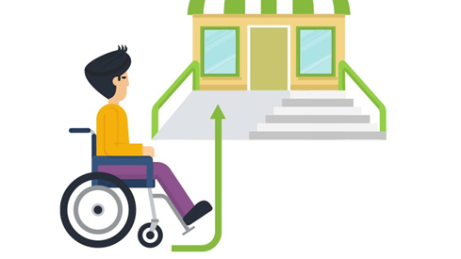
Logistics to access the event
Visit the venue of the meeting in advance and consider the:
Accessibility of the entrance, meeting room, corridors, toilets and breakfast room, lifts, the surrounding areas including proximity to public transport and parking.
Notes:
Logistics to access the event
Visit the venue of the meeting in advance and consider the:
Accessibility of the entrance, meeting room, corridors, toilets and breakfast room, lifts, the surrounding areas including proximity to public transport and parking.

Slide 24



Before the Meeting
Make sure the online registration form is accessible and ask for accessibility requirements:
Special dietary Transport needs Accessible parking
Documents in accessible formats (large print, easy to-read, accessible electronic format)
Notes:
Before the Meeting
Make sure the online registration form is accessible and ask for accessibility requirements:
Special dietary Transport needs Accessible parking
Documents in accessible formats (large print, easy to-read, accessible electronic format)

Slide 25
Programme of the event
Organise the programme with appropriate breaks and time for questions.
Send practical details in advance:
Venue of the meeting and the address of the hotel
Telephone number of the organisers, contact details
Transport information
Location of reserved parking places
Distribute the programme in accessible formats, ideally ahead of time
Notes:
Programme of the event
Organise the programme with appropriate breaks.
Send practical details in advance:
Venue of the meeting and the address of the hotel
Telephone number of the organisers, contact details
Transport information
Location of reserved parking places
Distribute the programme in accessible formats, ideally ahead of time

Slide 26
During the Meeting
One or two people should be available at arrival and departure (help desk)
When the person is there, address her or him directly (thereafter the assistant or sign language interpreter).
Find out how people with hearing impairments prefers to communicate – signing, lips reading or captioning
With people with visual impairments always speak first. Introduce yourself and other persons clearly, explaining where they are in relation to the person.
Notes:
During the Meeting
One or two people should be available at arrival and departure
When the person is there, address her or him directly to the person assistant or sign language interpreter.
Find out how people with hearing impairments prefers to communicate – signing, lips reading or captioning
With people with visual impairments always speak first. Introduce yourself and other persons clearly, explaining where they are in relation to the person.

Slide 27
Speakers and presentation
Inform speakers about the accessibility needs of the participants.
Speakers should talk speak as slowly and clearly as possible.
Check if the speaking arrangement is accessible. Speakers may need a ramp to get onto the stage, or the removal of a chair for a panel discussion. Captioning and sign language interpretation visible.
The content should be clear, concrete, and easy to understand.
Notes:
Speakers and presentation
Inform speakers about the accessibility needs of the participants.
Speakers should talk speak as slowly and clearly as possible.
Check if the speaking arrangement is accessible. Speakers may need a ramp to get onto the stage, or the removal of a chair for a panel discussion.
The content should be clear, concrete, and easy to understand.

Slide 28
After the meeting
Follow up in writing the key points of the discussion and any agreed outcomes or actions.
Provide copies of any documents discussed in the meeting. It can be helpful to share as much written information as you can.
Follow up with any attendees that required communication support to find out what worked well and what could be improved for next time.
Ask feedback on the event venue, suppliers, accessibility
Be ready to learn from the feedback you receive!
Notes:
After the meeting
Follow up in writing the key points of the discussion and any agreed outcomes or actions.
Provide copies of any documents discussed in the meeting. It can be helpful to share as much written information as you can
Follow up with any attendees that required communication support to find out what worked well and what could be improved for next time.
Ask feedback on the event venue, suppliers, accessibility
Be ready to learn from the feedback you receive!

Slide 29
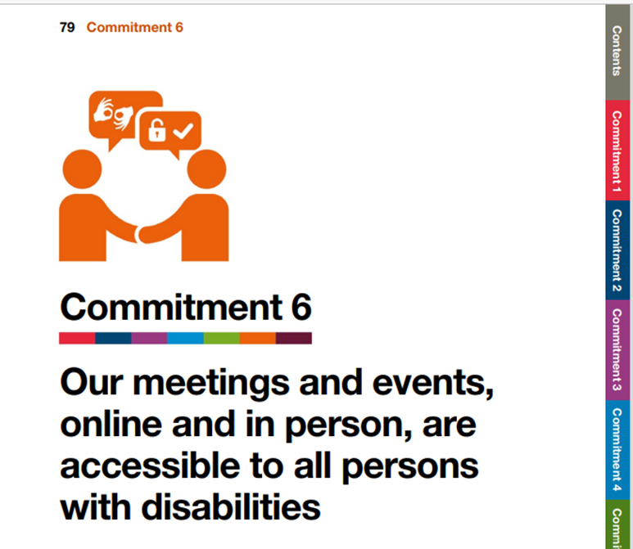
Inclusive Meetings & Events Self-Assessment Template
Accessibility Go! A guide to action by
The World Blind Union (WBU) and CBM Global.
Download the Self-Assessment Template
Useful recourses:
Accessible Word Documents Toolkit
Accessible PowerPoint presentation Toolkit
Accessible Social Media Toolkit
Notes:
Inclusive Meetings & Events Self-Assessment Template
Accessibility Go! A guide to action by
The World Blind Union (WBU) and CBM Global.
Download the Self-Assessment Template
Useful recourses:
Accessible Word Documents Toolkit
Accessible PowerPoint presentation Toolkit
Accessible Social Media Toolkit

Slide 30
Platform Accessibility Links
Zoom: Zoom – Accessibility; Zoom – Getting Started with Closed Captioning
Microsoft Teams: Microsoft Teams Accessibility
GoToMeetings: Accessibility Features
Google Hangouts: Using Hangouts with a Screen Reader; Keyboard Shortcuts for Hangouts
Google Meet: Google Meet Accessibility
Notes:
Platform Accessibility Links
Zoom: Zoom – Accessibility; Zoom – Getting Started with Closed Captioning
Microsoft Teams: Microsoft Teams Accessibility
GoToMeetings: Accessibility Features
Google Hangouts: Using Hangouts with a Screen Reader; Keyboard Shortcuts for Hangouts
Google Meet: Google Meet Accessibility

Slide 31
Thank you for your attention
The European Disability Forum
www.edf-feph.org
Avenue des Arts 7-8, Bruxelles 1210, Belgium
Twitter: @MyEDF @robiula
Facebook: @MyEDF
Notes:
Thank you for your attention
The European Disability Forum
www.edf-feph.org
Avenue des Arts 7-8, Bruxelles 1210
Belgium
Twitter: @MyEdf @robiula
Facebook: @?

