Slide 1

ABC of disability and accessibility
Online training
Zoom | 15 May 2023
Marie Denninghaus
European Disability Forum

Slide 2
Agenda
Welcome
What is disability? What is accessibility? Different accessibility needs related with different types of disabilities
Discussion & Questions
Short break
United Nations’ Convention on the Rights of Persons with Disabilities (UN CRPD)
The EU’s Strategy for the Rights of Persons with Disabilities 2021-2030
EU legislation and standards on accessibility
Discussion & Questions
Closing

Slide 3

Disability and accessibility

Slide 4
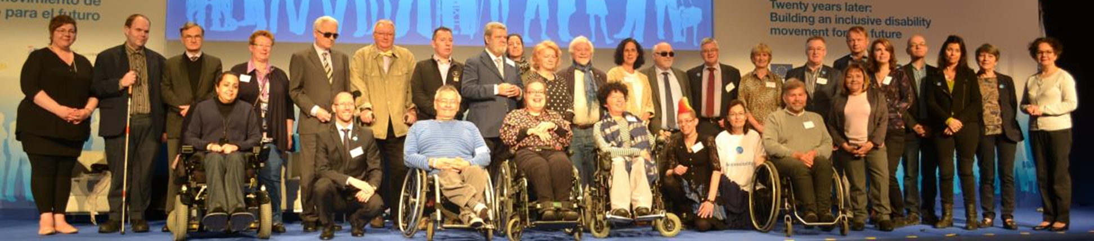
About EDF
European Disability Forum: an independent NGO representing 100 million persons with disabilities EU
Umbrella organisation: more than 100 member (national councils; national and European NGOs)
Represents all types of disabilities
Secretariat in Brussels
Organisation OF persons with disabilities, not FOR persons with disabilities
“Nothing about us without us”

Slide 5
What is disability?
There is no single agreed upon definition of disability. EDF uses the UN Convention of on the Rights of Persons with Disabilities (UN CRPD), ratified by the EU and all Member States, entails a shift away from charity/medical perspectives towards a human rights perspective. The definition of disability is therefore:
“Persons with disabilities include those who have long-term physical, mental, intellectual or sensory impairments which in interaction with various barriers may hinder their full and effective participation in society on an equal basis with others.“
Notes:
The language we use reflects on our thoughts and the way we see other people. When speaking about persons with disabilities, it is important to keep in mind they are persons with a family, a job, hobbies, talents and dreams and they are not defined by their impairments.
Therefore, focus on the individual and not on their particular limitation also in your use of language. Do not say “the disabled”, “the blind”, “the wheelchair”, etc., but refer to “the person with disability”, “the person who is blind”, “the person using a wheelchair” and so on.

Slide 6

The words do matter!
The language we use reflects on our thoughts and the way we see other people
focus on the individual and not on their particular limitation also in your use of language. Do not say “the disabled”, “the blind”, “the wheelchair”, etc., but refer to “the person with disability”, “the person who is blind”, “the person using a wheelchair” and so on.
Definitely NOT ok: “Crippled”, “deformed”, “crazy”, “retarded”, etc.
Notes:
The language we use reflects on our thoughts and the way we see other people. When speaking about persons with disabilities, it is important to keep in mind they are persons with a family, a job, hobbies, talents and dreams and they are not defined by their impairments.
Therefore, focus on the individual and not on their particular limitation also in your use of language. Do not say “the disabled”, “the blind”, “the wheelchair”, etc., but refer to “the person with disability”, “the person who is blind”, “the person using a wheelchair” and so on.
Also no euphemisms! “Special” can mean anything, and disability is not a bad word.

Slide 7
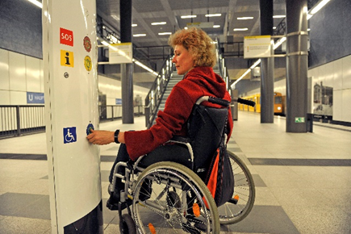
Some examples of disabilities
Persons with mobility impairments
Persons using wheelchairs or other kinds of mobility equipment like crutches, canes, walking frames, etc.
Persons with artificial or missing limbs.
Person of short/tall stature.
Many mobility impairments are not visible (e.g. heart disorders, diabetes), but still make it difficult for persons to move around
Copyright: Joite |Berliner Verkehrsbetriebe (BVG)

Slide 8
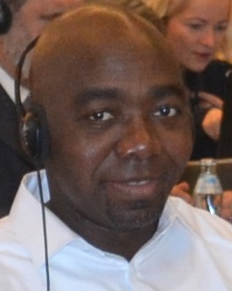
Example 1: Serge
“I have a mobility impairment, so I usually use my canes to walk and sometimes a wheelchair. I regularly travel by public transport and what I noticed is that it would help if staff were more aware of disability issues. The bus drivers often stop too far away from the pavement or they don’t stop at all! I know the rules are different in each country, but in France, the drivers are not allowed to leave their seat so they can also not assist, but it would be nice if there was a more ‘human’ approach. Little things help and they reflect an inclusive society.”
(Serge Mabally, France)

Slide 9
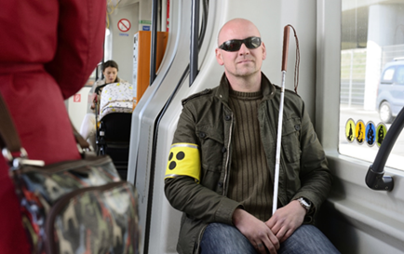
Some examples of disabilities
Persons who are blind or partially sighted
Some persons who are blind or partially sighted use white canes.
A red and white cane often indicates that the person is deaf-blind.
Some people might wear dark glasses.
Others might be accompanied by a personal assistant or a guide dog with a distinctive harness.
But not all blind or partially sighted persons have any of these characteristics!
Copyright: Wiener Linien
Notes:
How does the person perceive his/her surroundings?
Visual disabilities vary widely. One person may have a total loss of vision, while another may have difficulty seeing only under certain conditions or have a limited field of vision.
Perception depends on both the individual’s eyesight and the conditions in the surrounding environment, for example the amount of light or level of contrast.
Persons who are blind or partially sighted and using a cane may need their arms to balance.

Slide 10
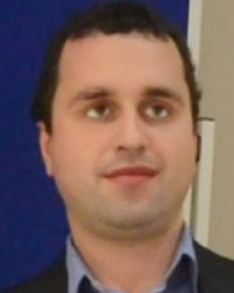
Example 2: Ovidiu
“I’m blind and I regularly use buses. The main difficulty for me is to know which bus is approaching the stop, since I cannot see the number. It would help me if the bus driver told me the bus number when he stops because I can never tell if I’m flagging down the correct bus. In general, it would help if the buses themselves became more accessible with audio announcements, for example.”
(Ovidiu Tuduruță, Romania)

Slide 11
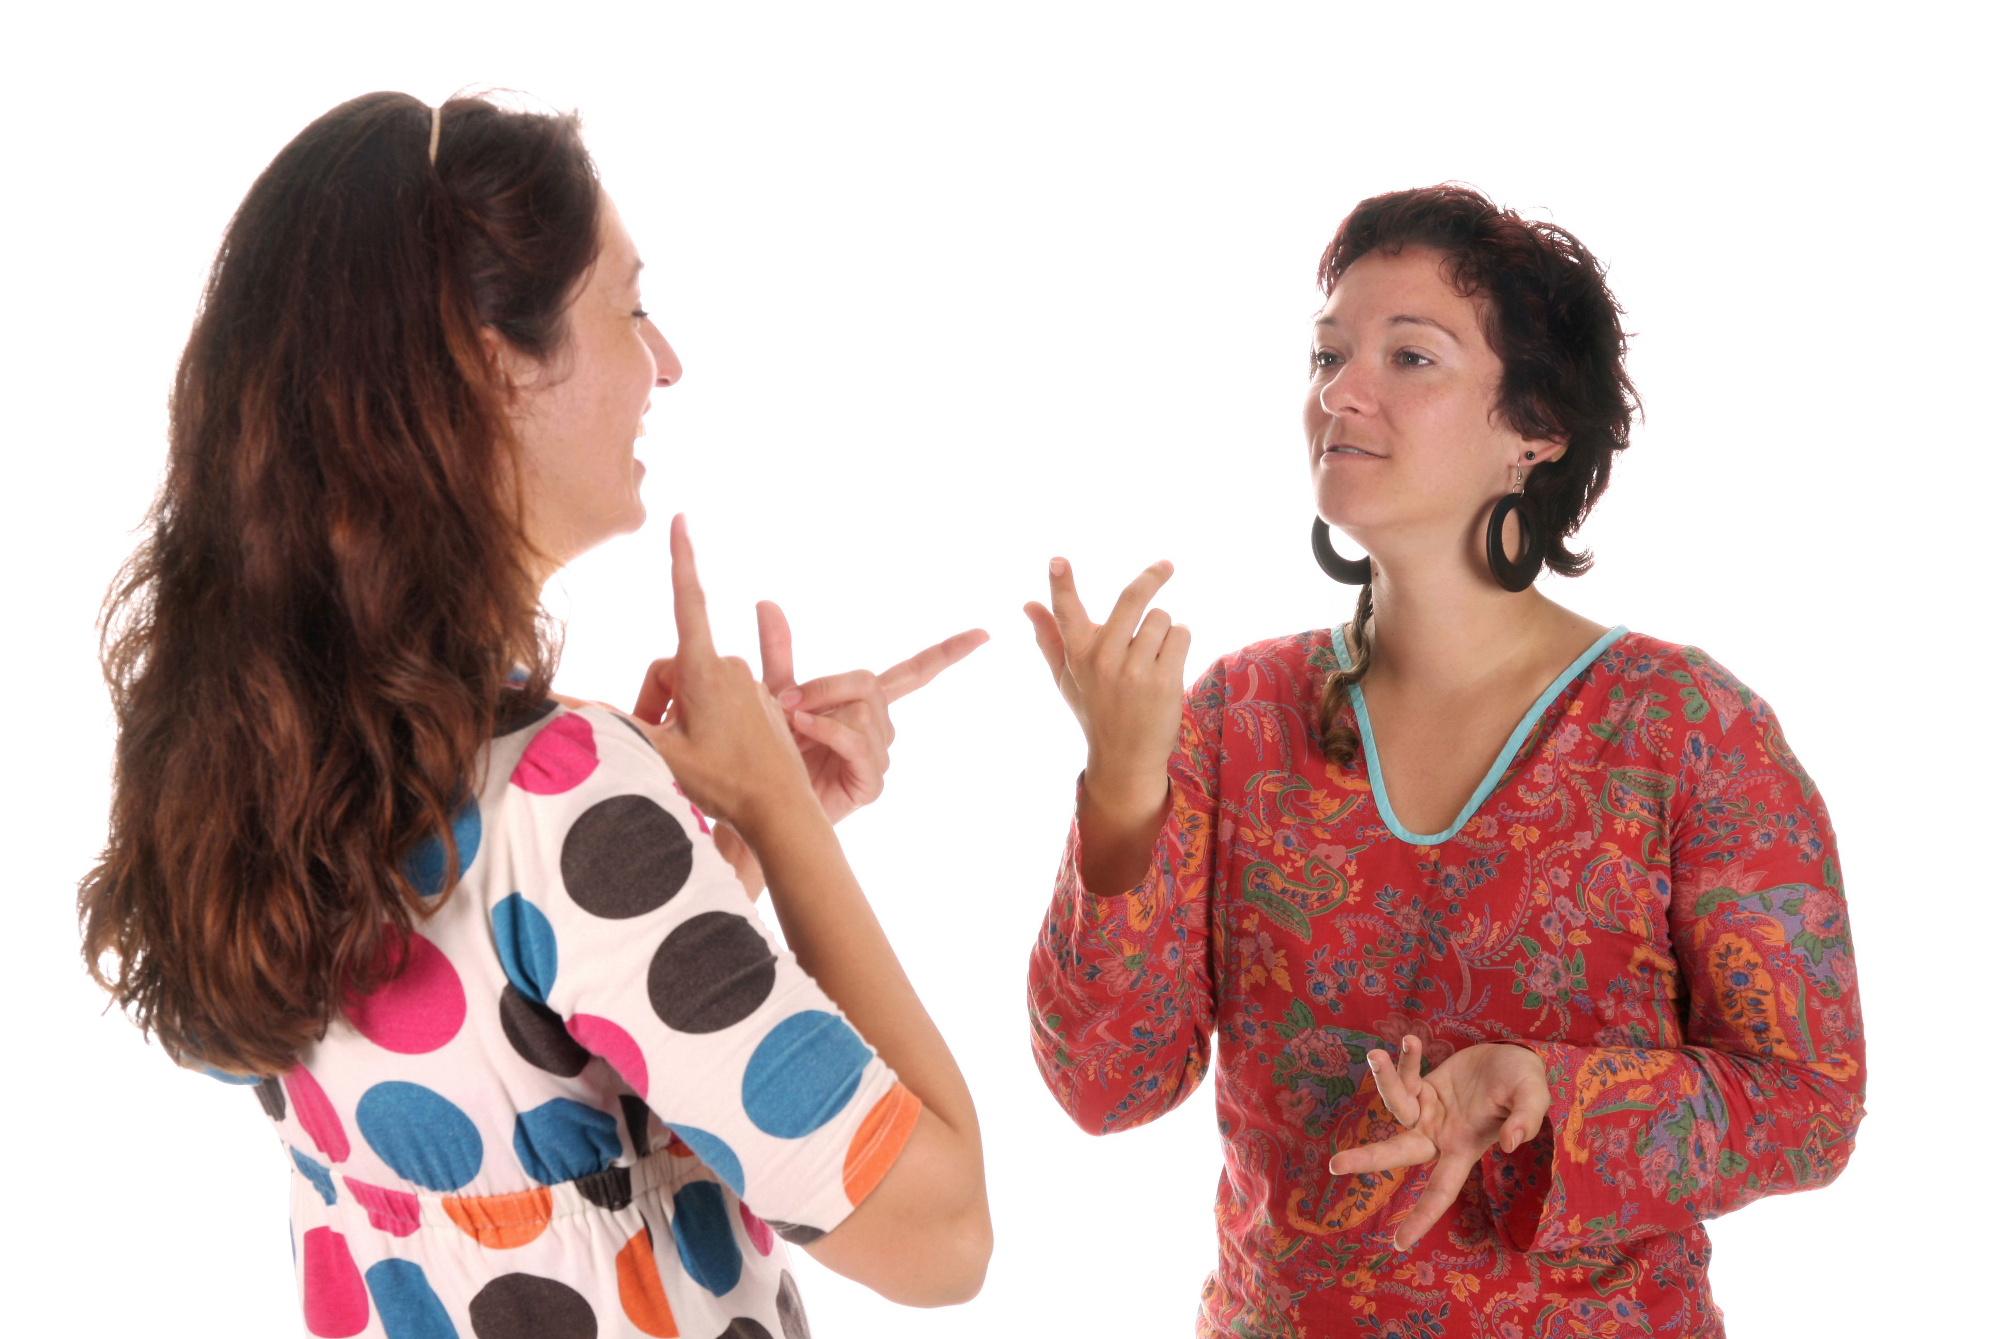
Some examples of disabilities
Persons who are deaf or hard of hearing
Various hearing impairments – deaf is not the same as hard of hearing!
Chances are you won’t notice a person who is deaf or hearing impaired unless you see the person using sign language or wearing a hearing aid.
Sign Language is the first language for many deaf persons
There are (almost) as many sign languages as spoken languages!
Copyright: Shutterstock / Vladimir Mucibabic
Notes:
There are various types of hearing impairments ranging from slight hearing impairments that can be corrected by hearing aids to complete deafness. There are also persons who are deaf-blind, i.e. they have both a hearing impairment and a visual impairment (but do not necessarily have to be completely deaf and blind). Some people use implants that allow them to hear well. For some people, also those with hearing aids, loud environmental sounds may be amplified.
Many persons who are born deaf rely primarily on sign language for communication; it’s their mother tongue. There is not one single sign language that all deaf people use – there are different national sign languages, just like French, German, English, etc.
Lip-reading can help persons that are deaf or hard of hearing but not all persons use this technique.
Some persons who are deaf or hearing impaired speak clearly while others’ speech might sound different.

Slide 12

Example 3: Marcel
“I am hard of hearing and take the bus and sometimes the train to work every day. Visual information is crucial for me. If the timetable changes or there are disruptions, I often miss that important bit of information because it is only delivered via loudspeakers and not in writing. It would be helpful for me to have a display with upcoming stops in the bus, for example. If that system is broken and I need to ask the driver, it is important for me that he looks at me and switches on the light so that I can see his face to lip-read.”
(Marcel Bobeldijk, Netherlands

Slide 13
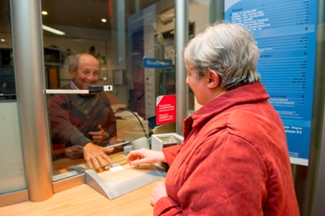
Some examples of disabilities
Persons with speech impairments
Unless you talk to this person, you will probably not recognise it.
Be careful not to draw quick conclusions: just because somebody has trouble expressing themselves , this does not mean they have any other (intellectual) disabilities.
Persons with speech impairments, e.g. somebody who stutters, may feel anxious about communicating and human interaction, especially when under pressure (meeting new people, giving a presentation, unfamiliar place, etc.).
Be patient and give the person your full attention!
Notes:
When communicating, give the person your full attention, as you would to somebody who does not speak your language.
Be patient. Do not interrupt or finish the person’s sentences. Speech impairments often get worse when the person is put under pressure.
If you have trouble understanding a person with a speech impairment, ask him/her to repeat. Ask yes/no questions. If, after trying to clarify, you still do not understand, ask the person to write the question down.
If you are not sure whether you understood the situation correctly, repeat for verification.

Slide 14
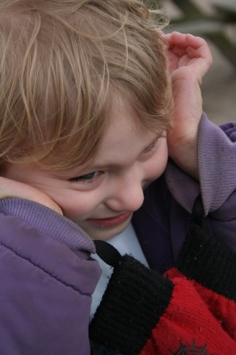
Some examples of disabilities
Persons with cognitive disabilities (e.g. intellectual disabilities, traumatic brain injury, or autism)
Sometimes also called „hidden disabilities“ – you will probably not recognize it at first sight
The person may have a hard time processing information or expressing themselves, difficulties orienting themselves, or understanding and following instructions
The person may get stressed in a seemingly “normal” situation, so their behaviour might seem erratic and strange.
Notes:
Even though some disabilities such as Down's Syndrome are well-known, you will probably not recognise persons with intellectual disabilities in most cases. Intellectual disabilities come in many different forms so do not draw any conclusions from the way somebody looks.
Persons with a brain injury may have loss of muscle control or poor impulse control, but this is not necessarily visible. They may also have poor directional orientation and use an assistance dog although seemingly not mobility impaired.
It may not be obvious if a person is on the autism spectrum. Autism affects how a person communicates with, and relates to, other people. It also affects how they make sense of the world around them. The main symptoms of autism are deficits in social communication and social interaction as well as restricted, repetitive patterns of behaviour, interests or activities.
Persons with dyslexia can have problems reading written information.
Persons with an auditory processing disorder may not be able to process verbal information.
Persons with autism often experience sensory difficulties, such as increased or reduced sensitivity to light, sound, colour, smell, taste or touch.
Persons with autism may have difficulty understanding figurative language and idioms.
What problem may the person encounter? What may they worry about? What can go wrong?
The person may find it difficult to ask for information or help, or he/she might be confused by the information and multiple stimuli in a given situation.
The person may have difficulties reading The person may find it difficult to count the correct amount of money for the fare and/or the change. The person may get stressed in a seemingly “normal” situation, so their behaviour might seem erratic and strange.
The person might be confused when addressed and he/she may have problems communicating.
Persons with autism may be uncomfortable with eye contact and direct communication. They may avoid your gaze while listening to you.
They may also be uncomfortable in crowded places and in situations that are unfamiliar
Their tone of voice, body language and facial expressions may not match the content of their communication.
Some persons with autism are unaware of dangers, such as approaching vehicles.
In situations of extreme distress, they may shut down and stop responding to outside stimuli.
In case of an epileptic seizure, the person may be in danger of getting hurt by falling or choking when unconscious.
How to assist?
Be patient and give the person your full attention, but never assume that he/she is “stupid” and does not understand you.
If the person seems to have difficulties understanding information or instructions, repeat clearly and slowly what you said, using simple language if necessary.
If the person asks for it, do not hesitate to write simple instructions down for them. He/she may also ask you for information that is clearly written somewhere.
Use simple words or use gestures to underline what you are saying, e.g. by pointing at objects to clarify.
If the person asks for it, indicate clearly the stop where he/she plans to get off. Sometimes they carry a self-made map or other information with them that points out their destination.
Bear in mind that you cannot expect persons with autism to pick up on non-verbal communication, so be direct if necessary. Also be concrete and specific, e.g. do not use figurative language.
In case of conflicts between a person with a cognitive disability and other passengers, try to de-escalate the situation and intervene calmly.
Be patient and give the person space to calm down.
Should a conflict escalate, give priority to the person with the disability. Should it nevertheless be necessary to ask a person with a cognitive disability to leave the bus, try to ensure that the person is safe and knows how to orient him/herself or is accompanied.
In case of a seizure, follow your company instructions and inform emergency services. In the meantime, depending on your situation, you can provide first aid or ask others to do so and make sure the person is safe.

Slide 15

Example 4: Erika
“Many persons with autism perceive everything with sharper senses: smells, sounds, vision… Therefore it can be very stressful for us to use public transport. For me, it is important that everything is structured and that things are the same so that I know what to expect. For example, the bus should be on time and stop always at the same place so that I can plan ahead. It is also important that the driver is aware of what autism is and how people with autism can behave so that they know how to react if somebody has a ‘meltdown’.”
(Erika Becerra, Italy

Slide 16
Some examples of disabilities
Persons with psychosocial disabilities
Psychosocial disabilities, or mental ill-health, as it more commonly known, are invisible.
Mental ill-health can affect anyone and covers a wide spectrum.
Some people experiencing mental ill health may sometimes have difficulties coping with daily life and the tasks and interactions it brings.
The person may use a variety of coping strategies to manage their feelings of distress or overwhelm, and these coping strategies may look or seem unusual to you.
Notes:
Psychosocial disabilities, or mental ill-health, as it more commonly known, are invisible.
Mental ill-health can affect anyone and covers a wide spectrum.
How does the person perceive his/her surroundings?
Some people experiencing mental ill health may sometimes experience difficulties coping with daily life and the tasks and interactions it brings.
Interacting with people in public can be a source of stress for some people, as it may trigger feelings of panic, distress, claustrophobia or being overwhelmed.
Some persons experiencing mental ill health may feel more comfortable travelling with a friend, family member or assistant for emotional support.
What problem may the person encounter? What may they worry about? What can go wrong?
Public events and outings can trigger stress in some people for many different reasons: it can, for example, feel overwhelming coping with the unknowns of a journey or a location. People can also feel claustrophobic in a crowded environment. Furthermore, it may trigger memories of difficult life events which may feel overwhelming.
The person may use a variety of coping strategies to manage their feelings of distress or overwhelm, and these coping strategies may look or seem unusual to you.
How to assist?
Use respectful language and avoid labels like ‘mentally ill’, or pejorative or stigmatising terms like ‘crazy’.
If the person is distressed, respond to him/her in a calm and polite way – try to see the person and not just the problem.
If a person mentions that he/she has a psychosocial disability or is experiencing mental ill-health, take it seriously and treat the person with respect. It may be difficult for them to open up about it.
Offer assistance if the person seems confused, overwhelmed or distressed.
Answer calmly any questions the person might have; the information may be important to reassure him/her.

Slide 17
Disability „etiquette“
Be aware and ready to act, offer assistance, but do not insist on it
Ask the person, rather than jumping to conclusions
Put people first and not their disability (see previous slide)
Be patient
Always speak directly to persons with disabilities - not their assistant!
It can be useful to carry a pen and paper with you
Be especially attentive towards gestures and facial expressions
Be mindful in unforeseen events
Respect the personal space of persons with disabilities - Always ask before you touch or bend over a person or touch their equipment (e.g. their wheelchair, guide dog, crutches, etc.).
Notes:
Be aware and ready to act, offer assistance, but do not insist on it
Just like everybody, persons with disabilities wish to maintain their dignity and independence.
Ask the person, rather than jumping to conclusions
No person is exactly like any other, and from first glance, you cannot tell what knowledge or abilities anyone might have. Persons with disabilities and persons with reduced mobility are a very heterogeneous group. Persons with the same impairment may need different types of assistance during their trip. Ultimately, persons with disabilities are the best judge of what they can or cannot do. Refrain from taking decisions on their behalf, but simply ask if you can help and how.
Put people first and not their disability
The language we use reflects on our thoughts and the way we see other people. When speaking about persons with disabilities, it is important to keep in mind they are persons with a family, a job, hobbies, talents and dreams and they are not defined by their impairments. Therefore, focus on the individual and not on their particular limitation also in your use of language. Do not say “the disabled”, “the blind”, “the wheelchair”, etc., but refer to “the person with disability”, “the person who is blind”, “the person using a wheelchair” and so on. Try to be empathic and put yourself in your passengers’ shoes
A person is not disabled because of his or her impairment, but because of the way in which society is organised. This includes the way stations and vehicles are designed, the way timetables are displayed, etc.
Be patient
Persons with disabilities or persons with reduced mobility may need longer to board or leave a vehicle, especially if a ramp is needed for a person with a wheelchair or mobility aide. If you are the driver, this may put pressure on you, in particular if your vehicle is already behind schedule for other reasons. Remember that it is not the person’s fault if the boarding takes longer and that every person has a right to mobility – so just accept the situation, let the person take the necessary time to board and continue your journey.
Always speak directly to persons with disabilities
Do not address their accompanying person, interpreter or personal assistant unless you are directed to do so by the passenger. Speak clearly and try to keep conversations private, rather than shouting over a long distance. If you are asked to repeat what you said, do so calmly and pleasantly. Make eye contact and take sunglasses off; if you wear them, the person is not able to see your eyes and may perceive you as threatening.
It can be useful to carry a pen and paper with you
When you encounter persons who are deaf or hard of hearing, it will come in handy to be able to communicate in writing. Also, written communication can make things easier when talking to persons who are not familiar with the place or the local language.
Be especially attentive towards gestures and facial expressions
If your body language is not in line with what you are saying verbally, people with cognitive disabilities may be confused by these mixed messages. So, use clear gestures and signals: for example, nod to acknowledge the wish of a person. Align your gestures and facial expressions to your verbal expressions – otherwise, even if you communicate politely, your facial expression, tone of your voice, gestures, etc. may still convey your impatience or bad mood.
Be mindful in unforeseen events
Even persons with reduced mobility and persons with disabilities, who under normal circumstances have no trouble, will struggle in case of unforeseen events and emergencies.
Respect the personal space of persons with disabilities or reduced mobility
Always ask before you touch or bend over a person or touch their equipment (e.g. their wheelchair, guide dog, crutches, etc.).ARDS
Take special care of older people
Many older people have one or several of the impairments mentioned in the next chapter.

Slide 18
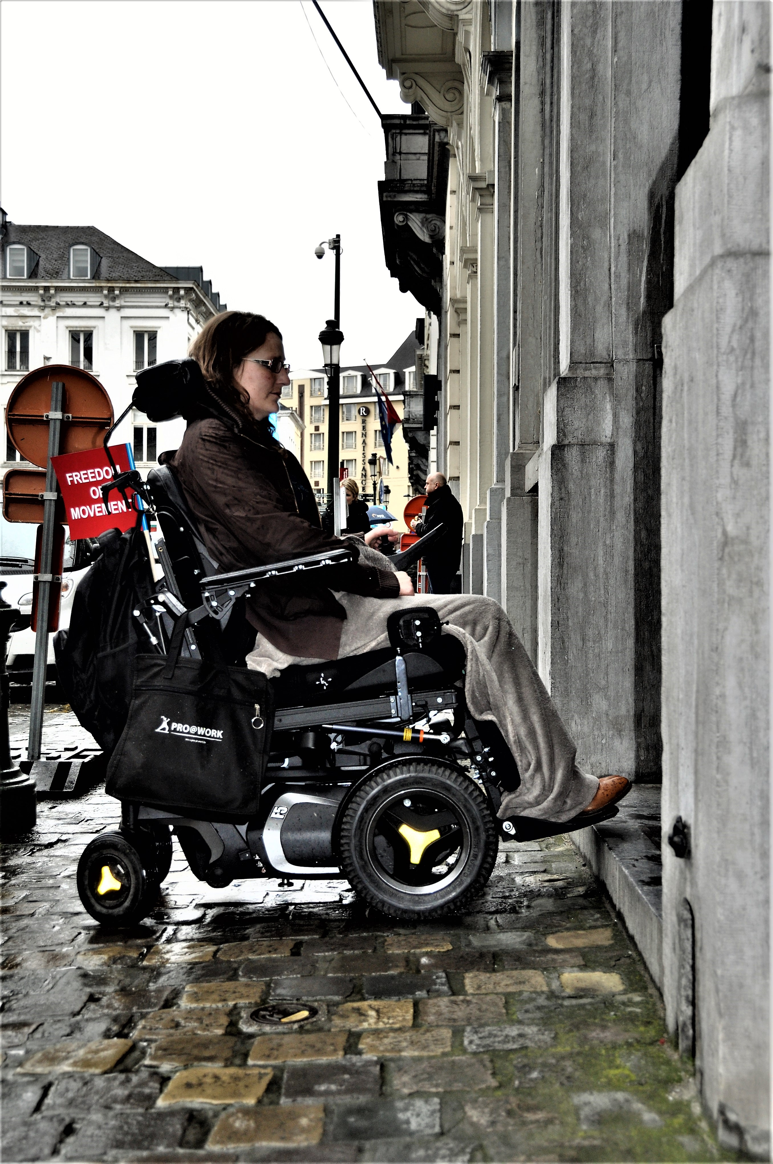
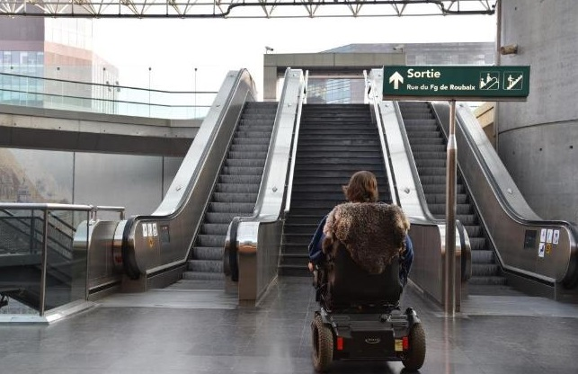
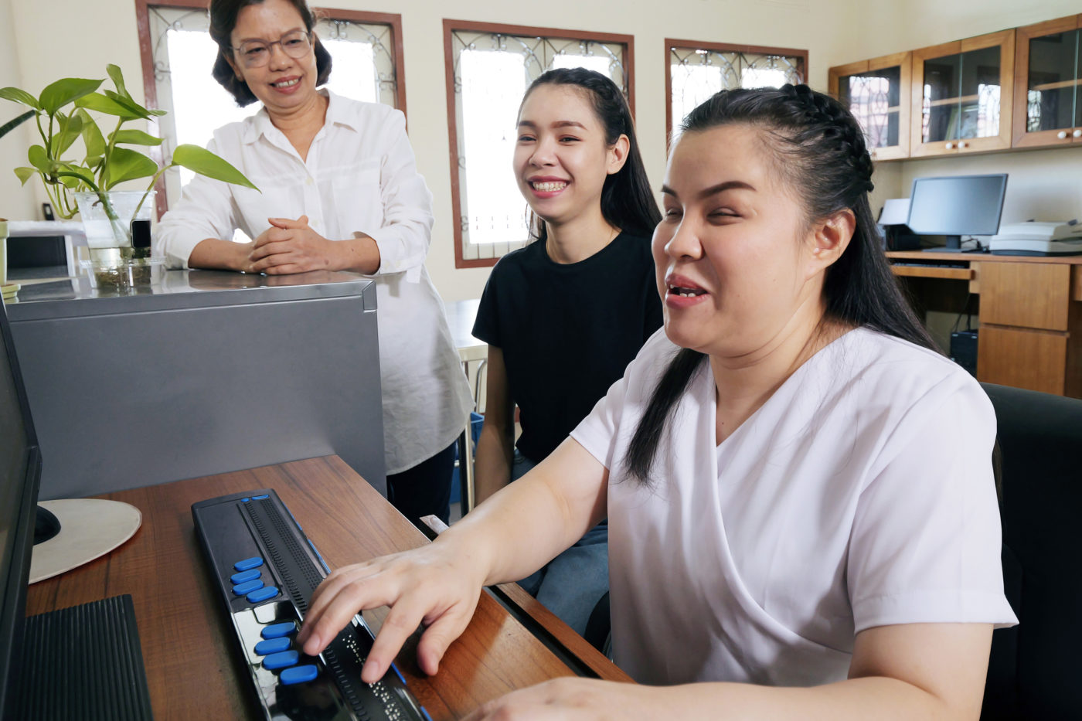
What is accessibility?
A person is not disabled because of their impairment, but because of the way in which society is organised!
„Accessibility“ means therefore to remove those barriers in a structured way.
Notes:
Accessbility vs reasonable accommodation
Design for all /universal design

Slide 19

Questions & Answers

Slide 20

Break (10 Minutes)

Slide 21
Wider legal and policy framework
United Nations Convention on the Rights of Persons with Disabilities
European Strategy on the Rights of Persons with Disabilities
EU legislation and standards on accessibility

Slide 22
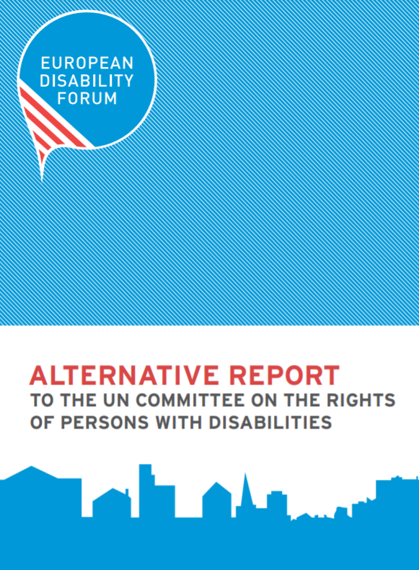
UN Convention on the Rights of Persons with Disabilities
Adopted in 2006 by the United Nations
Addresses all rights of persons with disabilities (equality, direct involvement, education, employment, accessibility, legal capacity, freedom from violence, right to vote, etc.)
Ratified by the EU and all its Member States since 2019; legally binding
Review of EU and its member states by CRPD Committee
Article 9 (Accessibility) & Article 30 (Participation in cultural life, recreation, leisure and sport)
Notes:
https://social.desa.un.org/issues/disability/crpd/convention-on-the-rights-of-persons-with-disabilities-crpd?page=2

Slide 23
UN Convention on the Rights of Persons with Disabilities
Article 9 - Accessibility:
“To enable persons with disabilities to live independently and participate fully in all aspects of life, States Parties shall take appropriate measures to ensure to persons with disabilities access, on an equal basis with others, to the physical environment, to transportation, to information and communications, including information and communications technologies and systems, and to other facilities and services open or provided to the public, both in urban and in rural areas. […]”

Slide 24
UN Convention on the Rights of Persons with Disabilities
Article 30 - Participation in cultural life, recreation, leisure and sport
“ […] Enjoy access to places for cultural performances or services, such as theatres, museums, cinemas, libraries and tourism services, and, as far as possible, enjoy access to monuments and sites of national cultural importance.”

Slide 25
UN Convention on the Rights of Persons with Disabilities
What does this mean in the EU context?
All new and revised EU (and national!) legislation and programmes have to respect the provisions of the UN CRPD
Theoretically, no EU money should be spent on actions that are in conflict with the CRPD (example: institutions)
BUT: Implementation and enforcement of the UN CRPD are difficult as technically almost all EU legislation is concerned becaus of the horizontal nature of the topic.
2023-2024: The EU will be reviewed by the UN Committee on the Rights of Persons with Disabilities and will receive recommendations

Slide 26
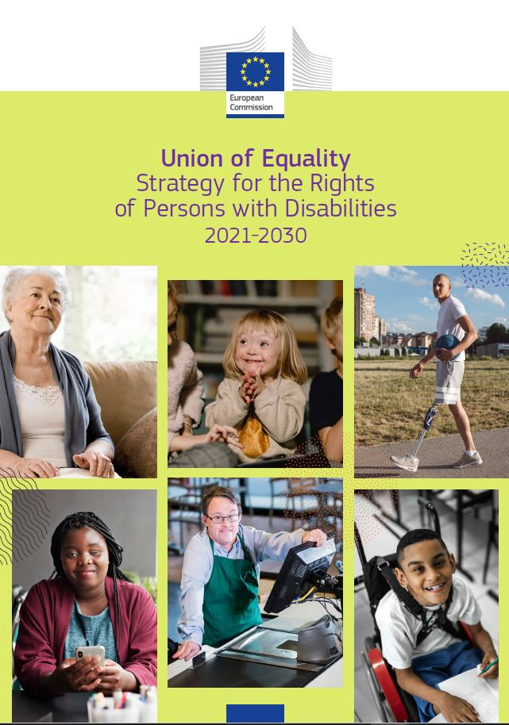
EU Strategy on the Rights of Persons with Disabilities
Adopted in March 2021
Follow up on the previous Strategy and the concluding observations adopted by the CRPD Committee in 2015
Chapters: Accessibility; Enjoying EU Rights; Decent quality of life and living independently; Equal Access and non-discrimination; Promoting the rights of persons with disabilities globally; Efficiently delivering the strategy; Leading by example
Proposals of EU legislations (mostly review), Flagship initiatives (European resource centre AccessibleEU, European Disability Card, recommendations on independent living, etc.)
Notes:
Link to report: https://ec.europa.eu/social/main.jsp?catId=738&langId=en&pubId=8376&furtherPubs=yes
The objective of this Strategy is to progress towards ensuring that all persons with disabilities in Europe, regardless of their sex, racial or ethnic origin, religion or belief, age or sexual orientation
enjoy their human rights
have equal opportunities, equal access to participate in society and economy
are able to decide where, how and with whom they live
move freely in the EU regardless of their support needs
and no longer experience discrimination
This new and strengthened Strategy takes account of the diversity of disability comprising long-term physical, mental, intellectual or sensory impairments (in line with Article 1 of the United Nations Convention on the Rights of Persons with Disabilities), which are often invisible.
Addressing the risks of multiple disadvantage faced by women, children, older persons, refugees with disabilities, and those with socioeconomic difficulties, it promotes an intersectional perspective in line with the United Nations 2030 Agenda for Sustainable Development and Sustainable Development Goals (SDGs).
The new strategy therefore contains an ambitious set of actions and flagship initiatives in various domains and has numerous priorities, such as
accessibility: being able to move and reside freely but also to participate in the democratic process
having a decent quality of life and to live independently as it focuses notably on the de-institutionalisation process, social protection and non-discrimination at work
equal participation as it aims to effectively protect persons with disabilities from any form of discrimination and violence, to ensure equal opportunities in and access to justice, education, culture, sport and tourism, but also equal access to all health services
the role of the EU to lead by example
the EU’s intention to deliver on that strategy
promoting the rights of persons with disabilities globally
Flagship initiatives
AccessibleEU: a knowledge base providing information and good practices on accessibility across sectors (by end 2022)
European Disability Card: the European Commission will propose a European Disability Card that would apply to all EU countries. The card will make it easier for persons with disabilities to get the proper support when they travel or move to another country in the European Union. (by end 2023)
Guidance recommending improvements on independent living and inclusion in the community. This will contribute to enabling persons with disabilities to live in accessible, supported housing in the community or to continue living at home (2023).
A framework for social services of excellence for persons with disabilities (2024)
A package to improve labour market outcomes of persons with disabilities (to be launched second half of 2022)
Disability Platform: The Disability Platform brings together national authorities responsible for implementation of the Convention, organisations of persons with disabilities and the Commission. It supports the implementation of the strategy and enhances cooperation and exchange on implementing the Convention.
Renewed HR strategy for the European Commission, including actions to promote diversity and inclusion of persons with disabilities.

Slide 27
EU legislation and standards on accessbility
EU legislation focussing on accessibility
There is no clear legislative framework on accessibility, progress happens step by step → “patchwork” approach. Some examples:
Regulation 1107/2006 on air passengers’ rights for persons with diabilities
Regulation 1300/2014 on rail accessibility (“TSI-PRM”)
Directive 2102/2016 on the accessibility of the websites and mobile applications of public sector bodies
Directive 882/2019 on the accessibility requirements for products and services (“Accessibility Act”)
+ many more provisions in mainstream legislation…. Maybe a topic for a separate presentation?

Slide 28
EU legislation and standards on accessbility
European Standards on accessibility
A Standard is weaker than legislation and more technical. It can help implement the law but it can not replace it. Some examples:
EN 17210:2021 ‘Accessibility and usability of the built environment - Functional requirements’.
EN 301 549 on accessibility requirements for Information and Communication Technologies (ICT) products and services
Standardisation Mandate 376 on European accessibility requirements Standardisation Mandate 473 to include “Design for All” in relevant standardization initiatives
for public procurement of products and services in the ICT domain
+ Upcoming Standards on the Accessibility Act
Notes:
EDF‘s work on standards: https://www.edf-feph.org/standards/

Slide 29
Questions & Answers

Slide 30
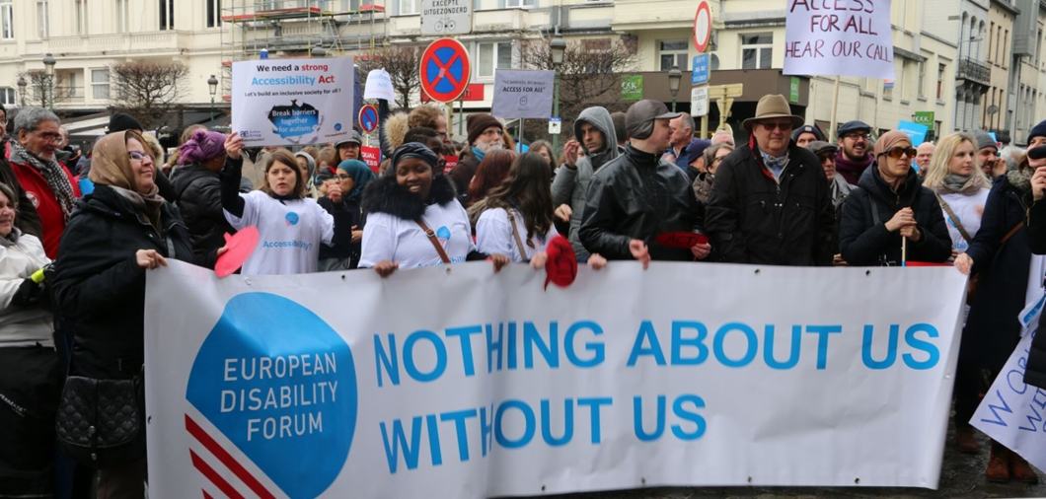
Thank you!

Slide 31
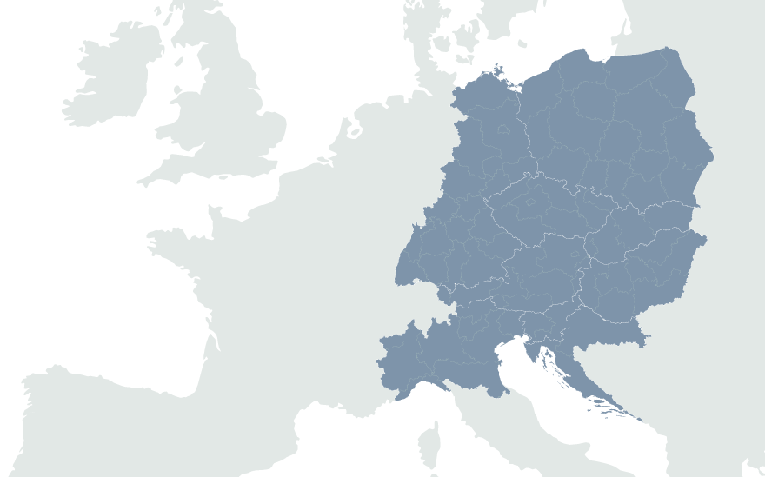
European Disability Forum
7-9 Avenu des Arts
1210 Brussels, Belgium
www.edf-feph.org
Marie.denninghaus@edf-feph.org
Facebook.com/CESpaces4All
Linkedin.com/company/ce-spaces4all/
Youtube.com/@CE-Spaces4All
Instagram.com/ce_spaces4all/

