Slide 1
Accessibility training How to make digital materials accessible
28th March 11 am CET
Loredana Dicsi, Membership, Internal Communication & Youth
Roberta Lulli, Project officer
Notes:
Accessibility training How to make digital materials accessible
Loredana Dicsi, Membership, Internal Communication & Youth
Roberta Lulli, project officer

Slide 2
Practical information
Zoom provides automatic captions
For content questions please use the chat box or raise your hand
Let’s have a discussion
Right to make mistake, all questions are valid!
Notes:
Practical information
Zoom provides automatic captions
For content questions please use the chat box or raise your hand
Let’s have a discussion
Right to make mistake, all questions are valid!

Slide 3
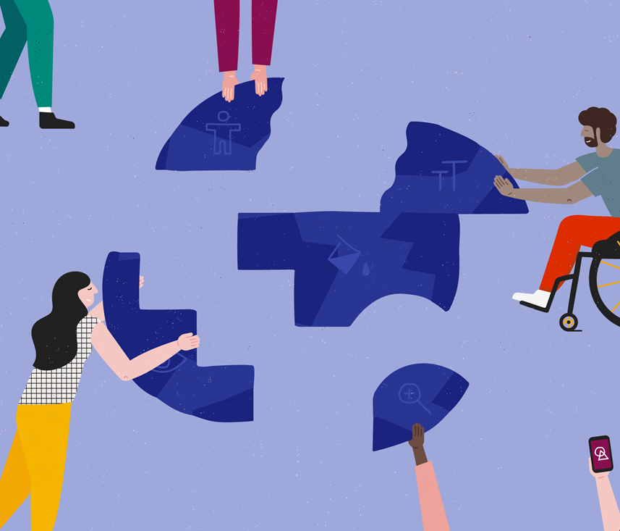
Accessibility
Accessibility is all about making something easily available for as many people as possible.
It benefits everyone.
It's about ability, not disability.
Notes:
Accessibility
Accessibility is all about making something easily available for as many people as possible.
It benefits everyone.
It's about ability, not disability.

Slide 4
Web Content Accessibility Guidelines (WCAG)
The World Wide Web Consortium (W3C) develops international Web standards called W3C Recommendations
The Web Content Accessibility Guidelines (WCAG) provide a framework for making web content more accessible, for people with disabilities.
Strategies, standards, resources to make the Web accessible
W3C standard guidelines: https://www.w3.org/WAI/standards-guidelines/
Notes:
Web Content Accessibility Guidelines (WCAG) is comprehensive but incredibly detailed, and quite difficult to gain a rapid understanding of. Web “content” generally refers to the information in a web page or web application, including natural information such as text, images, and sounds,
code or markup that defines structure, presentation, etc. WCAG applies to dynamic content, multimedia, “mobile”, etc.
WCAG can also be applied to non-web information and communications technologies (ICT)
WCAG version 2.0 was published in 2008 and updated to WCAG 2.1

Slide 5
Accessible digital materials
Making digital materials accessible benefit individuals and businesses – but also society as a whole.
Equal access to information, regardless of ability, is a human right and is essential for all individuals to participate fully in society.
Accessible documents and powerpoint can be read using any of a variety of assistive technologies, such as screen readers, magnification software, or speech recognition programs.
Reaching a wider audience
Notes:
Accessible Word document
Making digital materials accessible benefit individuals and businesses – but also society as a whole.
Equal access to information, regardless of ability, is a human right and is essential for all individuals to participate fully in society.
Accessible document can be read using any of a variety of assistive technologies, such as screen readers, magnification software, or speech recognition programs.
Reaching a wider audience

Slide 6
Make your check list
"Is my document or powerpoint accessible to all people who might use it?“
Make your content accessible
Headings, style, font size, structure
Add Alt -Text (alternatives text)
Meaningful hyperlinks
Check the color contrast
Start accessibility form the scratch
Notes:
Make your check list
"Is my document or powerpoint accessible to all people who might use it?“
Make your content accessible
Headings, style, font size, structure
Add Alt -Text (alternatives text)
Meaningful hyperlinks
Check the color contrast
Start accessibility form the scratch

Slide 7
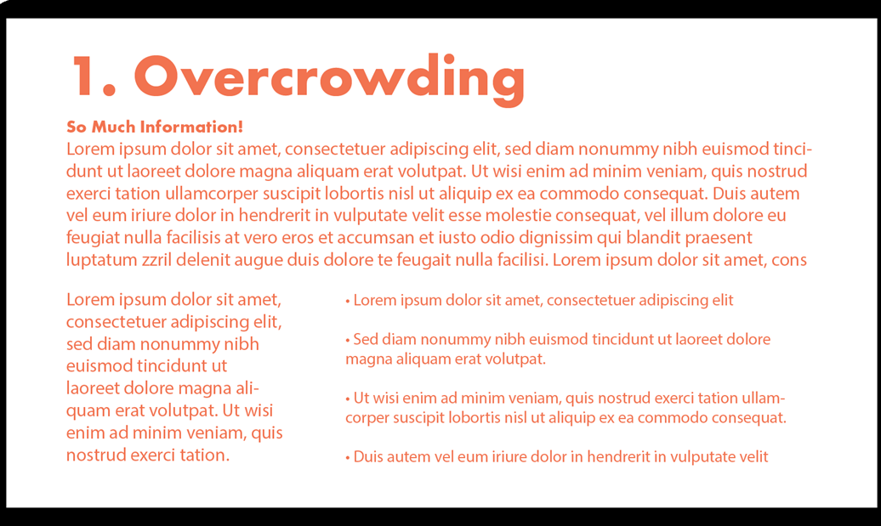
Make your content accessible
It means that your entire audience is going to be able to fully engage with it and learn from the content you are creating.
Create them for your audience.
Less is more! Tips:
Do not overcrowd your slides with text
Make a list
Use clear and concise language
Support text with images
Notes:
Make your content accessible
It means that your entire audience is going to be able to fully engage with it and learn from the content you are creating.
Create them for your audience.
Less is more! Tips:
Do not overcrowd your slides with text
Highlight ‘bullet’ points
Use clear and concise language
Support text with images

Slide 8
Fonts and size check list
Recommended 12 point or larger
Be consistent with the fonts used in the document
Using italics or upper-case letters for emphasis is not recommended.
Use bold to add emphasis rather than italics or in “brackets”
Use a sans serif font – such as Arial, Helvetica or Verdana
Notes:
Fonts and size check list
Recommended 12 point or larger
Use a sans serif font – such as Arial, Helvetica or Verdana
Be consistent with the fonts used in the document
Using italics or upper-case letters for emphasis is not recommended.
Use bold to add emphasis rather than italics or UPPERCASE but use it sparingly!

Slide 9
Serif Fonts / Sans Serif Fonts
Times New Romans
Garamond
Perpetua
Cambria
The small features on the ends of strokes are known as “Serifs.”
“Sans serif” means “without the decorative line” and it’s considered accessible
Verdana
Arial
Calibri
Helvetica
Notes:
Two fonts types: Serif Fonts and Sans Serif fonts
The small features on the ends of strokes in some fonts are known as “Serifs.”
The serif font is more ornamental and has serifs extending from the ends while the sans serif font on the right has clean and very precise ends.
Fonts that are very elaborate or ornate can be difficult to read or see clearly as the letter shapes are not well defined or regular in shape and size

Slide 10
Headings and structure
A good heading structure is often the most important accessibility consideration in Word documents.
Headings provide the organisation of the content within the document.
Screen readers give users the ability to navigate a document using headings as long as the headings are organized properly.
Notes:
Headings provide the organization of the content within the document.
A good heading structure is often the most important accessibility consideration in Word documents.
Screen readers give users the ability to navigate a document using headings as long as the headings are organized properly.

Slide 11
Headings and style
Word Styles contain preconfigured headings understood by assistive technology (e.g., Heading 1- Heading 6). These headings are available under the Styles section in the Home tab of the Ribbon.
Apply the “Heading 1” style for the main heading and “Heading 2” for sub-headings.
Notes:
The most important heading is the Heading 1 usually the title and is used only once. This is followed by a Heading 2 then nested within a Heading 2 will be a Heading 3 and nested with a Heading 3 a Heading 4.
People using screen readers need to have text formatted in certain ways in order to easily navigate content. Think of headings as an outline or table of contents that will help screen reader users understand the structure of the document and quickly find information. Heading structure allows screen reader users to easily search for sections and jump directly to specific content without having to listen to the entire document each time.

Slide 12
Verify headings
Every heading in a document can be verified using the Navigation Pane, located in the Show group on the View tab of the Ribbon.
This pane also allows users to navigate to any section of the document by clicking on the corresponding heading.
Notes:
How to verify headings
Every heading in a document can be verified using the Navigation Pane, located in the Show group on the View tab of the Ribbon.
This pane also allows users to navigate to any section of the document by clicking on the corresponding heading.

Slide 13
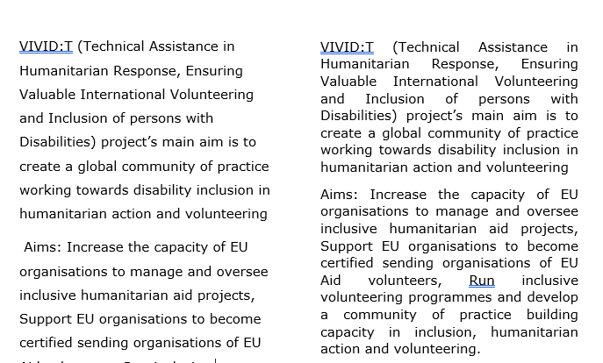
Line Spacing and Text Alignment
Double or 1.5 spacing between lines can make a document more accessible.
Left aligned text
Notes:
Line spacing impacts readability. If text is tightly packed together, it’s harder to read. Audience members living with cognitive disability and/or visual impairment might well have difficulty reading tightly packed lines of text.
For accessibility purposes, it’s best to increase line spacing so lines of text are less tightly packed and easier to read.
If text is justified, it opens gaps between words which are described as ‘text rivers’ or a ‘rivers of white’. These spaces can make the text harder to read.
Lines of text can be too far spaced also, this can appear disjointed. Line spacing of 1.5 (minimum) or 2 is good practice.

Slide 14
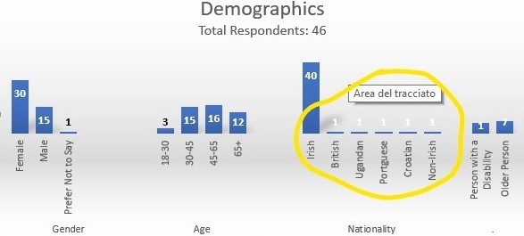
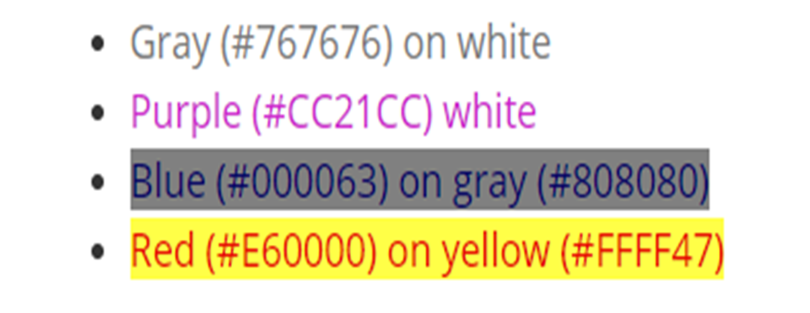
Colors Contrast
Text has adequate contrast to background (e.g. black and white)
Text and background colors have a contrast ratio of at least 4.5:1 (large text that is ≥14 point and bold or ≥18 point can have a ratio of 3:1).
This is 4.5:1 the minimum required by WCAG.
Notes:
Colors Contrast
Text has adequate contrast to background (e.g. black and white)
Text and background colors have a contrast ratio of at least 4.5:1 (large text that is ≥14 point and bold or ≥18 point can have a ratio of 3:1).
This is 4.5:1 the minimum required by WCAG.

Slide 15
Contrast Checker Web accessibility in Mind
Colour Contrast Checker
Notes:
Good and Poor high Contrasting Colors example

Slide 16
Demonstration

Slide 17
Questions

Slide 18
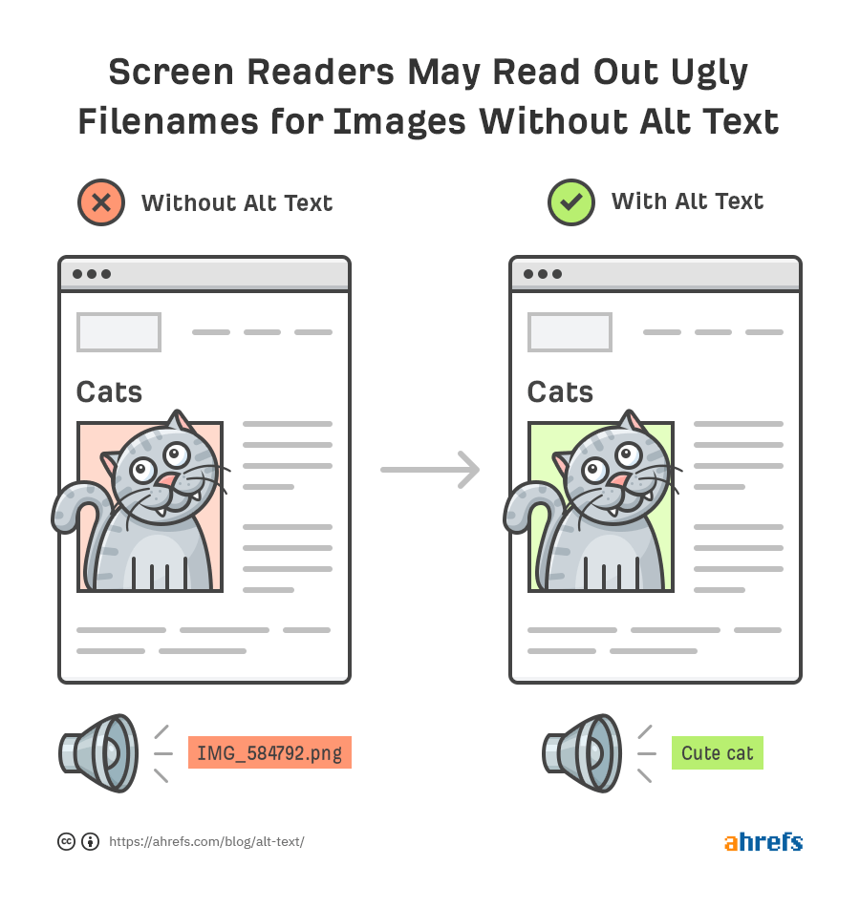
ALT Text /Alternative Text
Alt text describes an image, provides a textual alternative to non-text content.
When a screen reader encounters an image, the alternative text will be read out to the user, helping them understand what's going on in the image.
Notes:
Alt text (alternative text) describes an image, provides a textual alternative to non-text content.
When a screen reader encounters an image in a Word document, the alternative text will be read out to the user, helping them understand what's going on in the image.

Slide 19
Example
Alt text: Access City Award 2020. A guide dog. The hashtag #EUAccessCity and the European Commission logo
Notes:
Images and Alt Text
Alt text: Access City Award 2020. A guide dog. The hashtag #EUAccessCity and the European Commission logo
Add the Alternative Text (including text in the image) and copy it into the notes
Do not overlap the image with other elements
Verbally describe all meaningful visual content

Slide 20
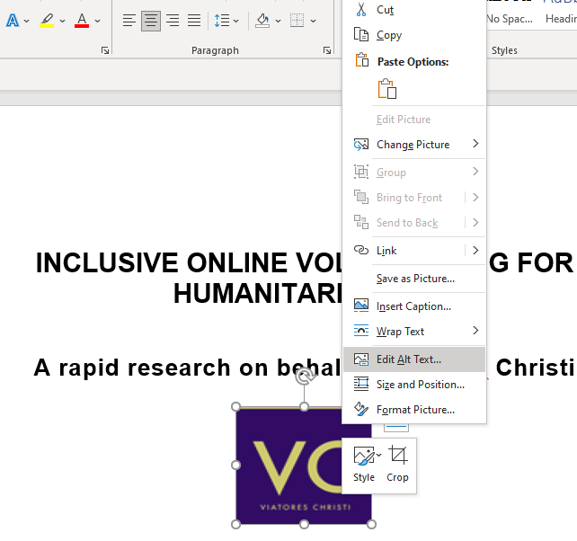
How to add Alt Text
Right-click the picture
Click on Edit Alt Text
In the "Description" field, enter a description of the image.
Notes:
How to add Alt Text
Right-click the picture
Click on Edit Alt Text
In the "Description" field, enter a description of the image.

Slide 21
How to write effective Alt Text
Be specific
Describe the content of the image
Never start with “Image of …” or “Picture of …”
Use keywords
Include text that's part of the image.
Don't add alt text to 'decorative' images.
Notes:
How to write effective Alt Text
Be specific, and succinct.
Describe the content of the image
Never start with “Image of …” or “Picture of …”
Use keywords
Include text that's part of the image.
Don't add alt text to 'decorative' images

Slide 22
Hyperlinks
Make your links unique and descriptive names.
Keep it concise and clear
Should be visual distinct (blue and underlined)
Avoid words: Click here; Read more; Learn more, More info
Avoid the word “Link” in your link and naked URL:
Link to https://www.edf-feph.org/
Do not capitalize links: WWW.EDF-FEPH.ORG
to something more natural and meaningful.
Notes:
Hyperlinks
Make your links unique and descriptive names.
Keep it concise and clear
Should be visual distinct (blue and underlined)
Avoid words: Click here; Read more; Learn more, More info
Avoid the word “Link” in your link and naked URL:
Link to https://www.edf-feph.org/
Do not capitalize links: WWW.EDF-FEPH.ORG

Slide 23
Tables
Steps to creating accessible Tables
1. In the Ribbon, select Insert tab, then select Table.
2. Select the number of rows and columns by highlighting the boxes on the grid.
3. Title your table using the caption tool.
In the Ribbon, select References tab, then select Insert Caption.
In the popup window, type the title of the table in the Caption textbox.
In the Label textbox, select Table. Then select OK.
Notes:
Tables
Steps to creating accessible Tables
1. In the Ribbon, select Insert tab, then select Table.
2. Select the number of rows and columns by highlighting the boxes on the grid.
3. Title your table using the caption tool.
In the Ribbon, select References tab, then select Insert Caption.
In the popup window, type the title of the table in the Caption textbox.
In the Label textbox, select Table. Then select OK.

Slide 24
Things you should NOT do
Do not create your table using the Draw Table Tool.
Do not create page layouts with tables.
Do not merge or split cells.
Do not control spacing in your table with blank rows or columns. Adjust line spacing instead.
Notes:
Things you should NOT do
Do not create your table using the Draw Table Tool.
Do not create page layouts with tables.
Do not merge or split cells.
Do not control spacing in your table with blank rows or columns. Adjust line spacing instead.

Slide 25
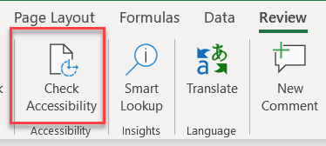
Accessibility Checker
Check accessibility button is on the Review tab
Don't see Accessibility Checker?
If you don't see the Check Accessibility button on the Review tab, follow these steps
Select File > Info.
Select the Check for Issues button.
Notes:
Check accessibility button is on the Review tab
Don't see Accessibility Checker?
If you don't see the Check Accessibility button on the Review tab, follow these steps
Select File > Info.
Select the Check for Issues button.
It’s a great way to learn.

Slide 26
Accessibility Checker (I)
The Accessibility Checker is a great tool in Office products that we can use to check our document for accessibility issues. However, it will not catch everything.
It will:
Alert you to issues (Error) that would be a barrier to accessibility
Explain why you should fix issues and how to fix them
It won’t:
Check for poor color contrast
Check when headings are not real headings
Inaccurate content of Alt Text
Call out lists that are not formatted as lists
Notes:
Microsoft Word’s built-in accessibility checker won’t catch everything. It doesn’t fix problems for you, either. But it will help you find and fix a lot of things. It’s a great way to learn. If your headings are text made big and bold, not real headings, the accessibility checker won’t see a problem. So you will also have to check headings yourself.
The checker will tell you if an image has no alternative text. But it can’t tell if an image has inaccurate or badly-written alternative text. So you must check all images, even if the checker says they are OK.

Slide 27
The checker’s Inspection Results
Three categories:
Errors: content that makes a document very difficult or impossible to access. Example: an image with no alt text.
Warnings: content that in most cases makes the document difficult to access. Example: a link with text that is not descriptive of its function.
Tips: accessible content, but that might be better organized or presented. Example: skipping from a first-level heading to a third-level heading.
Notes:
Three categories:
Errors: content that makes a document very difficult or impossible for people with disabilities to access. Example: an image with no alt text.
Warnings: content that in most—but not all—cases makes the document difficult for people with disabilities to access.
Example: a link with text that is not descriptive of its function.
Tips: content that people with disabilities can access, but that might be better organized or presented.
Example: skipping from a first-level heading to a third-level heading.

Slide 28
Convert Word Doc to PDF
Make sure the original Word document is accessible
The exported PDF will preserve the accessible features of the Word document, including:
heading structure
alternate text for images
lists
Tables
The process of creating an accessible PDF requires the installation of Adobe Acrobat Pro.
Notes:
You can convert the Word file to an accessible PDF document, as long as the Word file is accessible. if you think about accessibility from the beginning, just a few simple steps is often all you need to do. You first need to make sure that your original Word document is accessible, then you will be able to convert it to an accessible PDF using Word.
The exported PDF will preserve the accessible features of the Word document, including:
heading structure
alternate text for images
lists
tables

Slide 29
Demostration

Slide 30
Download Accessibility Toolkits
They will help you to make your PowerPoint, Word Documents, social media content, online events, more accessible to people with disabilities.
Word documents PowerPoint Social Media Online event
Accessible Word Documents
Accessible PowerPoint presentation
Accessible social media
Accessible online event
Accessible video
Notes:
Accessibility Toolkits
Toolkits are a great way to share some easy tips on accessibility.
They will help you to make your PowerPoint, Word Documents, social media content, online events, more accessible to people with disabilities. They are for all!
Word documents PowerPoint Social Media Online event

Slide 31
Exercise
Choose materials you are working on: article, report, presentation.
Check:
Headings, style, font size
Colour contrast
Links
Image and pictures
Content
Notes:
Exercise
Choose materials you are working on: article, report, presentation.
Check:
Headings, style, font size
Colour contrast
Links
Image and pictures
Content

Slide 32
Thank you for your attention
The European Disability Forum
www.edf-feph.org
Avenue des Arts 7-8, Bruxelles 1210, Belgium
Twitter: @MyEDF
Facebook: @MyEDF
Roberta Lulli: roberta.lulli@edf-feph.org
Loredana Dicsi: loredana.dicsi@edf-feph.org
Notes:
Thank you for your attention
The European Disability Forum
www.edf-feph.org
Avenue des Arts 7-8, Bruxelles 1210
Belgium
Twitter: @MyEdf
Facebook: @?

