Slide 1

Good practices in accessible tourism
Online training
Zoom | 17 April 2024
An-Sofie Leenknecht
European Disability Forum
Notes:
Good practices in accessible tourism
Online training
Zoom 17 April 2024
An-Sofie Leenknecht
European Disability Forum

Slide 2


Agenda
Welcoming and introduction
Kamil Goungor, European Network on Independent Living
Marie Scott, Czech Paraplegic Association
Alexandre Bloxs, European Union of the Deaf
Lina Nilsson, Swedish Youth Association for hard of hearing persons
Q&A and Discussions with everyone
Closing remarks
Notes:
Agenda
Welcoming and introduction
Kamil Goungor, European Network on Independent Living
Marie Scott, Czech Paraplegic Association
Alexandre Bloxs, European Union of the Deaf
Lina Nilsson, Swedish Youth Association for hard of hearing persons
Q&A and Discussions with everyone
Closing remarks

Slide 3
Practical information (1/2)
Accessibility:
Real-time captioning in English (activate in zoom or use external link from chat box)
International Sign Interpretation
Questions and comments:
Use ‘raise hand’ function ALT+Y (if not possible either chat box or through microphone)
Send questions via the chat box
Notes:
Practical information (1/2)
Accessibility:
Real time captioning in English (activate in zoom or use external link from chat box)
International sign Interpretation
Questions and comments:
Use ‘raise hand’ function ALT+Y (if not possible either chat box or through microphone)
Send questions via the chat box

Slide 4
Practical information (2/2)
Housekeeping rules:
Training will be recorded for internal use only
When you speak, please have your video on if you wish
Introduce yourself when speaking
Please speak slowly
Notes:
Practical information (2/2)
Training will be recorded only for internal use
Please remain muted with camera off while you are not speaking
You will be given the floor
When you speak, please have your video on if you wish
Introduce yourself when speaking
Please speak slowly

Slide 5


Accessible tourism
Accessible tourism is all about making tourist tools and services easily available for as many people as possible.
It benefits everyone.
It's about ability, not disability.
Notes:
Accessible tourism
Accessible tourism is all about making tourist tools and services easily available for as many people as possible.
It benefits everyone.
It's about ability, not disability.

Slide 6
Persons with disabilities
Persons with disabilities include persons who are blind, Deafblind, Deaf, hard of hearing, and people who have physical, intellectual or psychosocial disabilities.
Examples of support needs include:
  Accessible rooms
  Sign language interpretation and captioning
  Easy to read information and explanation about the tourist place or activity beforehand
Notes:
Introduction
Persons with disabilities include persons who are blind, Deafblind, Deaf, hard of hearing, and people who have physical, intellectual or psychosocial disabilities.
Example of support needs include accessible rooms, sign language interpretation and captioning, easy to read information and explanation about the tourist place or activity beforehand

Slide 7

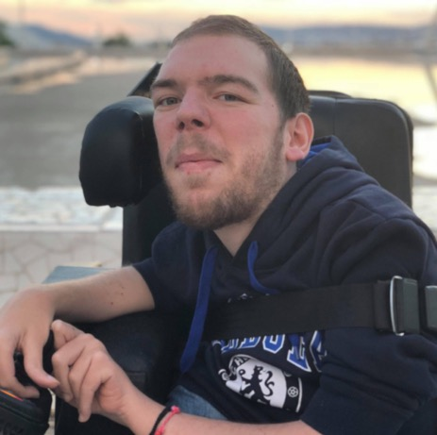
Kamil Goungor
European Network on Independent Living
Notes:
Kamil Goungor
European Network on Independent Living

Slide 8
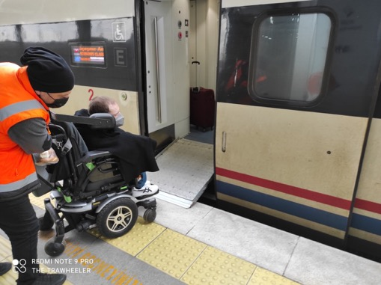
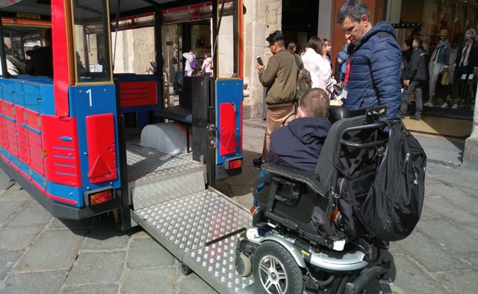
Accessible destinations and experiences
Notes:
Accessible destinations and experiences

Slide 9
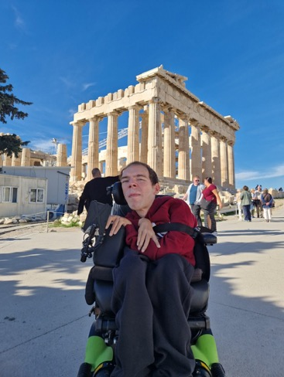
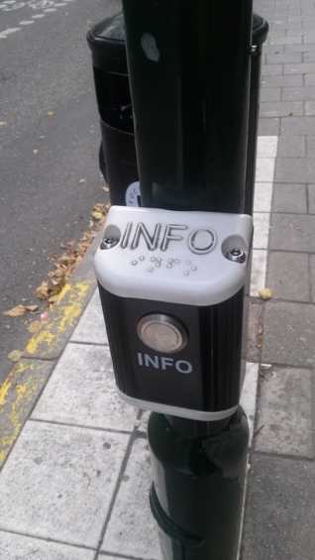
Accessible destinations and experiences
Notes:
Accessible destinations and experiences

Slide 10
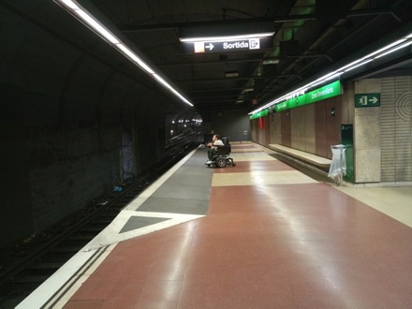
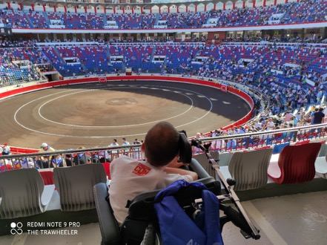
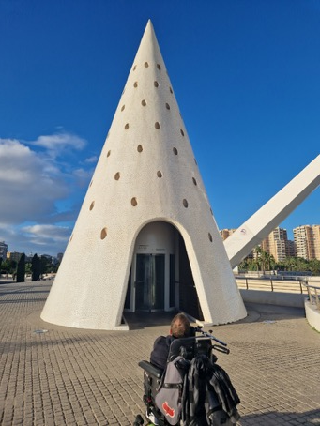
Accessible destinations and experiences - Spain
Notes:
Accessible destinations and experiences - Spain

Slide 11
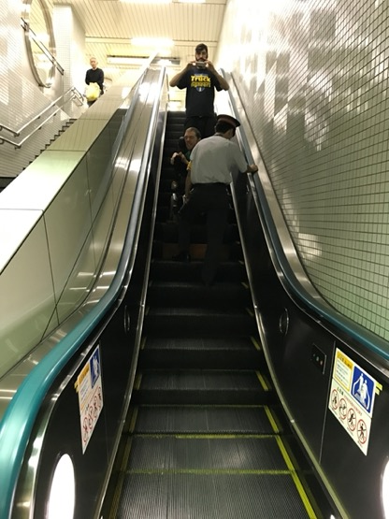
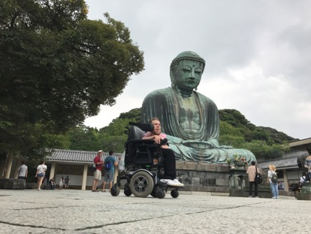
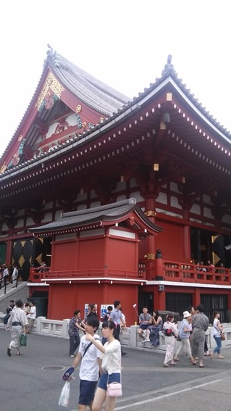
Accessible destinations and experiences - Japan
Notes:
Accessible destinations and experiences - Japan

Slide 12
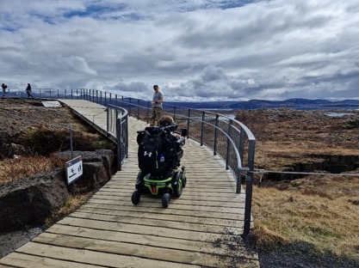
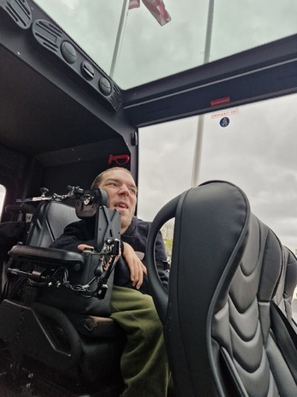
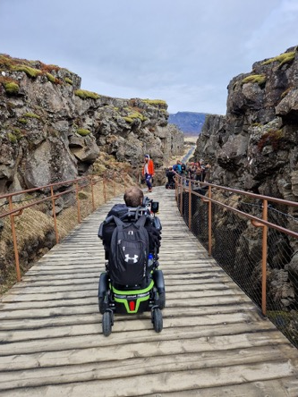
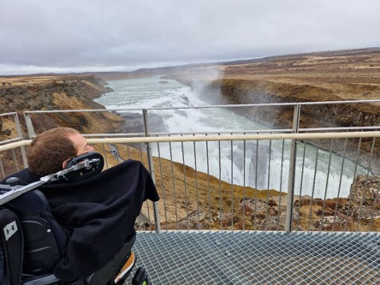
Accessible destinations and experiences – Iceland
Notes:
Accessible destinations and experiences - Iceland

Slide 13
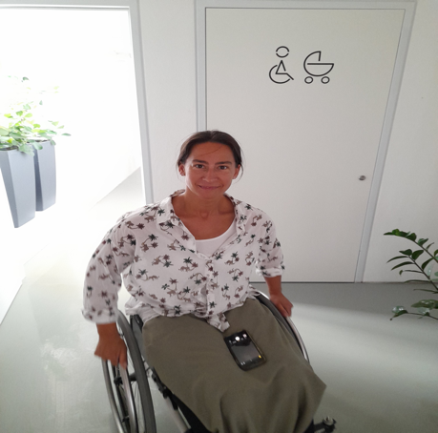
Marie Scott
Czech Paraplegic Association (CZEPA)
Notes:
Marie Scott
Czech Paraplegic Association (CZEPA)

Slide 14
Accessible tourism – UK model
Government’s ambition for the UK to become the most accessible tourism destination in Europe.
- Accessibility Guides since 2007
accessibility FEATURES rather than DISABILITY categories
Free questionnaire for tourism businesses’ websites (summer 2024)
AccessAble Detailed Access Guides (new provider)
Notes:
Accessible tourism – UK model
Government’s ambition for the UK to become the most accessible tourism destination in Europe.
- Accessibility Guides since 2007
accessibility FEATURES rather than DISABILITY categories
free questionnaire for tourism businesses’ websites (summer 2024)
AccessAble Detailed Access Guides (new provider)

Slide 15
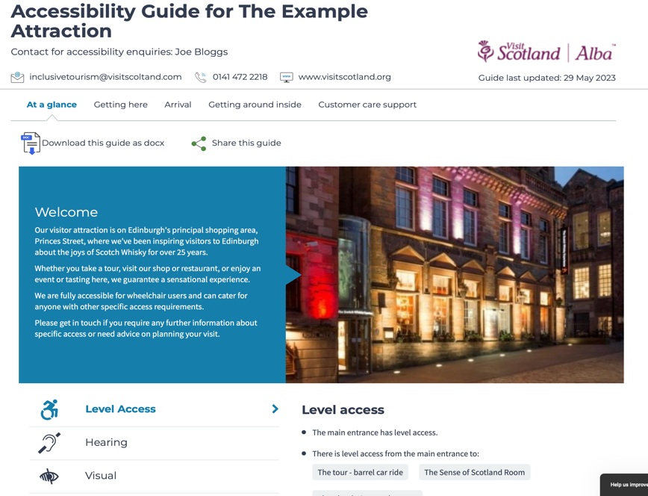
At a glance
Getting here
Arrival
Getting around inside
Customer care support
PHOTOS !
Notes:
Accessibility Guide example - Tourist attraction venue: https://www.accessibilityguides.org/content/example-attraction

Slide 16
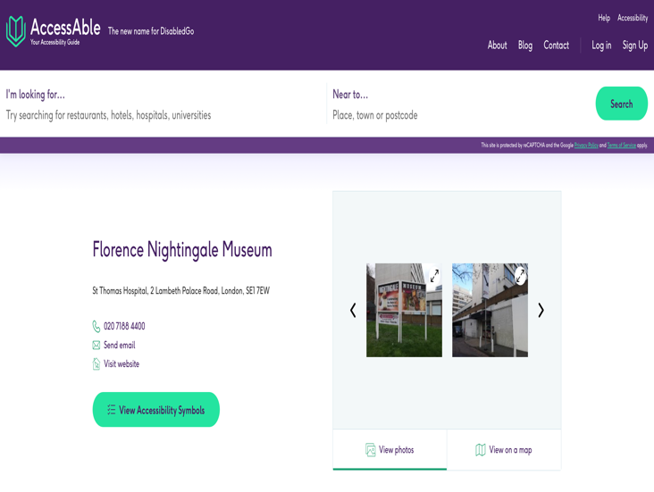
Detailed Access Guides via AccessAble
NEW professional accessibility guides
GUIDED
Remotely with a smartphone with camera
£85 for a one or two room café
ON-SITE ASSESSMENT
starts @ £125
ANNUAL renewal FEES
starts @ £10/month
Notes:
Detailed Access Guides via AccessAble

Slide 17
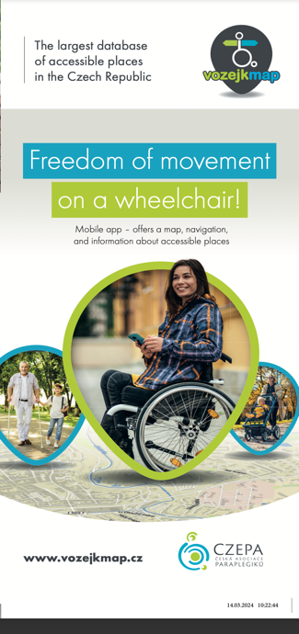
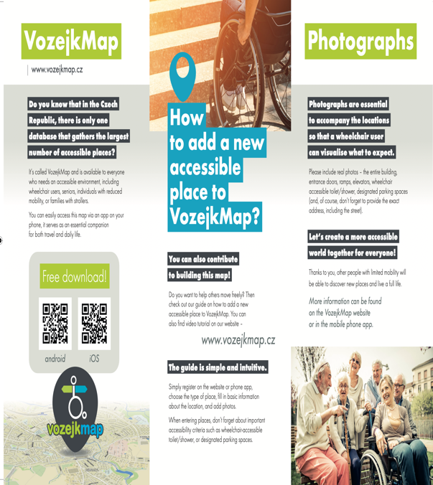

Slide 18
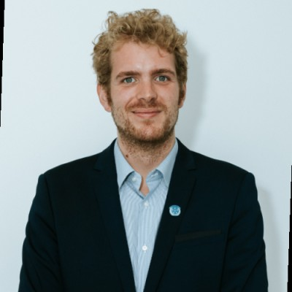
Alexandre Bloxs
European Union of the Deaf
Notes:
Alexandre Bloxs
European Union of the Deaf

Slide 19
Specific requirements of deaf people: National sign languages
Deaf people have the specific requirements of imparting information and communicating in their national sign languages;
Further than being a measure of accessibility, national sign languages are full languages with the same linguistic status as spoken languages.
They are the natural and preferred languages of deaf people.
There are 30 National Sign Languages within the European Union.
Notes:
Specific requirements of deaf people: National sign languages
Deaf people have the specific requirements of imparting information and communicating in their national sign languages;
Further than being a measure of accessibility, national sign languages are full languages with the same linguistic status as spoken languages.
They are the natural and preferred languages of deaf people.
There are 30 National Sign Languages within the European Union.

Slide 20
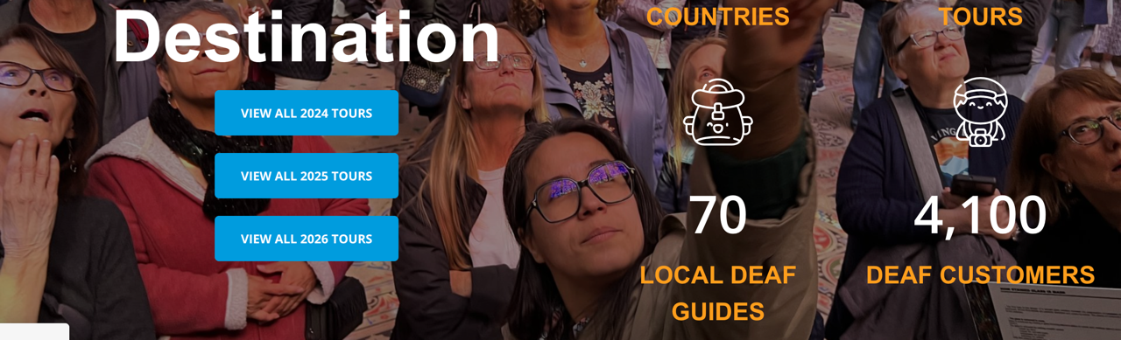
Incorporating National Sign Languages in tourism
This incorporation can be made in various ways:
Through deaf museums where information is directly imparted in the national sign language;
Through tour of museums or cultural and/or historical sites made in the national sign language either directly by deaf people or sign language interpreters
Through the use of pre-recorded video capsule in the national sign language displayed in tablets
Notes:
Incorporating National Sign Languages in tourism
This incorporation can be made in various ways:
Through deaf museums where information is directly imparted in the national sign language;
Through tour of museums or cultural and/or historical sites made in the national sign language either directly by deaf people or sign language interpreters
Through the use of pre-recorded video capsule in the national sign language displayed in tablets

Slide 21
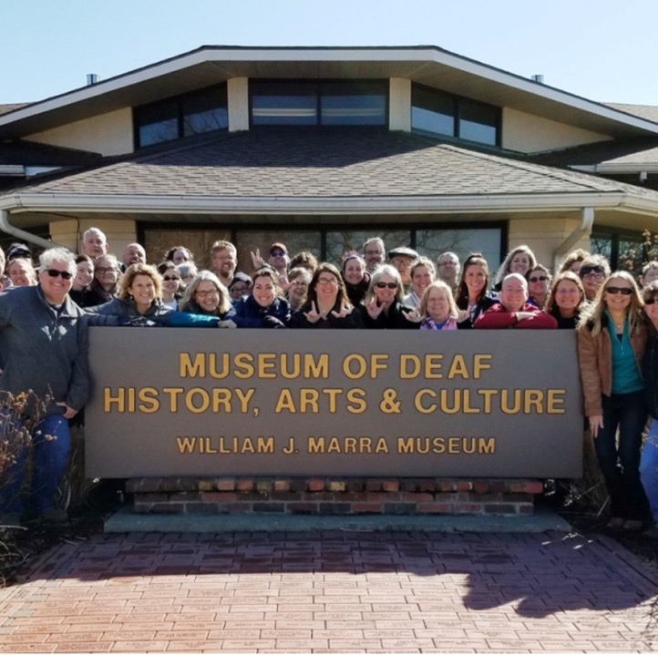
1) Deaf Museums
Denmark - Danish Deaf History Society
Finland - Finnish Museum of the Deaf, Kuurojen Museo
France - Musée d'Histoire et de Culture des Sourds
Germany - Museum zur Geschichte der Gehörlosen und Schwerhörigen
Ireland - Deaf Heritage Centre Ireland
The Netherlands - Museum of Deaf Education (Museum voor Dovenonderwijs)
Norway - Norwegian Museum of Deaf History and Culture
UK - Deaf Museum and Archive
Slovenia - The House of Sign Language
Notes:
Deaf Museums
Denmark - Danish Deaf History Society
Finland - Finnish Museum of the Deaf, Kuurojen Museo
France - Musée d'Histoire et de Culture des Sourds
Germany - Museum zur Geschichte der Gehörlosen und Schwerhörigen
Ireland - Deaf Heritage Centre Ireland
The Netherlands - Museum of Deaf Education (Museum voor Dovenonderwijs)
Norway - Norwegian Museum of Deaf History and Culture
UK - Deaf Museum and Archive
Slovenia - The House of Sign Language

Slide 22
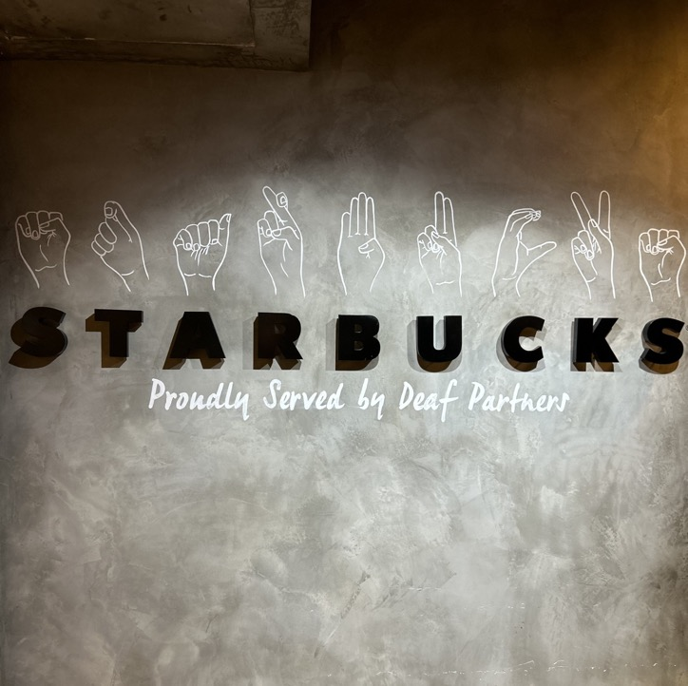
2) Tours in the national sign language
Hands On Travel, a deaf business doing tours for deaf people: https://handson.travel/
Swiss association (S5) that organizes adventure travels (https://s-5.ch/catalogue-voyage/).
There are also numerous local deaf associations which organize things like an annual trip for interested members as part of their activity program.
Notes:
2) Tours in the national sign language
Hands On Travel, a deaf business doing tours for deaf people: https://handson.travel/
Swiss association (S5) that organizes adventure travels (https://s-5.ch/catalogue-voyage/).
There are also numerous local deaf associations which organize things like an annual trip for interested members as part of their activity program.

Slide 23
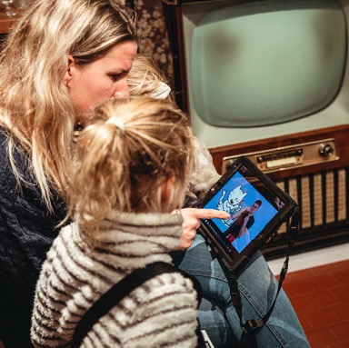
3) Use of pre-recorded video
Examples of museums providing such features:
Het Huis van Alijn in Ghent
Holy Blood Procession in Bruges
Vatican
Notes:
3) Use of pre-recorded video
Examples of museums providing such features:
Het Huis van Alijn in Ghent
Holy Blood Procession in Bruges
Vatican

Slide 24
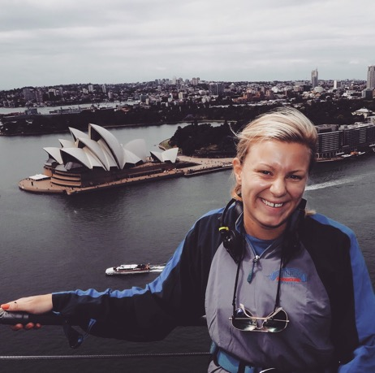
Lina Nilsson
Swedish Youth Association for hard of hearing persons
Notes:
Lina Nilsson
Swedish Youth Association for hard of hearing persons

Slide 25
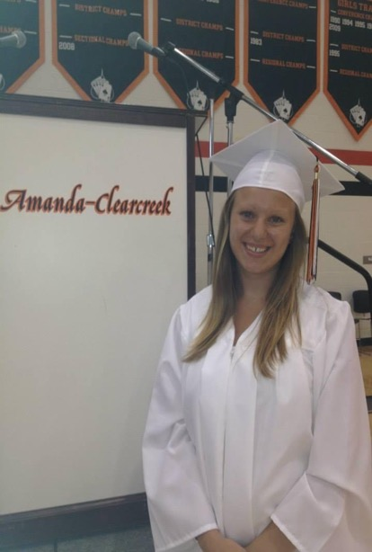
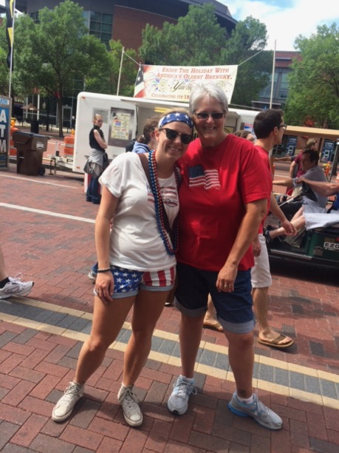

Slide 26
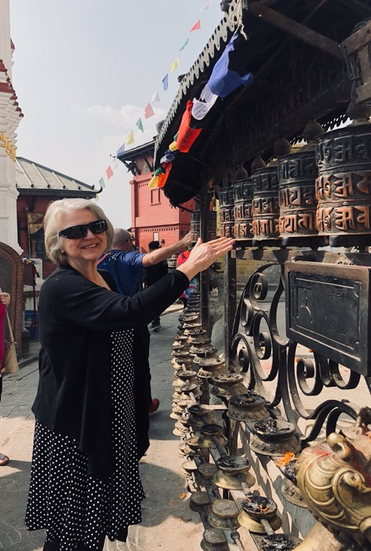
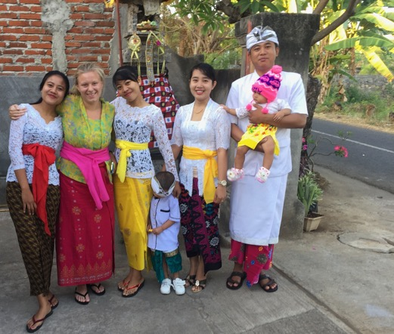

Slide 27

Questions & Answers
Notes:
Questions & Answers

Slide 28
Closing remarks
Blaž Barboric, project coordinator
An-Sofie Leenknecht, EDF human rights coordinator
Notes:
Closing remarks
Blaž Barboric, project coordinator
An-Sofie Leenknecht, EDF human rights coordinator

Slide 29
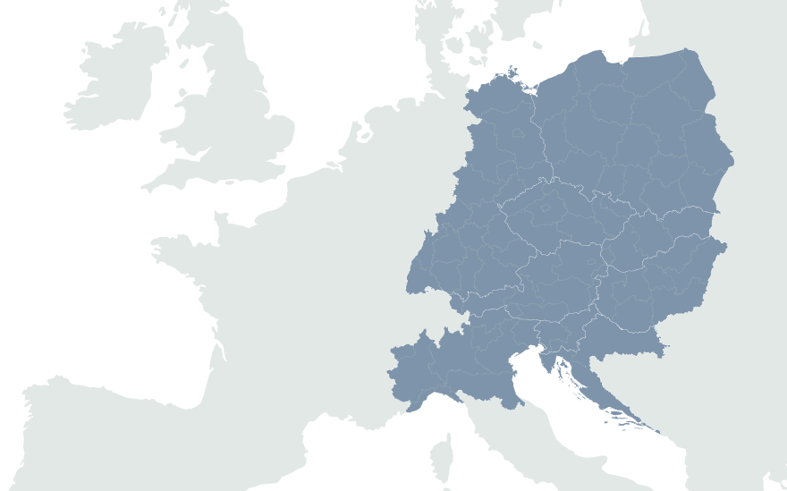

European Disability Forum
7-9 Avenu des Arts
1210 Brussels, Belgium
www.edf-feph.org
Ansofie.Leenknecht@edf-feph.org
Facebook.com/CESpaces4All
Linkedin.com/company/ce-spaces4all/
Youtube.com/@CE-Spaces4All
Instagram.com/ce_spaces4all/
Notes:
European Disability Forum
7-9 Avenu des Arts
1210 Brussels, Belgium
www.edf-feph.org
Ansofie.Leenknecht@edf-feph.org
Facebook.com/CESpaces4All
Linkedin.com/company/ce-spaces4all/
Youtube.com/@CE-Spaces4All
Instagram.com/ce_spaces4all

